Slide 1
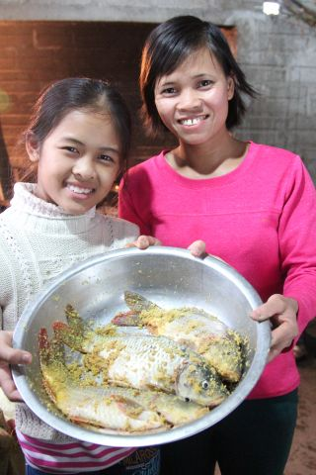
Impacting Nutrition of Adolescent Girls: Vietnam Nutrition Clubs
Girl Power in Play Symposium
June 18-19, 2015
Dr. Carolyn MacDonald
Nutrition Director, World Vision International

Slide 2
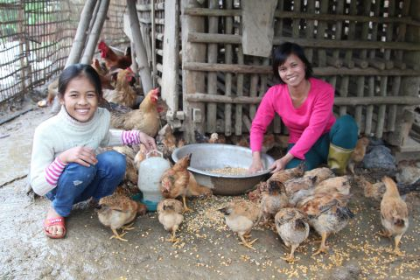
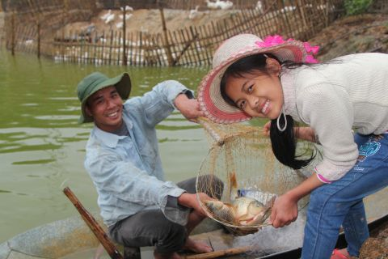
Meet 12-year-old Thuy
Thuy, currently a 6th grader, works together with her parents to improve the livelihood of the family.

Slide 3
Nutrition Club Approach
Nutrition Club Approach
Nutrition Club Approach
Area Development Program
WV Area Development Program
District Project Management Board
District Project Management Board
District Agriculture and Rural Development Department
District Project Management Board
District Agriculture and Rural Development Department
District Health Department
District Health Department
Village Development Board
Commune Health Center
Commune Agriculture and Rural Development
Commune Agriculture and Rural Development
Nutrition Club Facilitators
National Health Program
Vitamin A Supplementation
Immunization
Deworming
Community Interest Groups
Saving Group
Chicken Rearing Group
Pig Rearing Group
Nutrition Club
BCC/PDH
3+ 6 package core package
Child care practices
Child accident prevention
Growth Monitoring Program
ECCD
WASH

Slide 4
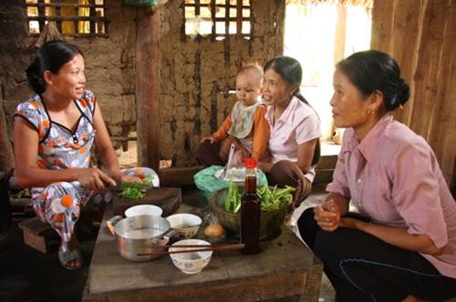
Hosting Sharing Sessions

Slide 5
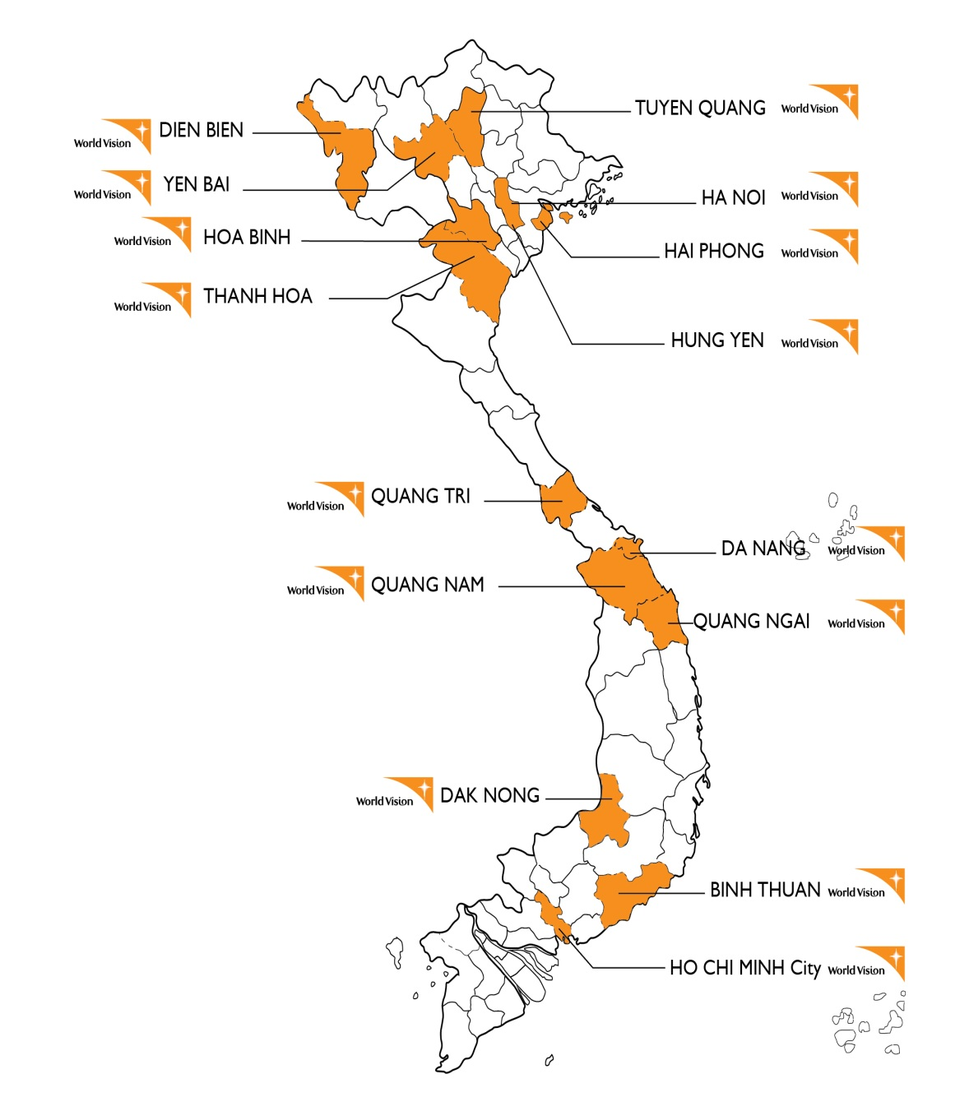
Scaling Nutrition Clubs
Now covering 30,000 families in 36 remote districts.
Further scale up on-going in coordination with Gov’t of Vietnam

Slide 6
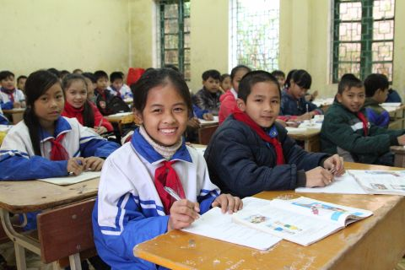
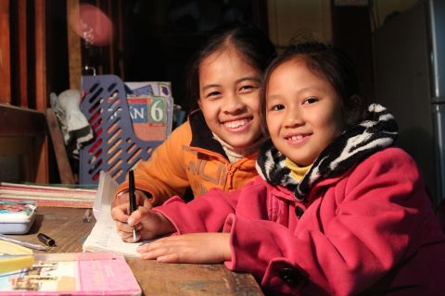
Thuy’s Dream
“I want to carry on studying to be a teacher in my community.”
“My parents hope my sister and I won’t have difficult lives like they did and that we’ll finish our education and become useful citizens. . .I believe my dreams will come true.”

Slide 7
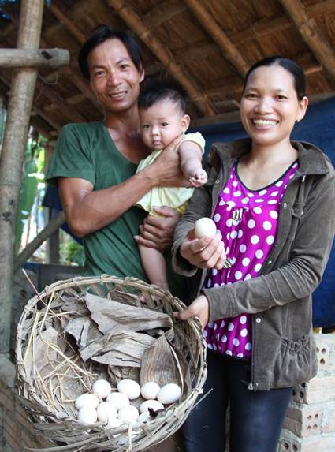
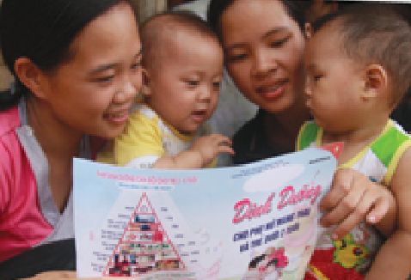
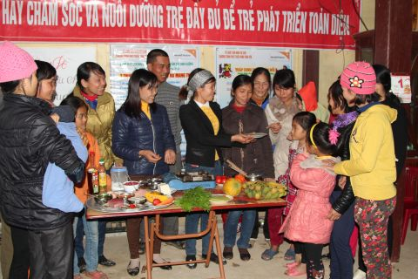
A Family Solution
The home is a place for sharing experience and learnings on farming, nutrition, income and gardens

Slide 8
Adolescent Girls’ Nutrition – It Matters!
So much we do not know! But here are a few things we do know:
In India, 83% of adolescent girls have iron deficiency anaemia and almost half of them are underweight.
50% of girls in Bangladesh are married by age 15 (90% of newlyweds are between 11 and 19 years old)
Complications during pregnancy and childbirth are the second cause of death for 15 to 19 year old girls globally.
A baby born to a mother under 20 faces a 50% higher risk of dying.
Notes:
36% of deaths world wide of 10-24 year old are due to maternal, perinatal, infectious and nutritional causes
Patton, G.C., Coffey, C., Sawyer, S.M., et al. ‘Global patterns of mortality in young people: a systematic analysis of population health data’. The Lancet, 2009; 374: 881–92.
83% of adolescent girls in India have iron deficiency anaemia http://www.who.int/nutrition/nlis/en/
Complications during pregnancy and childbirth are the second cause of death for 15-19 year-old girls globally … and Babies born to mother under 20 face a 50% higher risk of dying from WHO Media Centre Adolescent Pregnancy Fact Sheet N364 Sept 2014 http://www.who.int/mediacentre/factsheets/fs364/en/

Slide 9
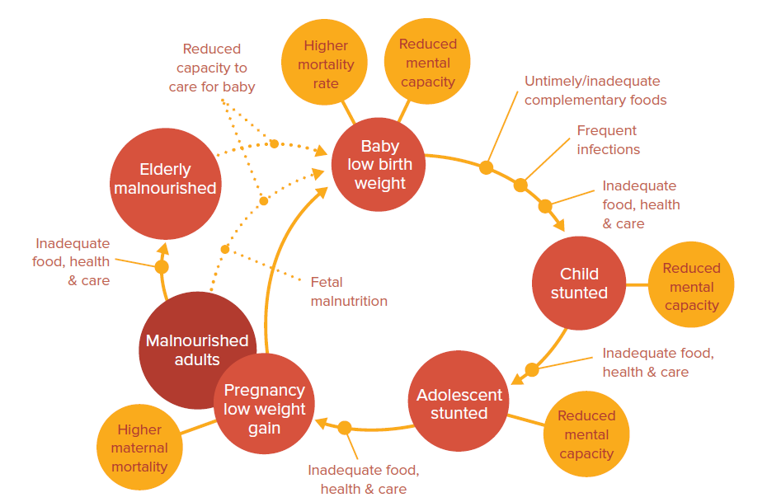
Breaking the Cycle
Source: Improving nutrition for adolescent girls in Asia and the Middle East: Innovations are needed. One Goal and the Every Woman, Every Child Innovation Working Group, 2014.

Slide 10
Let’s stop neglecting girls’ nutrition!
Sports organizations: How are you linked with nutrition programs? How are you using your platform to ensure good nutrition for girls?
NGOs and donors: How do the family and community based nutrition programs target and track adolescent nutrition?
Research institutions: How is your research contributing to the gap in information on adolescent girl nutrition?
Governments: How are your investments ensuring girls’ nutrition is not neglected?

Slide 11
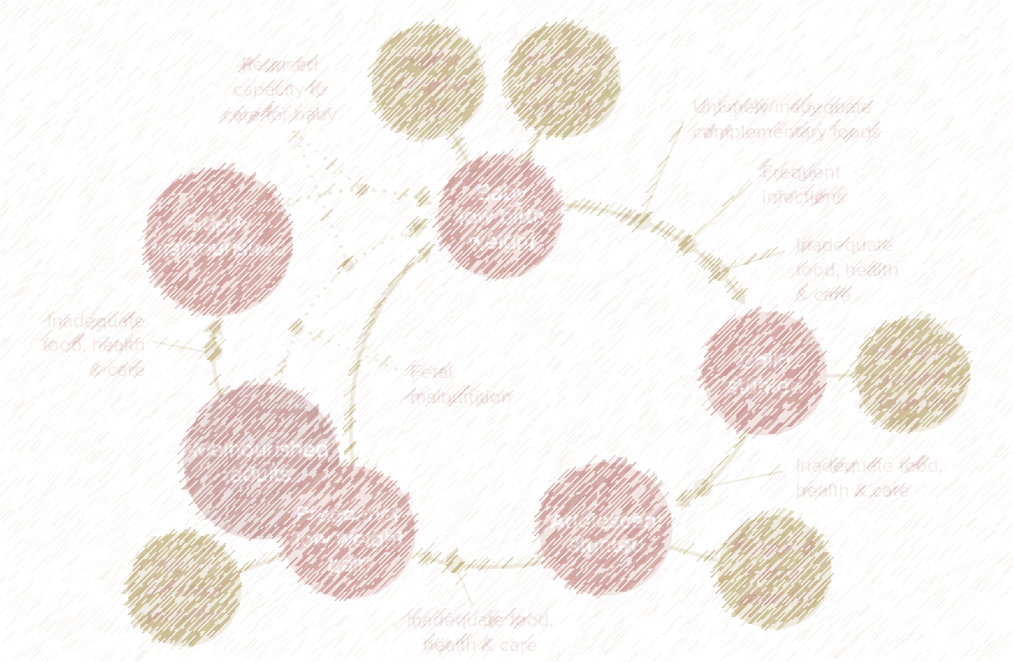
Breaking the Cycle!

