Slide 1
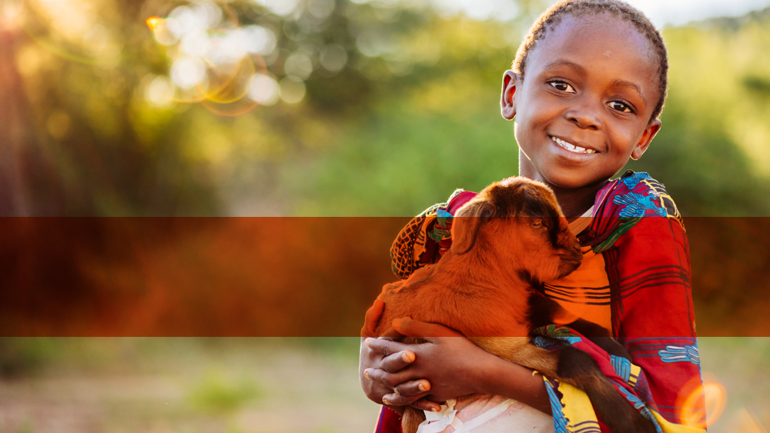

Adolescent Health at World Vision: Mental Health and Psychosocial Support
Julie DeSoto, Program Management Officer, WVUS
November 22, 2017

Slide 2

Session Objective
Participants will understand how World Vision is engaging in the Mental Health and Psychosocial Support (MHPSS) sector, and why this is relevant/intersectional with the adolescent health field.

Slide 3
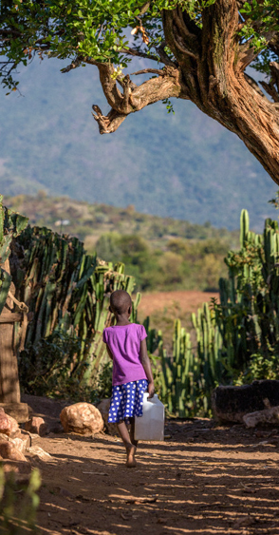
Mental wellbeing of adolescents– Why does it matter?
Mental, Emotional and Behavioral (MEB) Health
At any one time, 17-20% of young people in the United States are estimated to have one or more MEB disorders.
Mental Health Problems in Adulthood Begin in Childhood or Adolescence
Half of lifetime diagnosable mental illness start by age 14, and about 75% start by age 24
Patters of MEB Emergence
Anxiety disorders emerge by age 6
Behavioral disorders by age 11
Mood disorders by age 13
Substance use disorders by age 15

Slide 4
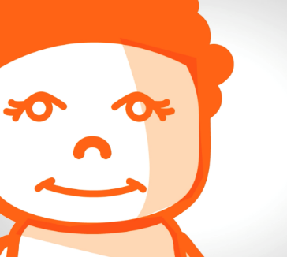
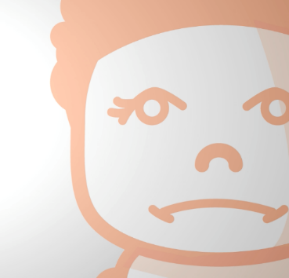
Did you know?
Mental health needs are increasing globally, particularly depression and suicide.
Children affected by violence and conflict are at higher risk of developing mental disorder later in life; and living with parents with mental disorder who may struggle to meet their care needs (including newborns).
WV has contributed to global evidence for MHPSS interventions and published such approaches with WHO (among others).
WV has > USD 10 million of MHPSS programming (as at Nov. 2017)/

Slide 5
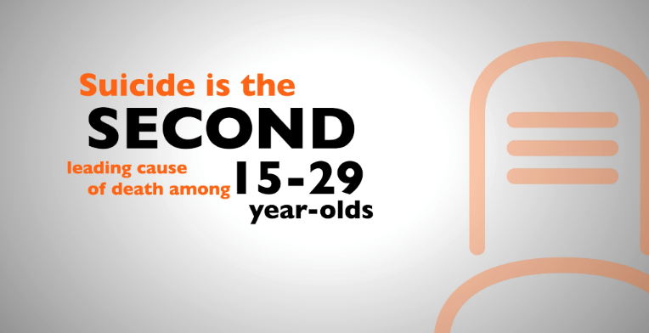
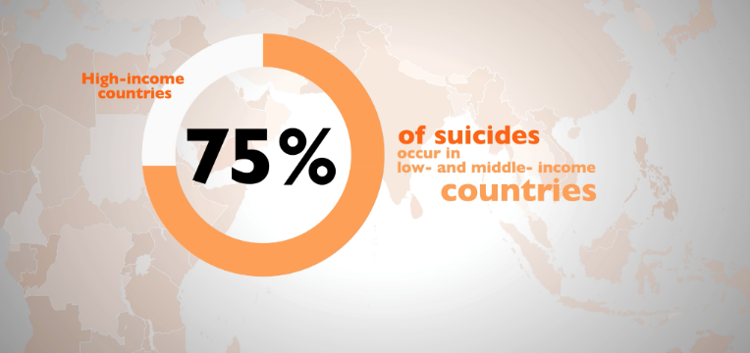
World Vision Strategies for Adolescents
Interpersonal Psychotherapy for Groups (IPTG)
- For 13+ (Uganda, South Africa, Sri Lanka)
Problem Management Plus (PM+)
- For 16+ (with research being done for 13-19 years), GBV survivors, etc. (submission of research for adolescents 13-19) (Kenya, South Syria, KRI)
Thinking Healthy
- For 18+, post-partum depression
Psychological First Aid (PFA)
- Widely used for all ages
mhGAP
- In Uganda for health care workers to provide adolescent friendly and MHPSS sensitive treatment

Slide 6
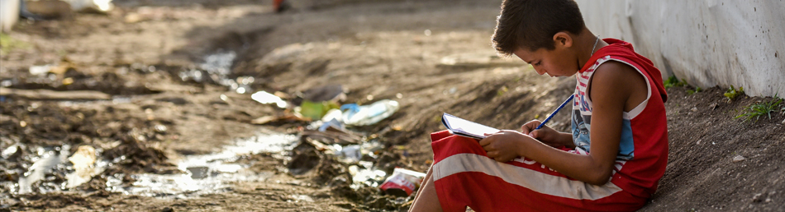
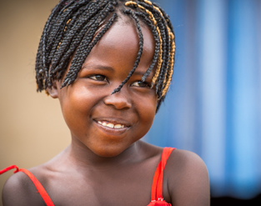
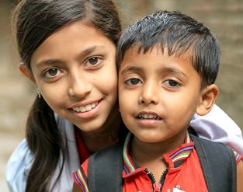
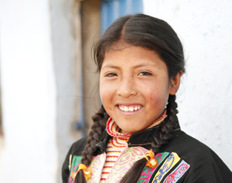
Thank you!

