Slide 1


Adolescent Health at World Vision:
SAGE-DREAMS Uganda
Julie DeSoto, Program Management Officer, WVUS
November 22, 2017

Slide 2

Session Objective
Participants will understand the innovations and strategies in the World Vision SAGE-DREAMS Program, why they align with global standards, and how this is relevant to adolescent programming globally.

Slide 3
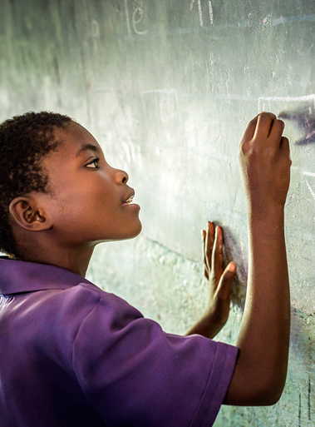
Adolescence Snapshot
Social Brain
Adolescence is characterized by psychological changes that affect an individual’s sense of identity, their self-consciousness and their relationships with others. Compared with children, adolescents are more sociable, form more complex and hierarchical peer relationships and are more sensitive to acceptance and rejection by their peers (Blakemore 2008).
Adolescent Health
The health of young people has been largely neglected in global public health because this age group is perceived as healthy (Gore 2011).
Social Determinants of Health
The health of adolescents is strongly affected by social factors at personal, family, community, and national levels. Improving adolescent health worldwide requires improving young people’s daily life with families and peers and in schools, addressing risk and protective factors in the social environment at a population level, and focusing on factors that are protective across various health outcomes (Viner 2012).

Slide 4
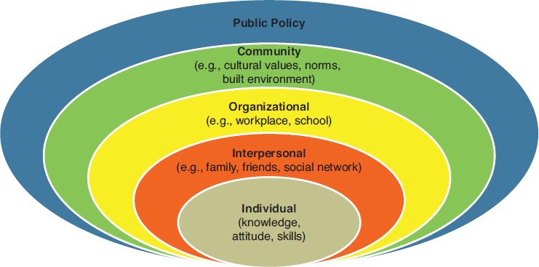
Ecological
Model

Slide 5
Successful Adolescent Interventions
Peer Groups
Whole School
Mentorship
Sports-Based
Adolescent Led
Safe Spaces

Slide 6
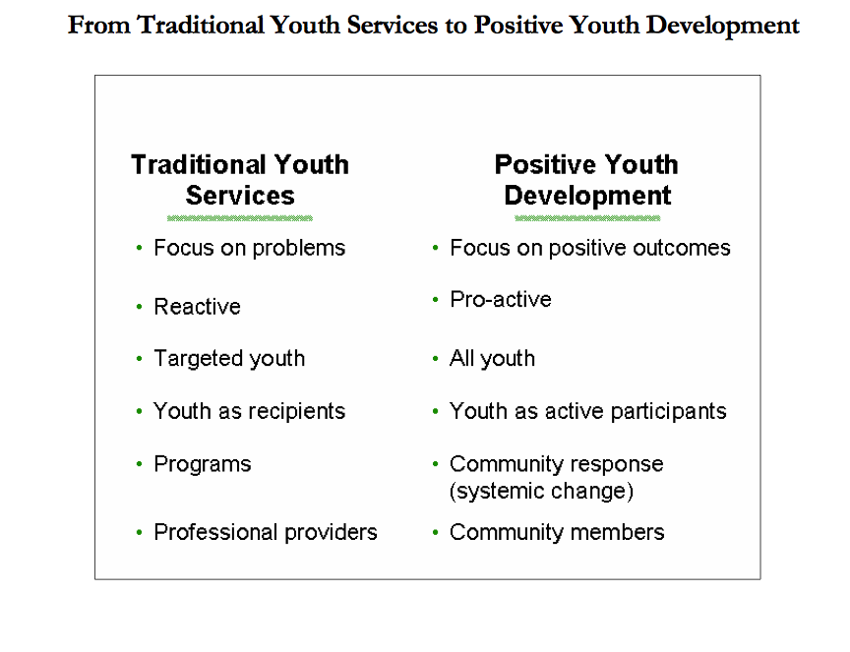

Slide 7
About the DREAMS Innovation Challenge
DREAMS is committed to achieving a 40 percent reduction in HIV infection among adolescent girls and young women in the highest-burden areas of 10 sub-Saharan African countries by the end of 2017.
Challenge is investing $85 million for innovative solutions that further DREAMS' commitment to reducing HIV among the most vulnerable to infection.
FOCUS AREA 1: STRENGTHENING CAPACITY OF COMMUNITIES TO DELIVER SERVICES
FOCUS AREA 2: KEEPING GIRLS IN SECONDARY SCHOOL
FOCUS AREA 3: LINKING MEN TO SERVICES
FOCUS AREA 4: SUPPORTING PRE-EXPOSURE PROPHYLAXIS
FOCUS AREA 5: PROVIDING A BRIDGE TO EMPLOYMENT
FOCUS AREA 6: APPLYING DATA TO INCREASE IMPACT

Slide 8
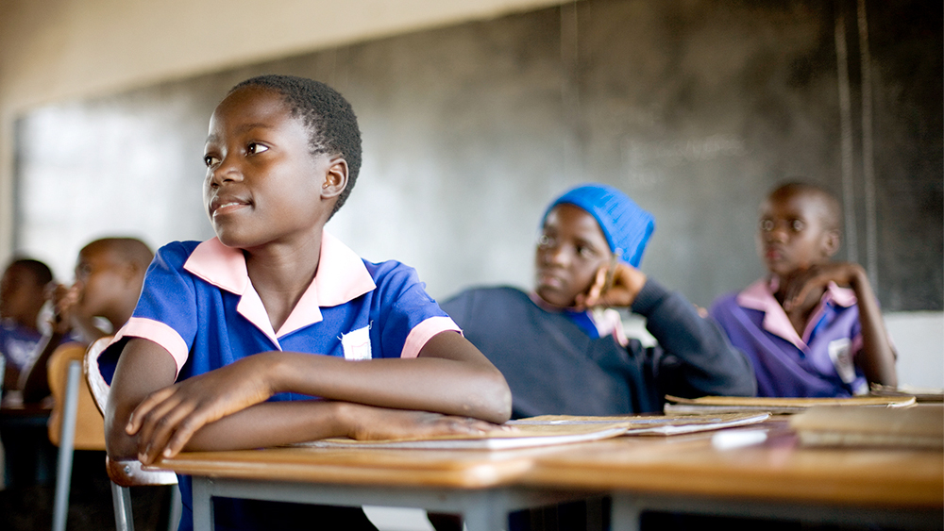
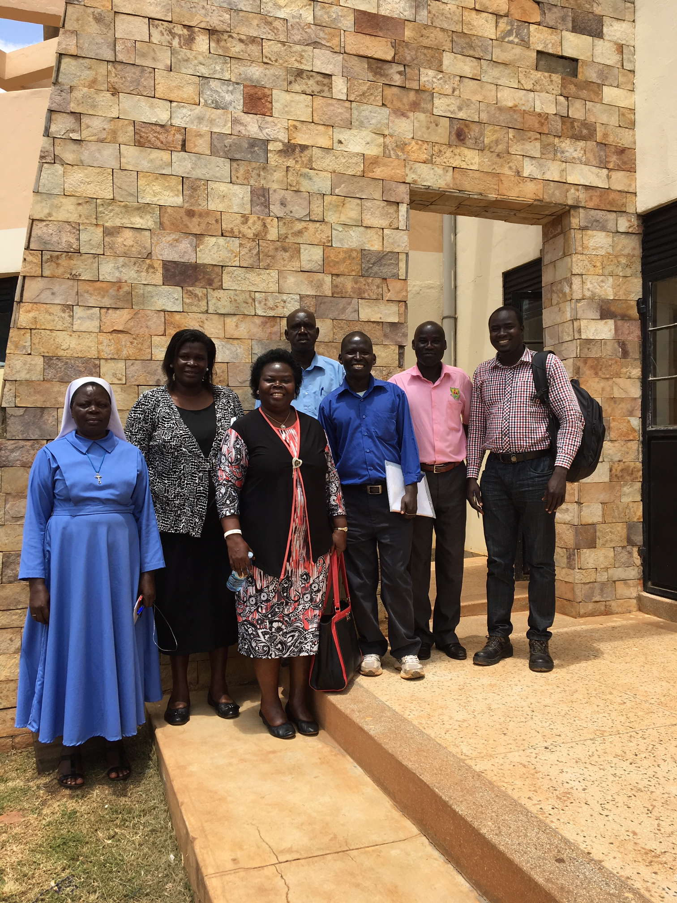
SAGE-DREAMS Overview
Project Goal
Reduced new HIV infections and improved retention of 45,000 adolescent girls ages 13-19 retained in 132 secondary school systems in 10 districts in Uganda.
Project Objectives
To establish adolescent girls-led Early Warning System (EWS) to prevent school drop out.
To strengthen school-community linkages to support AGs to remain in school and reduce new HIV infection.
To strengthen linkages with health care providers for referrals for HIV testing, care, and treatment.
Target
45,000 AGYW aged 13-19 years in 10 Districts in Uganda: Mukono, Rakai, Mubende, Bukomansimbi, Mityana, Gomba, Gulu, Oyam, Lira, Ssembabule.

Slide 9
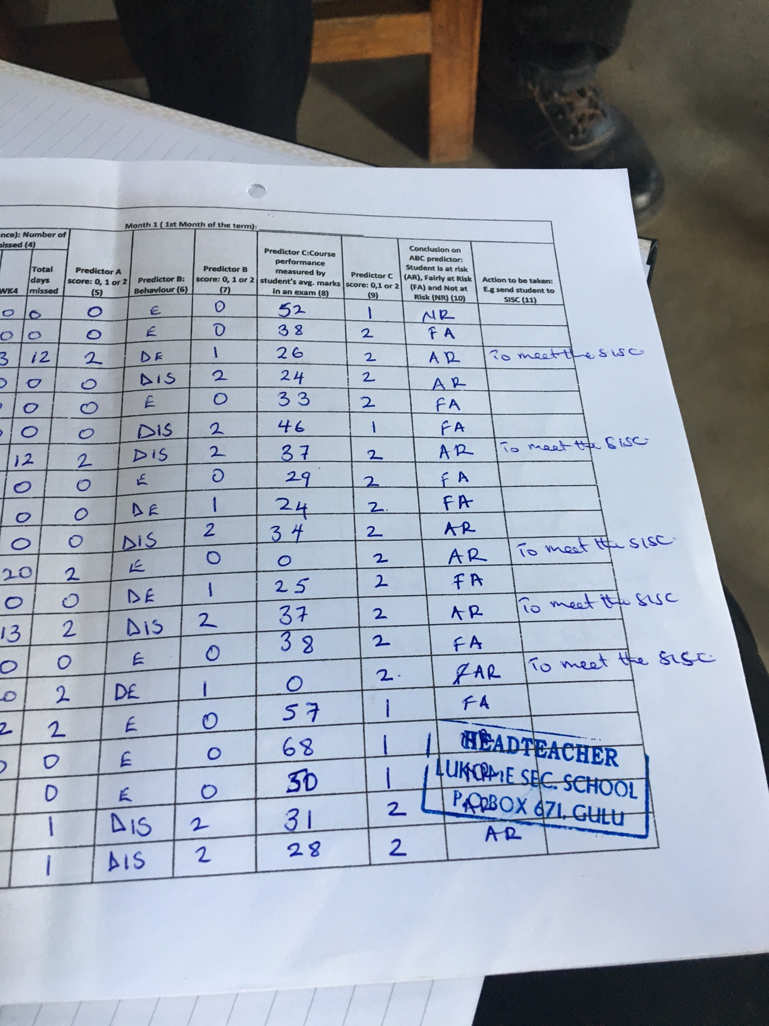
SAGE-DREAMS Innovations/Strategies
Adolescent Led, Adult Supported (Peer Educators)
Early Warning System (EWS)
Stay in School Committee (SISC)
Positive Discipline (Whole School Approach)
Safe Spaces & Safety Friends
Making Re-Usable Sanitary Pads

Slide 10
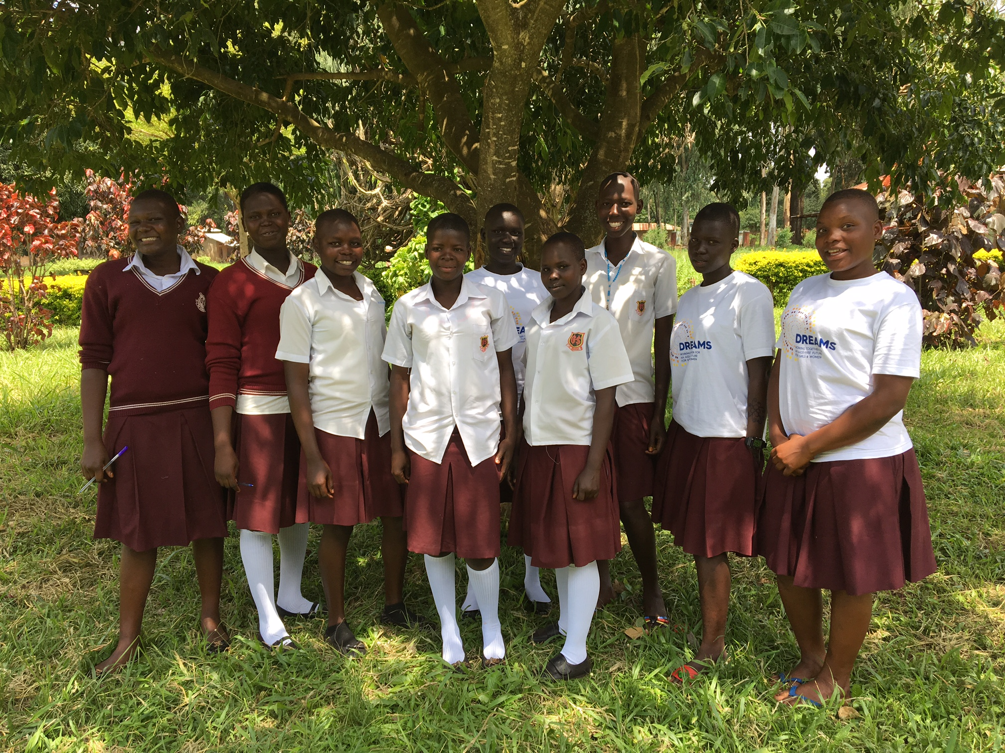
Peer Educators

Slide 11
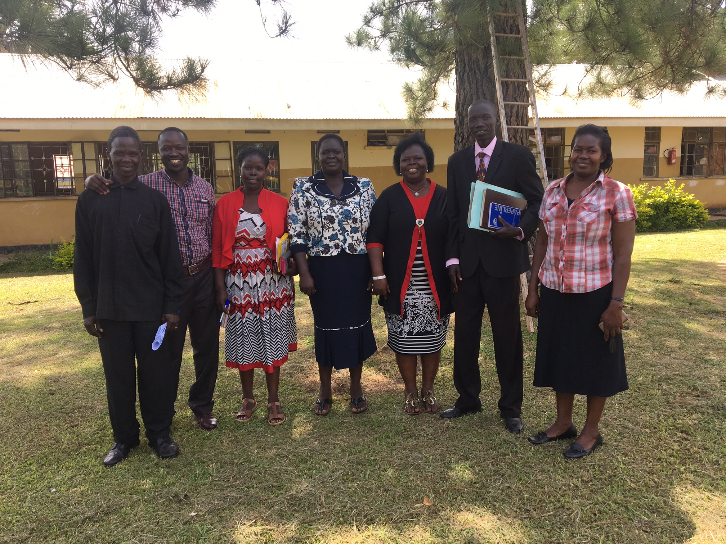
Stay in School Committees

Slide 12
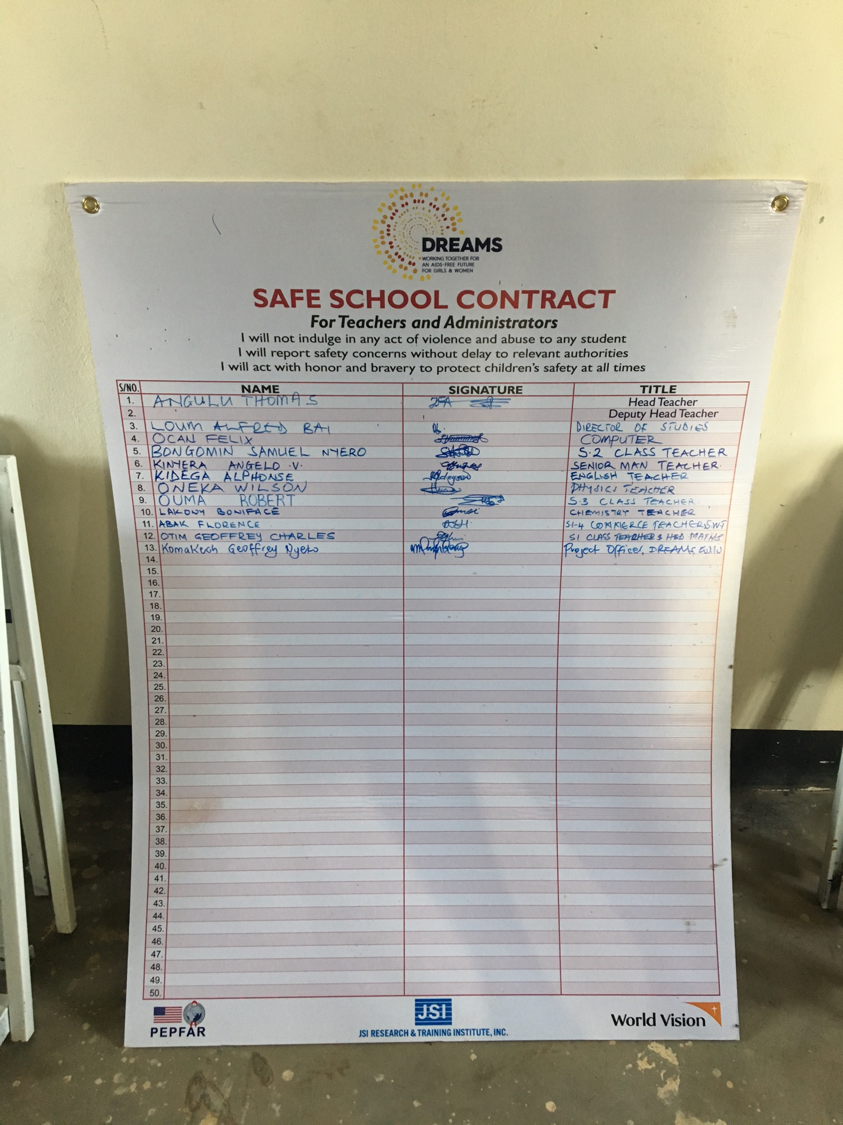
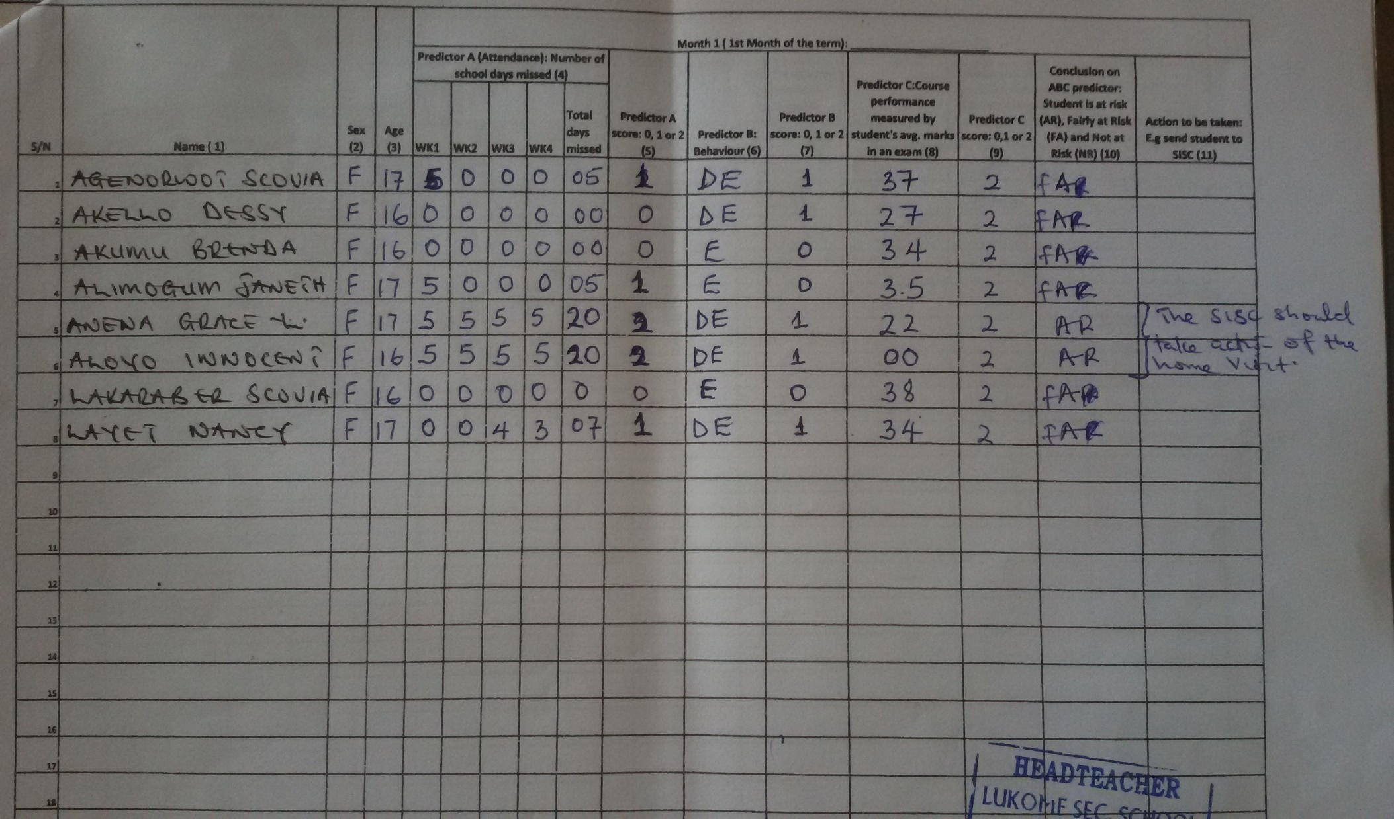
Safe School Contract and EWS

Slide 13
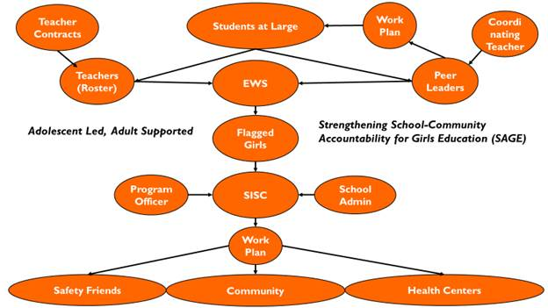
SAGE-DREAMS Project Diagram

Slide 14
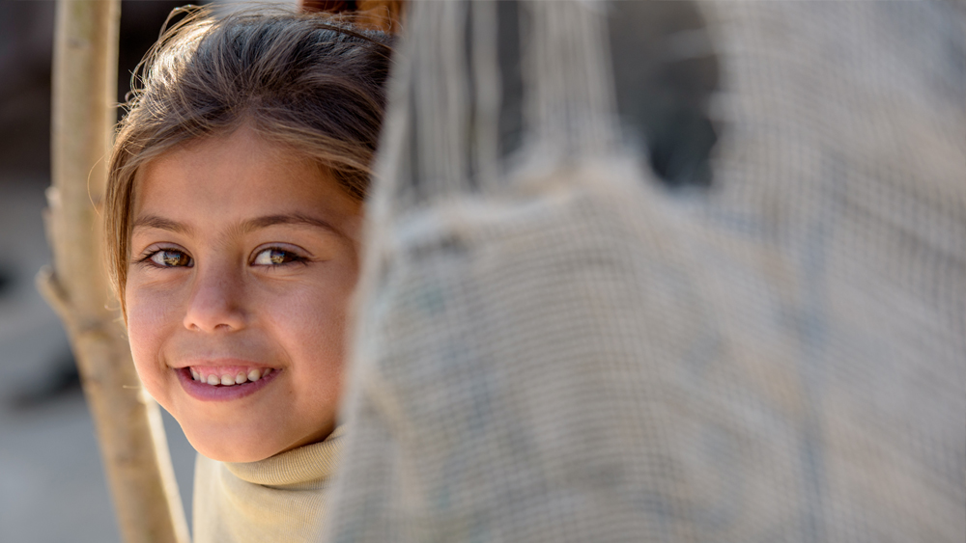
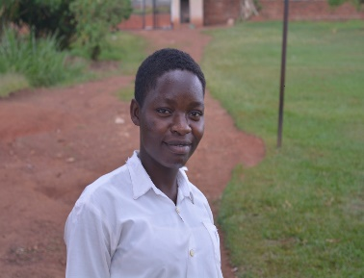
Achievements
1. Successfully Conducted project national launch
2. Rolled out Early Warning System (EWS) in 132 schools
- Using the EWS, Trained 1,651 individuals (726 Teachers and 925 Members of SISCs) in EWS and positive discipline
- 296 AGYW at risk of school dropout have been identified.
So far, 19 AGYW were re-enrolled back to school after dropping out.
3. Established and trained Stay in School Committee ( SISC) in 71 schools of year 1
- Trained 925 members of SISC (425 Girls and 500 Adults) – accounting for 87% of year 1 target (n=1,065)
- The AGYW are conducting peer mentoring of fellow girls and rolling Early Warning System (EWS) to reduce school dropout.

Slide 15
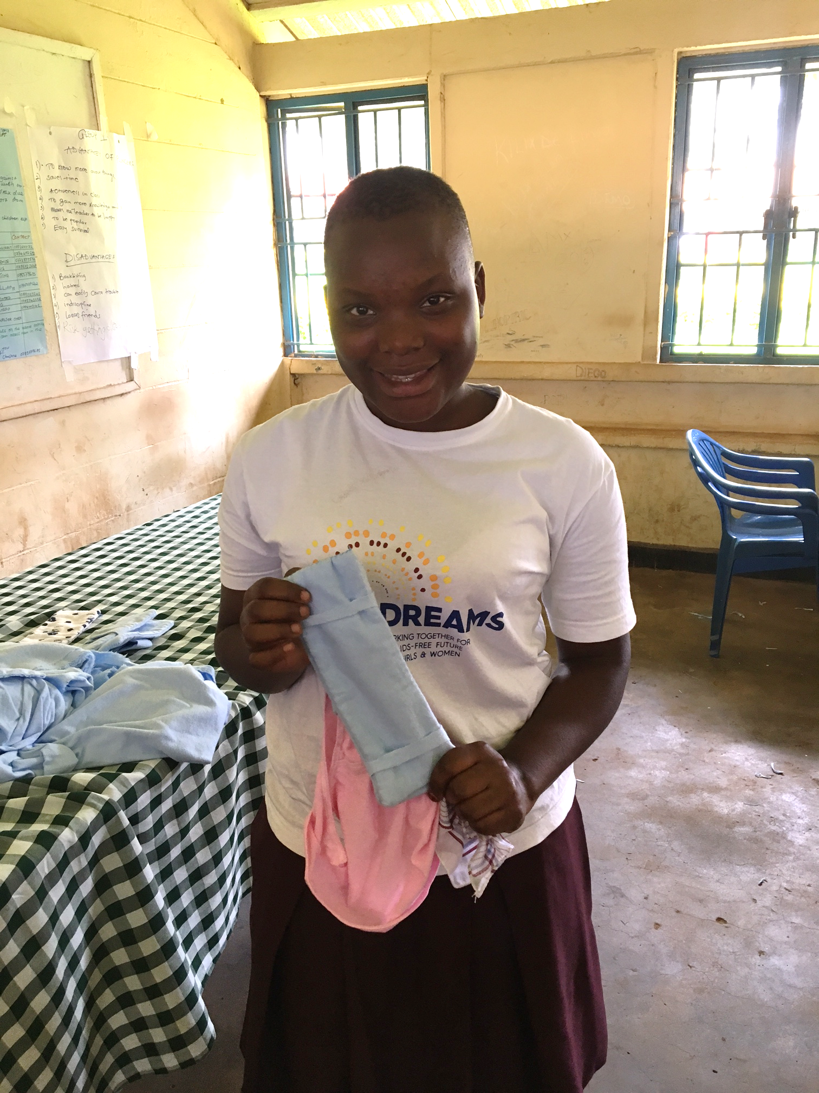

Slide 16
Year 1 Target = 3,497 Achieved = 103% ( n = 3,608)

Slide 17
Indicator : Number of AGYW reached with comprehensive HIV prevention messages
 | Year 1 | Year 2 | Total
Target | 10,650 | 12,350 | 23,000
Achieved ( %) | 8,143 (76%) | 575 (5%) | 8,718 (38%)
Indicator : Number of AGYW counseled, tested and received HTC results
 | Year 1 | Year 2 | Total
Target | 7,310 | 10,995 | 19,705
Achieved ( %) | 7,237(83%) | 575 (5.2%) | 7,812 (40%)

Slide 18
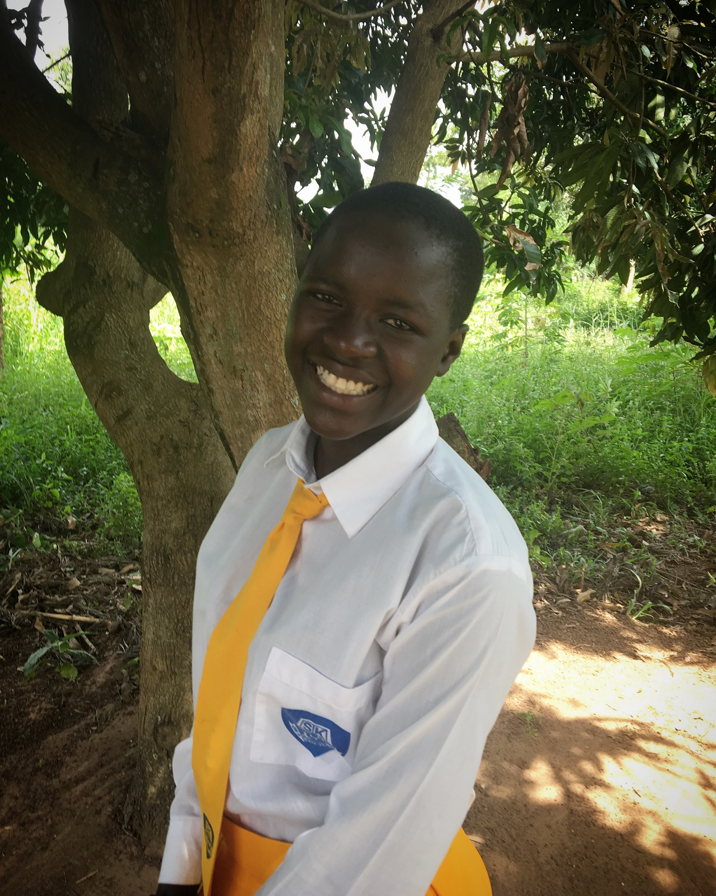
Rebecca Acio, Lira Uganda
17, first in her family to reach S5 (equivalent of last year of HS in the USA). Her father compelted P6, her mother P2 (illiterate)
Daughter of homeless farm hands who make 60 cents a day. Two younger sisters.
7 of 10 girls experience school related gender based violence
Rebecca’s parents make around 60 cents per day.
Less than 7 of ten girls transition from primary school to secondary school in Uganda.
Almost 4% of 15-19 year old girls have HIV.
Staying in school is a preventative factor.

Slide 19
“Before the project intervened, I felt bad because I have the potential to perform well, but there was no-one to support me. Now, I’m so happy and relieved. I want to encourage the girls suffering like me that they should not lose hope. I want to appreciate the donor (PEPFAR) and World Vision and encourage them to continue programs like these because I was suffering and they have given me the capacity to achieve my goal and helped me believe that life can change.”
- Rebecca Acio, northern Uganda

Slide 20
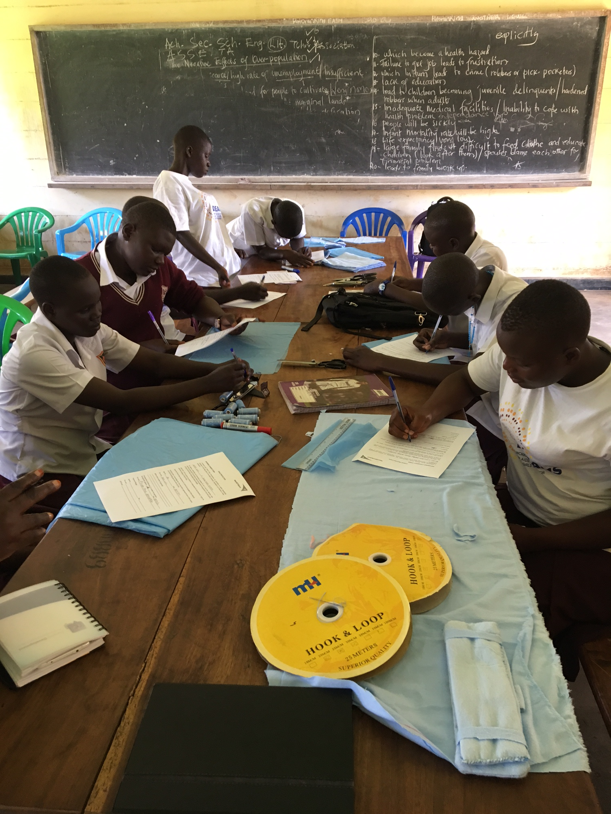
Challenges
School Related Gender Based Violence (SRGBV)
Boys excluded
No cash transfers available for school fees
Implementation limited to school times (and not during exams)

Slide 21
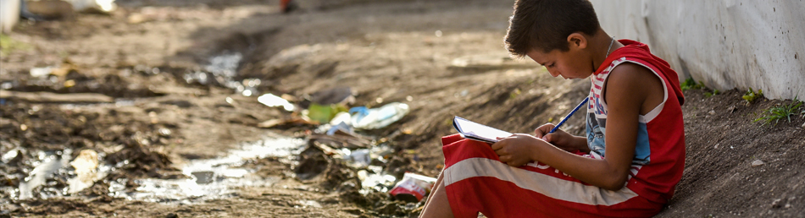
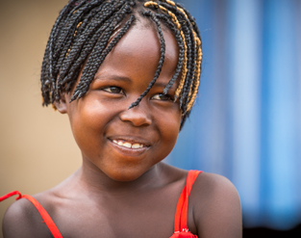
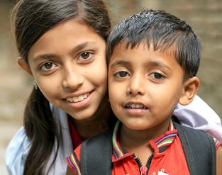
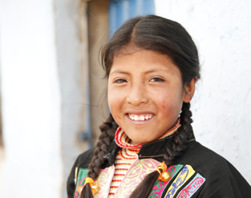
Thank you!

