Slide 1
Policy and systems support for CHWs programmes
HARMONIZATION IN ACTION: WORKING TOGETHER TO BUILD THE COMMUNITY HEALTH WORKFORCE
Dr Giorgio Cometto, Health Workforce Department, WHO
15 November 2016, Health Systems Research Symposium, Vancouver

Slide 2
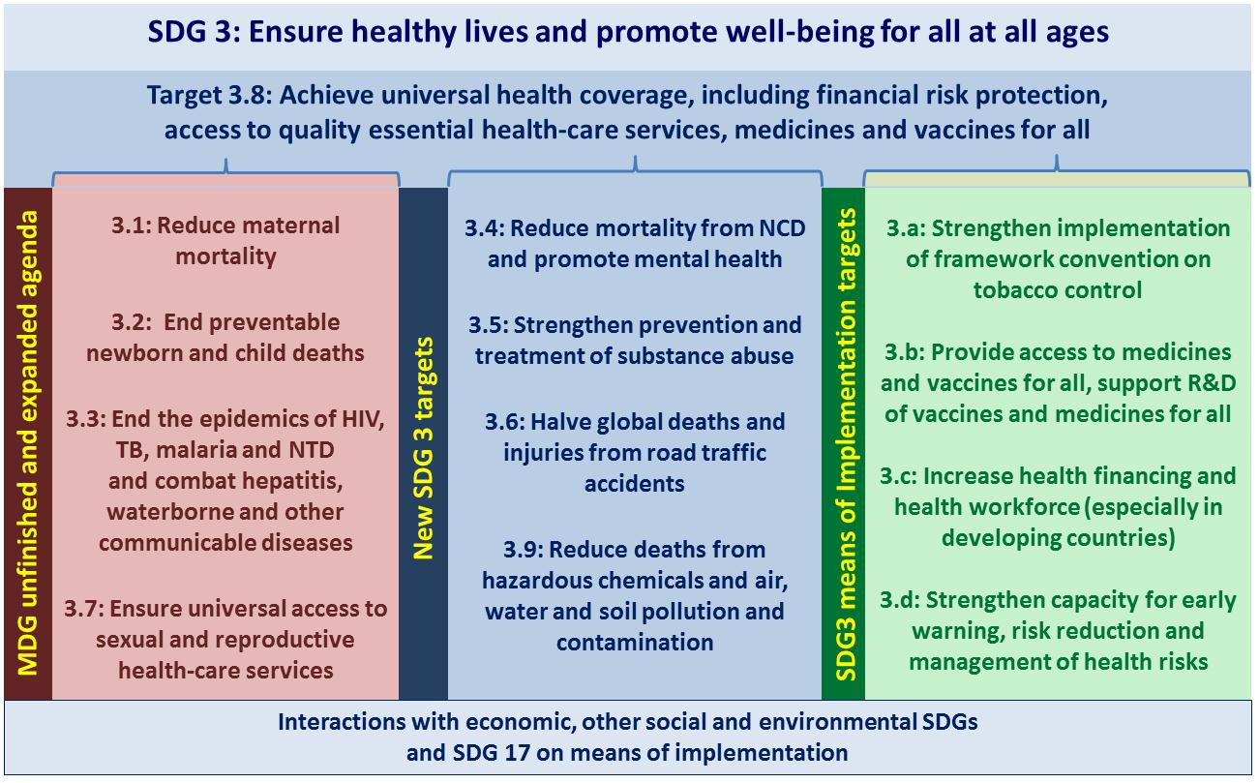

Slide 3
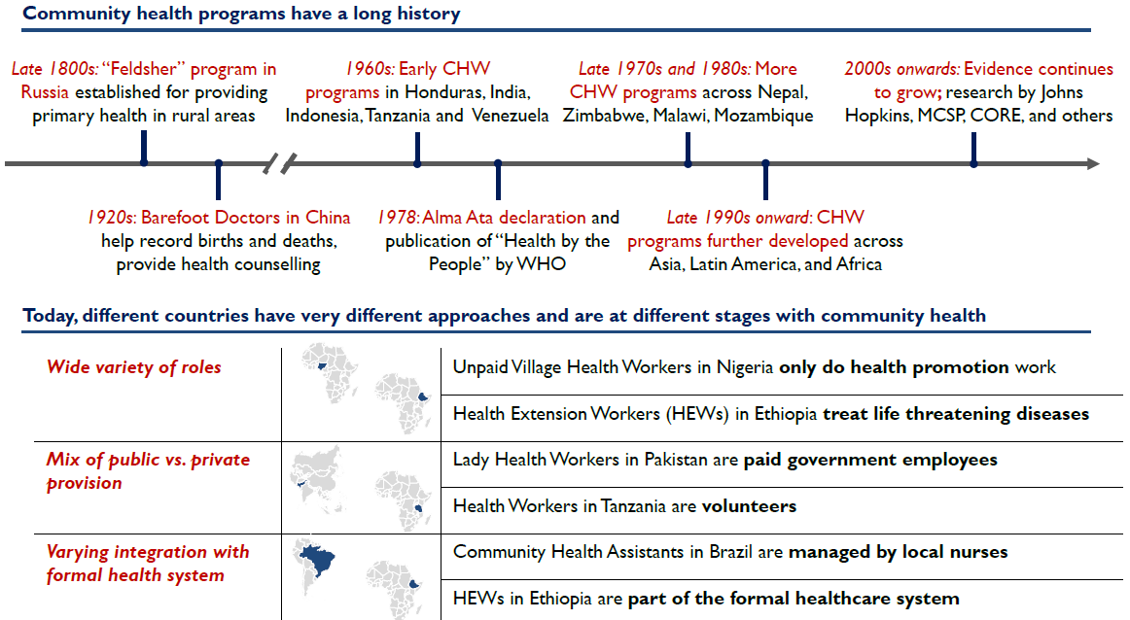
CHW programmes: long history, wide diversity
Source: USAID, 2015

Slide 4
Community health workers: an opportunity for maternal and child health, HIV, TB …
"Lay health workers provide promising benefits in promoting immunisation uptake and breastfeeding, improving TB treatment outcomes, and reducing child morbidity and mortality when compared to usual care" Lewin et al, Cochrane Rev, 2010
"Community health workers …were found to be especially effective in promoting mother-performed strategies (skin to skin care and exclusive breastfeeding)." Gilmore and McAuliffe, BMC Public Health 2013
"Community health workers were reported to enhance the reach, uptake and quality of HIV services, as well as the dignity, quality of life and retention in care of people living with HIV. The presence of CHWs in clinics was reported to reduce waiting times, streamline patient flow and reduce the workload of health workers. Clinical outcomes appeared not to be compromised." Mwai et al J Int AIDS Soc 2013

Slide 5
… and more
"Non-specialist health workers have some promising benefits in improving people's outcomes for general and perinatal depression, post-traumatic stress disorder and alcohol-use disorders, and patient- and carer-outcomes for dementia" van Ginneken et al, Cochrane Rev, 2013
"Overall, the studies consistently identified positive outcomes associated with CHW-delivered interventions, including decreased asthma symptoms, daytime activity limitations, and emergency and urgent care use." Postma et al J Asthma 2013
"CHW programmes can have large impacts on the control of Buruli ulcer in sub-Saharan Africa." Vouking et al, Pan Afr Med J 2013

Slide 6
Policy issues: classification
What are community health workers?
“lay health workers”, “frontline health workers”, “close-to-community providers”, "community based practitioners"?
ILO ISCO: " Community health workers provide health education, referral and follow-up, case management, basic preventive health care and home visiting services to specific communities… Occupations included in this unit group normally require formal or informal training and supervision recognized by the health and social services authorities.”
Source: ILO, 2008

Slide 7

Policy issues: (lack of) systems support
"inconsistent support of community health workers (CHWs) and failure to integrate them into the health system have impeded full realization of their potential contribution in the context of primary health care."
Scaling up and maintaining CHW programmes is fraught with a host of challenges:
  poor planning;
  multiple competing actors with little coordination;
  fragmented, disease-specific training;
  donor-driven management and funding;
  tenuous linkage with the health system;
  poor coordination, supervision and support, and
  under-recognition of CHWs’ contribution.
Source: Tulenko et al, WHO Bull, 2013

Slide 8
UNICEF Country offices reporting duration of training for CHWs in MoH CCM programs(2010): CHWs with non-financial incentives only highlighted in green, CHWs with financial incentives of some kind highlighted in orange, CHWs with salaries highlighted in red
Source: UNICEF

Slide 9
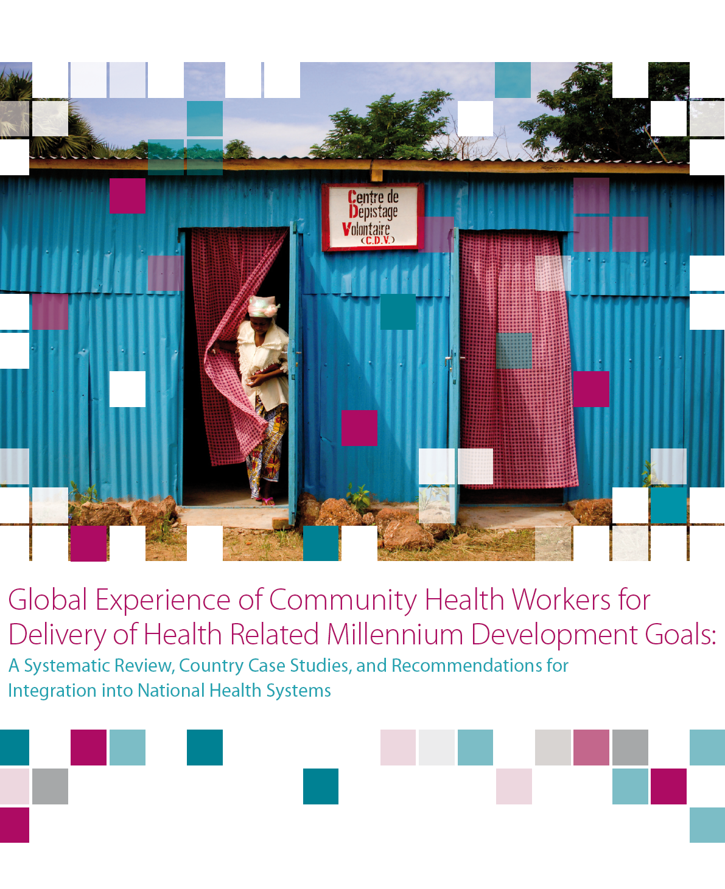
CHW integration: what does it mean?
  Clear/ transparent selection system, involving and responding to needs of communities
  Curriculum to include scientific knowledge on basic preventive and curative care
  Adapt contents to health system needs
  Include CHWs in HRH planning
  Have a budget line /
  resource allocation
Planning
Production/ Education
Perfor-mance
Deployment / retention
  Ensure supplies/ equipment
  Effective referral systems
  Regular monitoring & supervision
  Community preparedness
  Regular and sustainable remuneration package
  Opportunities for career and professional development
Source: Bhutta et al, GHWA, 2010

Slide 10
CHWs in the Global Strategy on HRH
“Addressing population needs for the SDGs and UHC requires making the best possible use of limited resources … a more sustainable and responsive skills mix, harnessing opportunities from the education and deployment of community-based and mid-level health workers;”
“Prioritize the deployment of inter-professional primary care teams of health workers with broad-based skills, avoiding the pitfalls and cost-escalation of overreliance on specialist and tertiary care. This requires adopting a diverse, sustainable skills mix, and harnessing the potential of community-based and mid-level health workers in inter-professional primary care teams.”
“In many settings, developing a national policy to integrate, where they exist, community-based health workers in the health system can enable these cadres to benefit from adequate system support and to operate more effectively within integrated primary care teams”
Invest in decent conditions of employment … include at the very least provision of a living wage (including for community-based health workers) … in line with the SDG Goal on Decent Work and Economic Growth.
The International Labour Organization (ILO) to revise the International Standard Classification of Occupations for greater clarity on delineation of health workers and health professions.(72) This will entail a move towards definitions that reflect worker competency together with the tasks they perform. Of particular urgency is the need to streamline and rationalize the categorization and nomenclature of community health workers and other types of community-based practitioners.
Source: WHO 2016, Global Strategy on HRH

Slide 11
The guideline planning proposal: rationale
Basic HR functions - formalized training, certification, payment etc - are taken as a given for professional health workers, but policies and practices vary enormously across countries in relation to the application of these same functions to community health workers
Sub-standard qualifications, management and support for these cadres in many contexts. Variable performance of CHW programmes
Well-intentioned and well performing CHW initiatives may fail to be properly integrated in health systems, and remain pilot projects or small scale initiatives that are excessively reliant on donor funding
Wastage of both human capital and financial resources
Good experiences not brought to scale or replicated/ adapted to other relevant contexts
Various guidelines and tools identify a role for CHWs
But there are no agreed standards for the policy and system support actions to optimize their performance

Slide 12
Target audience
  policy-makers, planners and managers responsible for health workforce policy and planning at national and local levels that rely on CHWs for the delivery of health services
  development partners, funding agencies, global health initiatives, donor contractors, NGOs and activists who fund, support, implement, and/ or advocate for the greater and more efficient involvement of CHWs in the delivery of health services

Slide 13
Objectives
Provide recommendations in the areas of CHW selection, education, continuing training, linkage with other health workers, management, supervision, performance enhancement, incentives, remuneration, governance, health system integration;
Identify relevant contextual elements, implementation and evaluation considerations at the policy and systems level;
Suggest tools to support the uptake of the recommendations at the country level in the context of the planning and implementation of CHW programmes;
Identify priority evidence gaps to be addressed through further research.

Slide 14
Exploring evidence for different categories of CHWs
Various stratifiers for each question:
  Volunteer vs. paid
  Level of training
  Polyvalent vs. monovalent
  Full time vs part time
  Expert client/patient
  Type of work (preventive/promotive versus also curative)

Slide 15
A multi-layered outcome framework
Results | Measures | Definition
Outputs changes at CHW level | Knowledge | Degree to which the CHW has the theoretical or practical understanding of the function and tasks assigned to him/her
 | Competencies | Degree to which the CHW has the skills necessary to carry out the tasks assigned to him/her
 | Motivation | An individual’s degree of willingness to exert and maintain effort on assigned tasks
 | Morale | The mental and emotional condition (as of enthusiasm, confidence, etc.) of an individual CHW with regard to the function or tasks at hand
 | Satisfaction | Degree to which CHWs derive personal satisfaction from serving the community, providing good quality services
 | Absenteeism | Rate at which those CHWs who are supposed to be delivering services habitually fail to appear to carry out their tasks
 | Service delivery | Quantity and quality of promotional, preventive, and curative services CHWs provide to community members
 | Responsiveness | The degree to which an individual CHW responds to the needs of an individual client or group within a reasonable time period
 | Productivity | A CHW’s total output per unit of total input
 | Attrition | The rate at which practicing CHWS resign, retire, or abandon their positions over time
 | Advancement | The rate at which CHWs are advancing in their skills, competencies, formal responsibilities, and formal status within the community and the formal health system over time
Outcomes CHW- attributable changes at patient, community l or health system level | Access | Client’s physical and social access to essential services delivered by CHWs
 | Coverage | The coverage of selected health services among the population served by CHWs
 | Quality | The quality of services rendered by CHWs
 | Health care-seeking behaviour | Client in need of essential services and with access to CHWs is routinely seeking and using promotional, preventive and/or curative services CHWs offer
 | Health-promoting behaviour in home | Client has adopted health-promoting behaviours in the home as a result of contact with CHWs
 | Satisfaction | Client’s reported degree of satisfaction with the services rendered by CHWs
 | Cost savings | Money not spent by client that he/she otherwise would have spent (on transportation and other items) in the absence of a CHW
 | Patient health | Change in client’s state of illness, wellness, survival
Impact CHW attributable changes at population level | Morbidity | Change in the prevalence of serious illness in the population served by CHWs
 | Mortality | Change in the level of mortality in the population served by CHWs
 | Fertility rate | The ratio of live births in a CHW-served area to the population of that area expressed per 1,000 population per year
 | Equity | Degree to which access, coverage, or morbidity/mortality levels vary among different socio-economic or socially defined sub-groups in the population served by CHWs
Source: Naimoli J et al

Slide 16
The 10 initial PICO questions
Are there desirable demographic or socio-economic profiles, or minimum pre-service training literacy selection criteria for CHWs?
What is the appropriate duration of pre-service training for CHWs?
What are the essential competencies for pre-service education of CHWs?
What are the most appropriate delivery modalities of pre-service education of CHWs?
Can certification of CHWs improve their quality and results of CHW programmes?

Slide 17
The 10 initial PICO questions (cont.)
What are the characteristics of effective supervision strategies to optimize the results of CHW programmes?
Should CHWs be paid for their work?
Should CHW be offered a career ladder opportunity/ framework within the health sector?
Should CHWs be formally contracted?
Is there an optimal population size covered by a CHW?

Slide 18
Additional PICO questions (following public hearing and GDG meeting)
Should CHWs collect/ use health data?
Should there be a single cadre of generalist/ polyvalent CHWs or multiple cadre of specialized CHWs?
Can community engagement strategies improve performance of CHW programmes?
Should CHWs mobilize community resources for health?
What strategies are effective to ensure availability to CHWs of essential commodities?

Slide 19
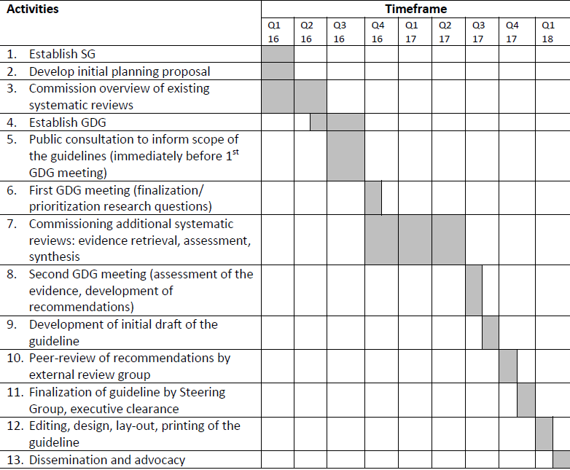
Tentative timeframes

Slide 20
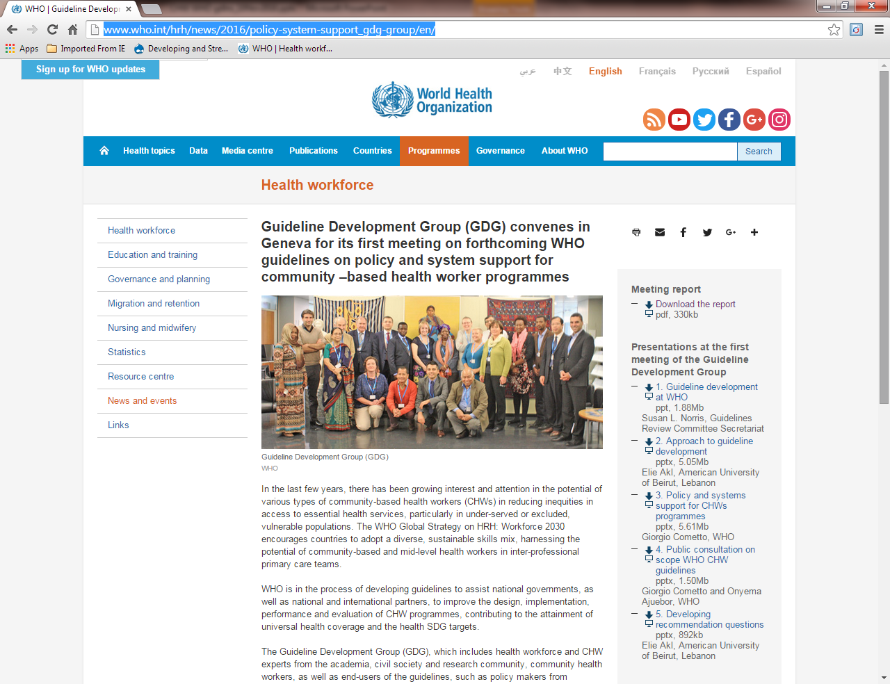
Source: http://www.who.int/hrh/news/2016/policy-system-support_gdg-group/en/

Slide 21
THANK YOU.
who.int/hrh
#workforce2030

Slide 22
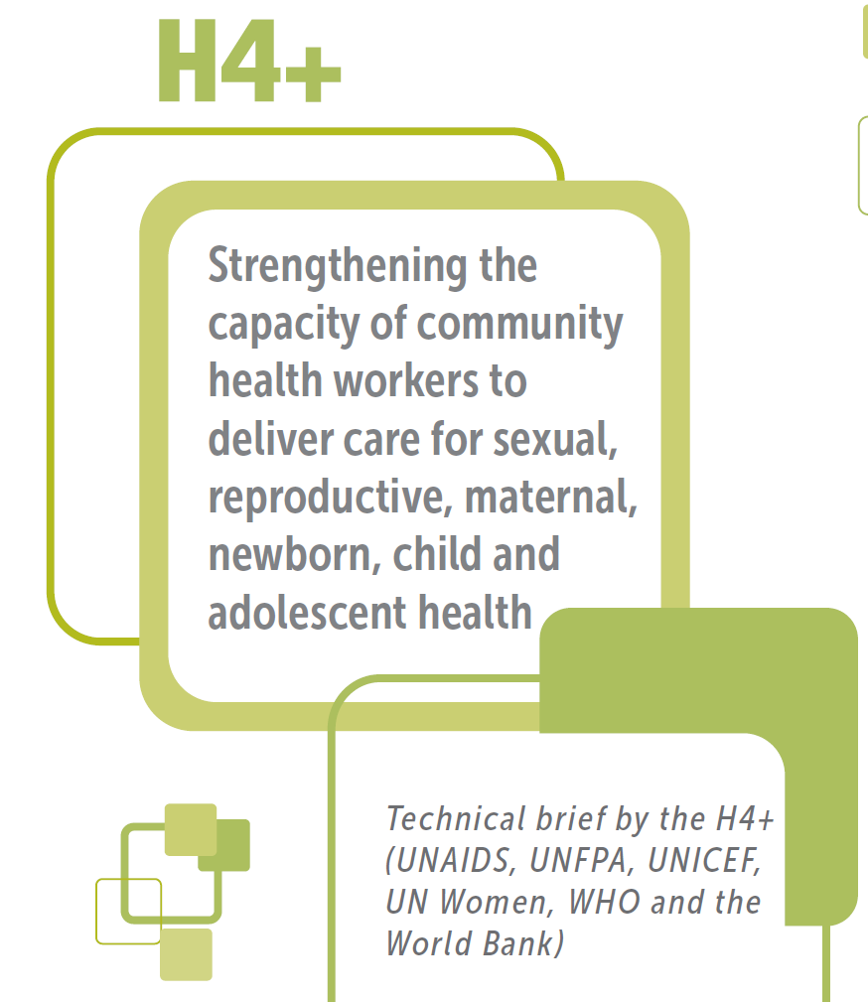

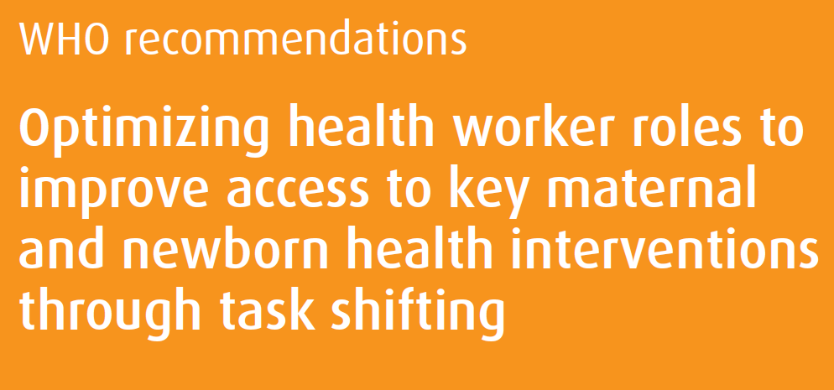
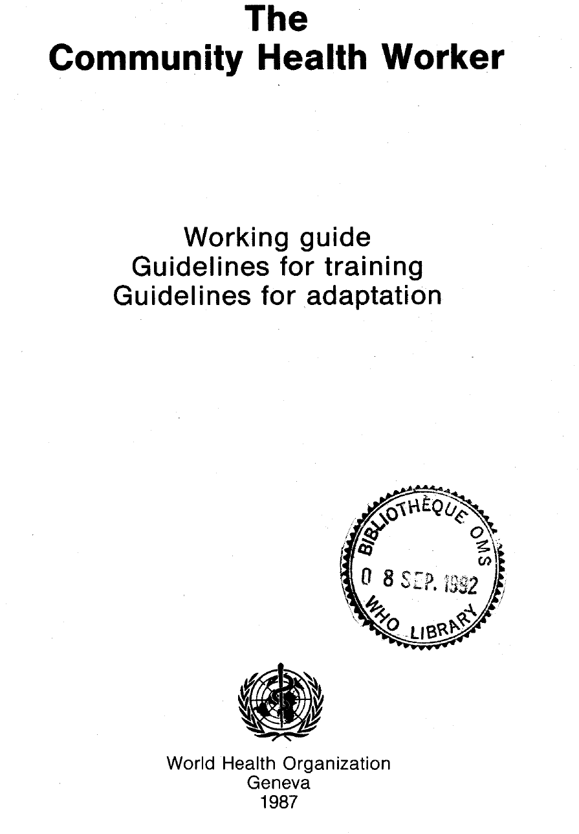
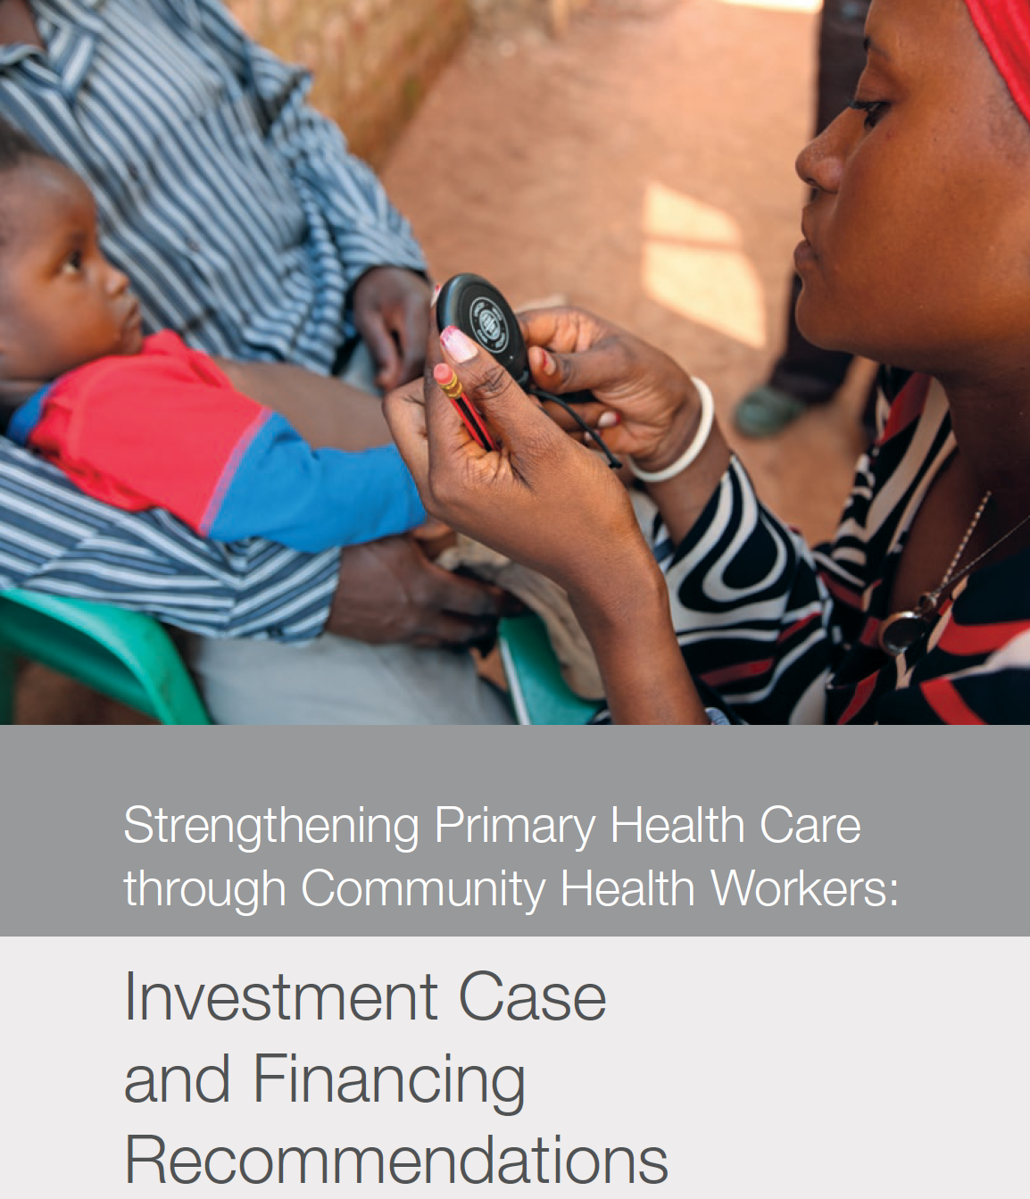


Slide 23
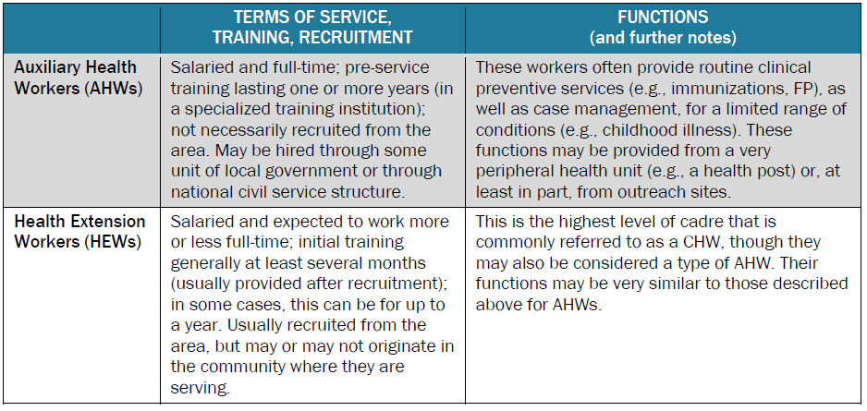
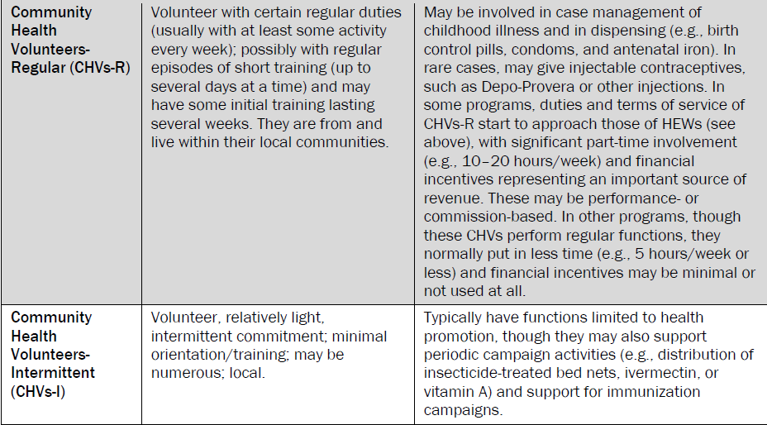
Varying CHW categorization
Source: JHPIEGO 2014

Slide 24
A mismatch in the global and national health labour markets
 | Stock |  |  | Needs-based shortage |  |  | Labour market demand
 | 2013 | 2030 | % change | 2013 | 2030 | % change | 2013 | 2030
Income
High | 17.6 | 24.3 | 38% | 0.1 | 0.1 | -7% | 17.7 | 23.8
Upper-middle | 14.7 | 22.6 | 54% | 3.7 | 1.8 | -50% | 19 | 33.3
Lower-middle | 10 | 18.3 | 82% | 9.1 | 6.6 | -28% | 10.9 | 21.7
Low | 1.1 | 2.1 | 86% | 4.6 | 6.1 | 33% | 0.6 | 1.4
Region |  |  |  |  | 0
Africa | 1.9 | 3.1 | 63% | 4.2 | 6.1 | 45% | 1.1 | 2.4
Americas | 9.4 | 14 | 50% | 0.8 | 0.6 | -17% | 8.8 | 15.3
Eastern Mediterranean | 3.1 | 5.3 | 72% | 1.7 | 1.7 | -1% | 3.1 | 6.2
Europe | 12.7 | 16.8 | 32% | 0.1 | 0.1 | -33% | 14.2 | 18.2
South-East Asia | 6.2 | 10.9 | 75% | 6.9 | 4.7 | -32% | 6 | 12.2
Western Pacific | 10.3 | 17.3 | 68% | 3.7 | 1.4 | -64% | 15.1 | 25.9
World | 43.5 | 67.3 | 55% | 17.4 | 14.5 | -17% | 48.3 | 80.2
All health worker figures in millions, rounded to nearest 100,000
Stock and shortage figures refer to 193 Member States
(Source: WHO Global Strategy on HRH http://who.int/hrh/resources/globstrathrh-2030/en/ )
Labour market demand figures refer to 165 Member States with sufficient data (source: World Bank)
Source: WHO 2016, Global Strategy on HRH

Slide 25
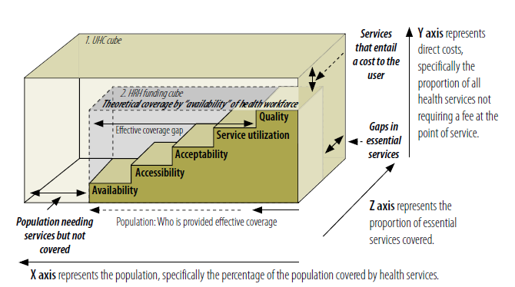
Health workforce for UHC: not just numbers
Source: Campbell J et al. A universal truth. WHO, 2013.

Slide 26
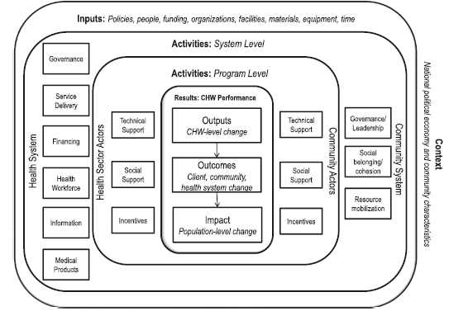
CHW logic model
Source: Naimoli et al, HRH Journal, 2014

