Slide 1
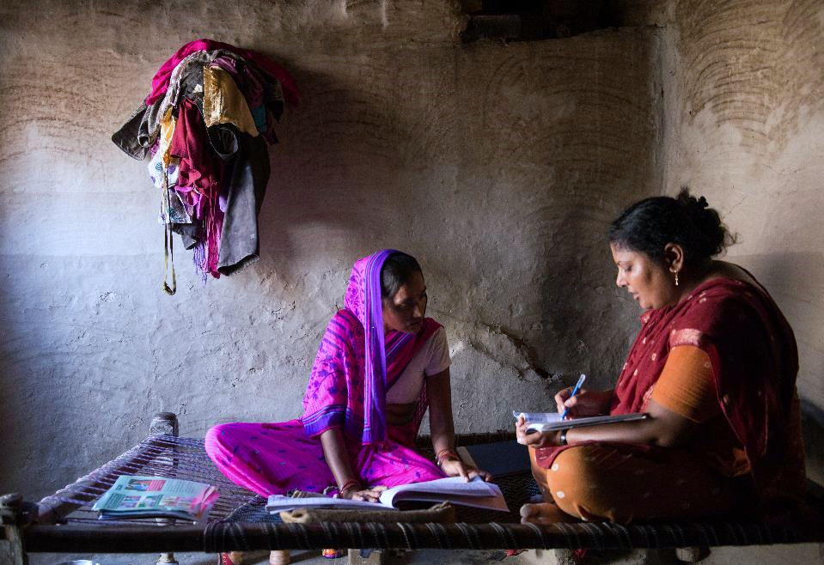
World Vision’s Global CHW Programme
Webinar: Trailblazing leadership in national CHW scale up - achievements in curriculum innovation
Notes:
Polly will do intro
Key stakeholders

Slide 2
Vision Statement for CHW programmes:
Work with existing health structures through strong, long-term partnerships to deliver consistent high quality support, to enable community health workforces that are sustainable, functional and effective.

Slide 3

CHW Principles of Practice 7 guiding principles: Working with Governments to support:
Legitimization and recognition of appropriate CHW cadres within the formal health system
Enable and support country leadership through national or regional multi-stakeholder coordination bodies
Work with and through existing local health services and mechanisms
Incentives / motivation - ethical, non-competitive, sustainable & locally relevant under unified country policy.
Training standards and continuing education under an agreed unified system linked to accreditation.
Support unified mechanisms for reporting, supervision and management of data – aim to create comparable / collated data between projects.
NGOs supporting CHW research, innovations, and judiciously taking to scale evidence-based cost-effective solutions made available in the public domain through partnership approaches.

Slide 4
Our Commitment at Recife
Work together to adapt, apply and implement the Framework for Partner Action
Advocate, endorse and apply the principles and processes delineated in the Framework for Partner Action;
Jointly promote the culture of self and mutual accountability, monitoring of commitments and plans (M&A Framework)
Respond to knowledge gaps and promote a coordinated response to needs-based research on CHWs (Research framework)
World Vision will
Extend its reach to support 100,000 CHWs
Strengthen and extend our reach with TTC and iCCM, CPMTCT and other CHW programmes
Advocate for CHW harmonization amongst partners
Support countries to take CHW programmes to scale
Integrate newborn care into iCCM, ttC, CHW programming (ENAP)

Slide 5
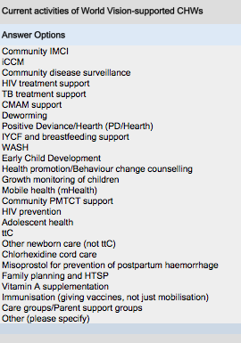
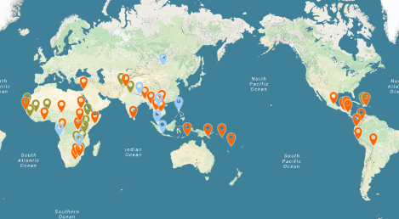
World Vision Global CHW programme
World Vision is currently supporting approx. 220,370 CHWs globally, more than twice the projected target for 2015
CHW programming is a core approach for health and nutrition in 48 national offices (84%)
34 of 48 countries have reached 50% or more communities in WV program areas
Where MOH CHW policy exists, WV programmes are fully aligned in 65% of countries
WV directly implements CHW programmes in only 25% of 48 countries: predominant mode of support is technical assistance and capacity building of MOH
http://bit.ly/1PnwHnq

Slide 6
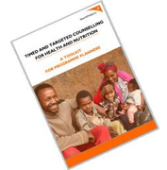


Timed and Targeted Counselling for Health and Nutrition, 2nd edition: A Comprehensive Training Course for Community Health Workers © World Vision International, 2015
3 modular course following the lifecycle approach from pregnancy to 24 months, with special care for vulnerable cases, mental health and ECCD
‘Family-centred’ dialogue counselling (yes that includes men!)
Comprehensive guidance for peer supervision and data monitoring tools adapted for low literacy/numeracy contexts
Trainers Guide, multimedia resources suite and mHealth application
Detailed country contextualization guidance
mHealth applications available on request.
All materials and tools are available at www.wvi.org/health, and also from our partners’ sites:

Slide 7
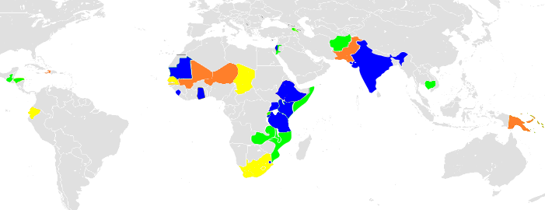


GLOBAL TTC PORTFOLIO- April 2016
SCALING UP TTC (10)
IMPLEMENTING (11)
PREPARATORY (7)
IN CONSULTATION
Uganda, Burundi, Ethiopia, India, JWBG, Sierra Leone, Swaziland, Mauritania, Kenya, Ghana
Armenia, Afghanistan, Cambodia, Guatemala, Honduras, Jordan, Malawi, Mozambique, Somalia, Tanzania, Zambia,
Chad, Ecuador, Senegal, Sudan, South Sudan, South Africa, Lesotho
Niger, Mali, Haiti, Pakistan
mHealth-ttC:
India, Tanzania, Kenya, Zambia, Uganda, Mozambique, Sierra Leone, Honduras (new)
Operations research:
chNIS Study: Guatemala, Cambodia, Zambia, Kenya
Other: JWBG, Armenia, Sierra Leone, Afghanistan
mHealth TTC
operations research
28 COUNTRIES

Slide 8
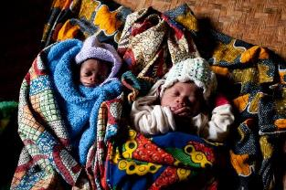
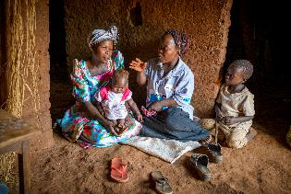
Achievements
TTC 2nd edition Curriculum translated in English, French, Spanish, Portuguese & Arabic*
Implementation underway in 28 countries
2015 – Kenya MOH revised national MNC module to include components of TTC-2 (psychological first aid, supportive care for most vulnerable and dialogue/storytelling methodology)
Adopted in part or full in national CHW curricula in Swaziland, Mauritania, Ghana, Kenya, Tanzania, Uganda, JWBG*

