Slide 1
Determined Behavior Change
A comparative study of the application of Barrier Analysis methodology
Presented by: Mathias Pollock, BCC Technical Advisor

Slide 2
Outline
Determined Behavior Change
Background
Methods
Results
Program
Process
Institutional
Limitations
Recommendations

Slide 3
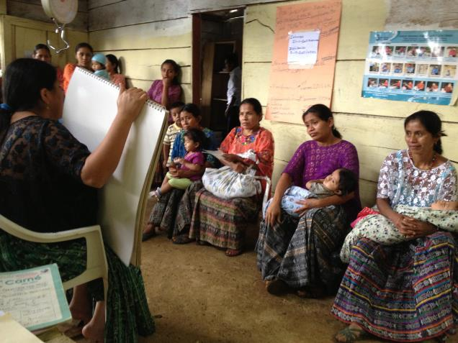
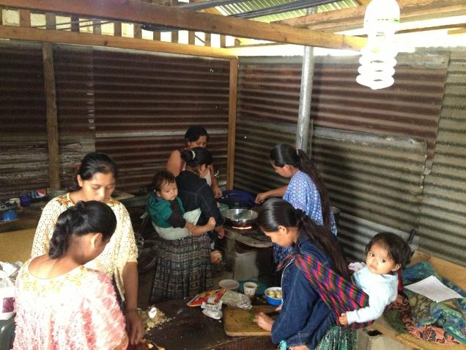
Background – Barrier ANalysis
Determined Behavior Change
A BCC education session with mothers of children <6months Photo: Mercy Corps
A cooking demonstration where mother leaders practice healthy recipes Photo: Mercy Corps
Notes:
Barrier Analysis
a methodology for better understanding the underlying determinants or factors that influence individual behavior choice
a rapid evaluation, mixed-method tool used to identify gaps between knowledge and behavior

Slide 4
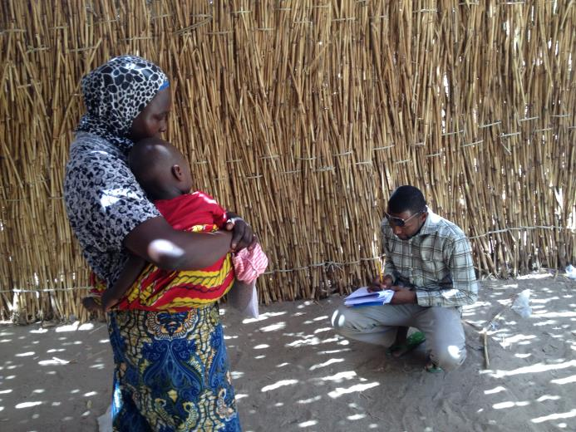
Methods
Determined Behavior Change
Study Design
29 Barrier Analysis studies
7 programs in different Mercy Corps countries
Variety of different behaviors
Desk review of results
Key informant interviews conducted with representative staff members
Interviewing a new mother on ANC attendance in Niger
Photo: Mercy Corps

Slide 5
Methods - sample
Determined Behavior Change
Country | Program | Example behavior
Guatemala | PROCOMIDA | Initiation of complementary feeding
Uganda | GHG | Latrine use
Niger | Sawki | ANC visits
Liberia | E-CAP | Ebola case reporting
Timor Leste | COMPAC | Household fish consumption
DRC | IMAGINE | Hand washing, use of ORS
Tajikistan | MCH Expansion | Infant feeding practices
Notes:
Guate – Title II Food for Peace program
Ug – USAID
Niger – Food for Peace
E-CAP – OFDA
TL – Swiss
DRC - ??
Tajikistan - ??

Slide 6
Results – Program Learning
Determined Behavior Change
Mothers in rural Guatemala have trouble remembering to initiate complementary feeding when their babies reach six months of age because they often do not have birth certificates and do not know how old their children are.
Heads of household in Liberia who reported suspected Ebola cases within the first 48 hours of noticing symptoms (in line with government recommendations) said that prioritizing the wellbeing of their community over the individual was a motivating factor.
Expecting mothers in Niger cited the support of their parents and their in-laws as a critical factor in their ability to attend the recommended antenatal care visits during their pregnancy.

Slide 7
Results – process learning
Determined Behavior Change
Perceived self-efficacy was found to be significant in 80% of the studies
Social norms were found to be significant determinants of behavior in almost 60% of the Barrier Analyses included in this study.
Notes:
It is important to note however, that in the majority of these cases survey respondents did not cite a lack of knowledge about the behavior as the issue.
While it is well accepted that individuals do not make decisions in a bubble and rather they are often affected by the opinions of those around them, these studies help to identify exactly who are the most important influencers so that they can be included as targets of intervention activities.
An example of this is the GHG program in Uganda, where Doers identified husbands as approving of certain health behaviors (such as exclusive breastfeeding, dietary supplementation of lactating women, facility-based delivery, and attendance at antenatal care visits), while Non-Doers perceived that their spouses would not approve

Slide 8
Results – Institutional learning
Determined Behavior Change
BA has been used to advise behavior change activities in almost 20% of the countries in which it has programming
100% of those interviewed indicated that they would use Barrier Analysis again
5 out of the 7 programs went on to implement subsequent Barrier Analysis
Project expansion and innovation
Notes:
After successful experiences conducting more traditional studies on infant care practices, the Guatemala team decided to employ Barrier Analysis to look into pre- and post-harvest practices to reduce aflatoxin (a carcinogen produced by the parasitic mold of the Aspergillus family linked to stunting) contamination in maize. The results point to some interesting determining factors that should be considered by future projects, including the lack of awareness of positive consequences, the difficulty in accessing materials, and the perception of God’s will regarding the promoted practices. It should also be noted that the questionnaires used in these studies were subsequently shared with the team in Timor Leste, where country staff were able to translate them into local language and conduct studies on the same behaviors.

Slide 9
Limitations
Determined Behavior Change
Rapid research study but time intensive process
Limited to examining one behavior at a time
Provides guidance but not solutions
Results are often not generalizable
Coordinated community entry in Liberia
Photo: Mercy Corps

Slide 10
Recommendations
Determined Behavior Change
Development programs benefit significantly from an increased understanding of the specific motivators and barriers faced by their beneficiaries.
Study managers need to allow sufficient time to sensitize staff to the questionnaire and translate it into the local language
Highlights the critical role of formative research in the design and implementation of effective development programming as it relates to behavior change
Barrier Analysis presents a tangible, relatively simple and inexpensive option to identify some of these issues, but it is one tool in what should be a larger toolbox

Slide 11
Thank you
Determined Behavior Change
Contact
Mathias Pollock
Technical Advisor, Child Survival and BCC
mpollock@psi.org

