Slide 1


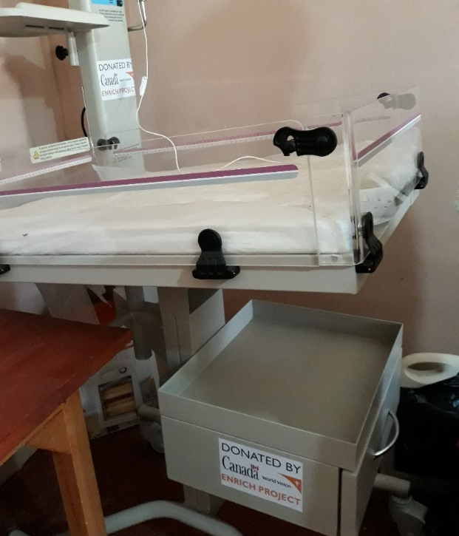
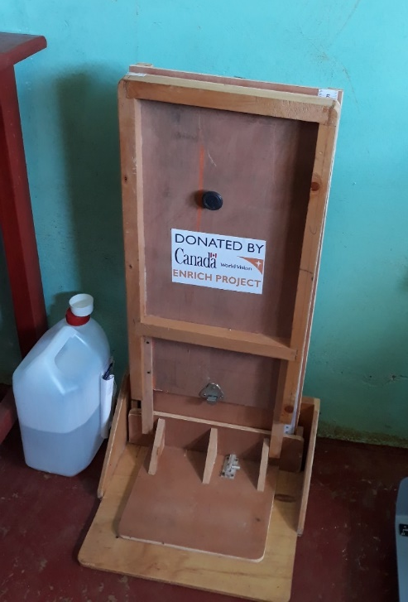
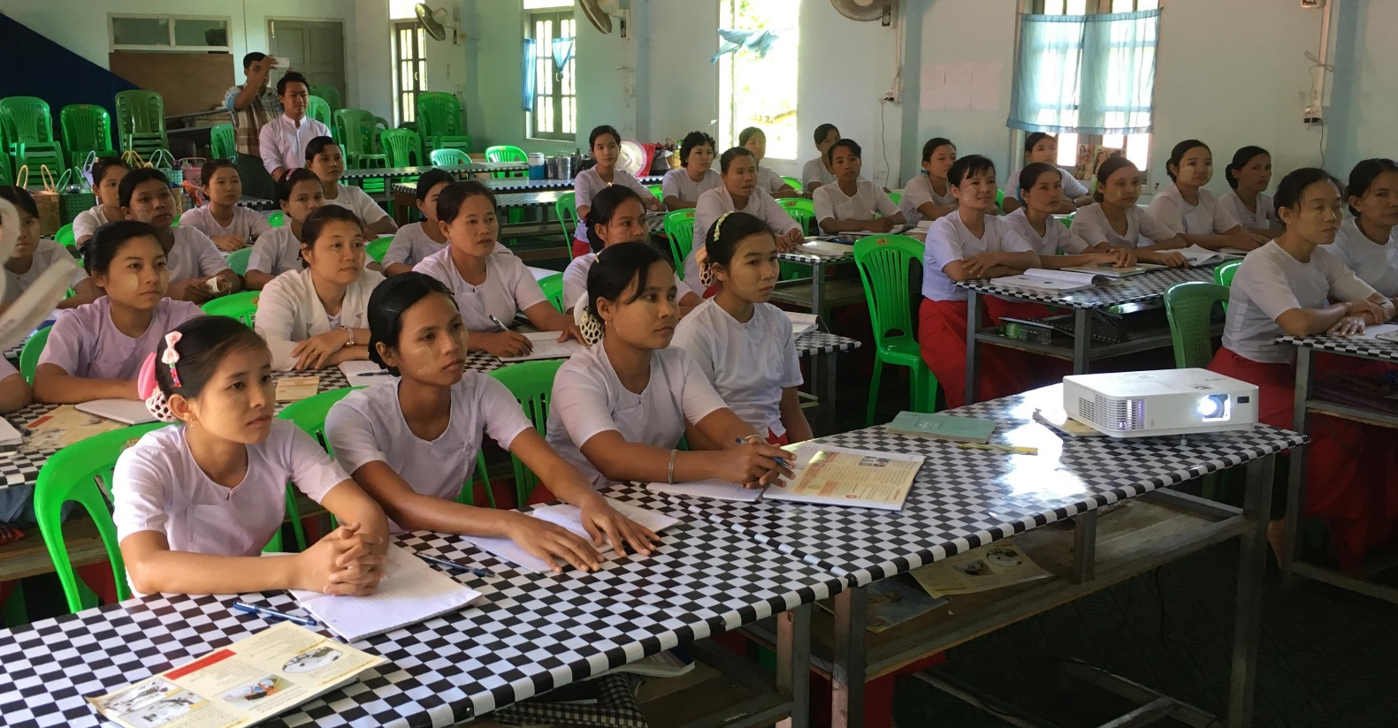
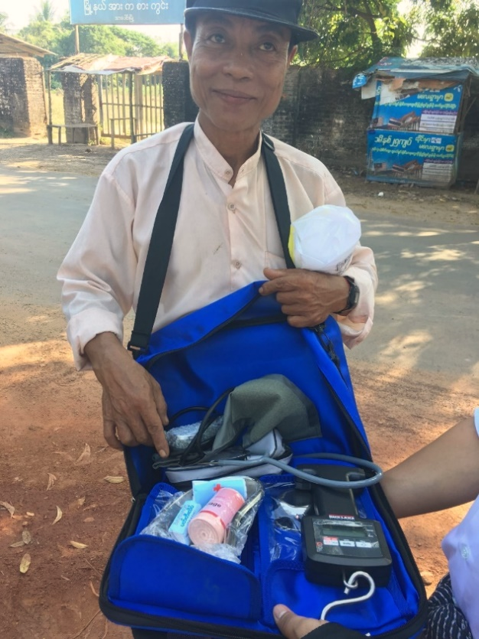
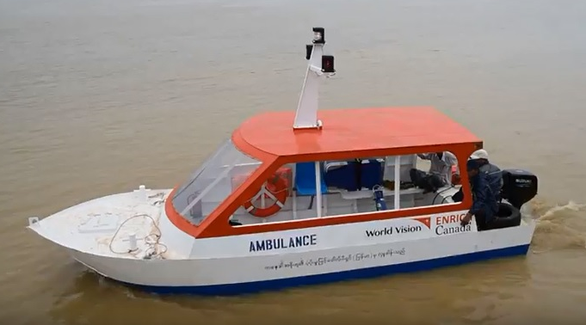
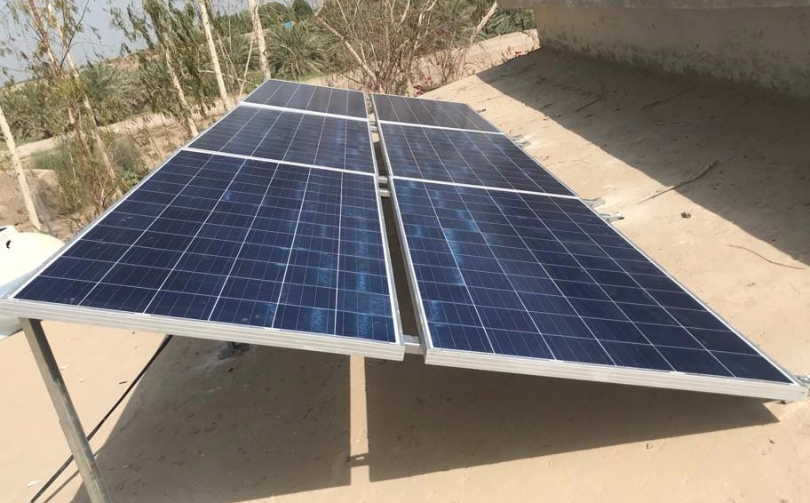





Improvement of Health Service Delivery through Integrated Health Systems Support Approach in Bangladesh, Kenya, Myanmar, Pakistan and Tanzania
AUTHORS: Asrat Dibaba, Abena Thomas, Melanie Gillespie, Miriam Chang, Barbara Main, Claudia Berloni
World Vision Canada, Mississauga, Canada
ENRICH is Igniting a Movement to Transform Communities
Background
Enhancing Nutrition Services to Improve Maternal and Child Health in Africa and Asia (ENRICH) is funded by Global Affairs Canada to improve the health and nutrition status of mothers, newborns and children in select regions of Bangladesh, Kenya, Myanmar, Pakistan and Tanzania.
ENRICH is implemented by World Vision Canada in collaboration with Nutrition International, HarvestPlus, Canadian Society for International Health, and the University of Toronto’s Dalla Lana School of Public Health.
Direct Beneficiaries
Two Million People
March 2016 to March 2021
CAD $47 Million
Program Interventions
Goal: to contribute to reduction of maternal and child mortality in the five countries.
Strategies:
Strengthen health systems and improve nutrition of pregnant women, infants and young children during the first 1,000 days from conception to 24 months of age.
Improving delivery of nutrition-specific interventions such as educating mothers about appropriate nutrition practices, breastfeeding and complementary feeding and micronutrient supplement to children.
Increasing production and consumption of nutritious foods (biofortified crops and nutrient-dense fruits and vegetables)
Strengthen governance, policy and public engagement of Maternal, Newborn and Child Health (MNCH) in Canada and target countries.
Health Systems Strengthening
ENRICH supports four of the six health system building blocks: service delivery; health governance; health information; and medical products, vaccines, and technologies.
Achievements
Improved access, quality, efficiency and responsiveness of MNCH services through:
provision of medical equipment, means of referral (boat ambulances),
on the job training to health workers,
rehabilitation of infrastructure, and construction of additional rooms,
training on Planning, Budgeting, Leadership & Management to regional and district health medical teams,
Key outputs are presented in the graph below.
Leadership/ Governance
Health Workforce
Information and Research
Healthcare Financing
Medical Products, Technologies
Service Delivery
Key Outputs, March 2016 to March 2018
Sample medical equipment distributed
Community midwives training
A trained CHW with his kit
Boat ambulance
New building for community midwives training & solar panels for lighting
Local Ownership and Sustainability
Health workers were trained on basic care and equipment maintenance,
Train-the-trainer method with local trainers allowed broad dissemination of new practices and skills,
Community groups (Citizen Voice and Action) were established, trained and supported to monitor quality of health services and demand improvement.
Acknowledgements
The program is funded by Global Affairs Canada, Manitoba Council for International Cooperation and World Vision Canada.
For further information contact
Dr. Asrat Dibaba (MD, MPH)
Chief of Party, ENRICH
World Vision Canada asrat_dibaba@worldvision.ca

