Slide 1
Fighting Poverty with Lean Six Sigma
Andrew Parris, PhD – World Vision International

Slide 2
Outline
Who is World Vision?
What is the experience of poverty?
How does World Vision fight poverty?
How do Lean Six Sigma help fight poverty?
How can you help fight poverty?

Slide 3
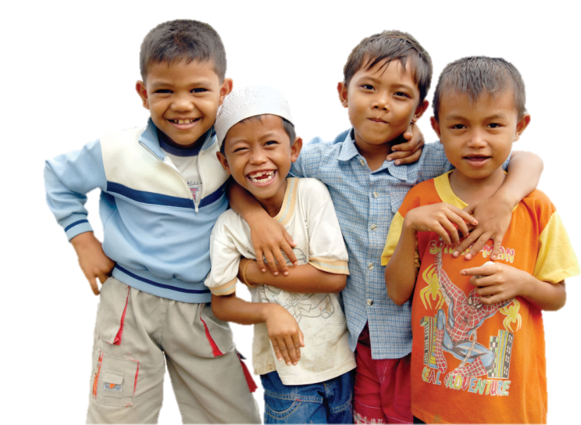
Who is World Vision?
A Christian relief, development and advocacy organization
dedicated to working with children, families and communities
to overcome poverty and injustice.
$2.7 Billion in revenue (2013)
45,000 staff in nearly 100 countries
(www.worldvision.org)


Slide 4












Land of Plenty


Slide 5
Experience of Poverty


Slide 6
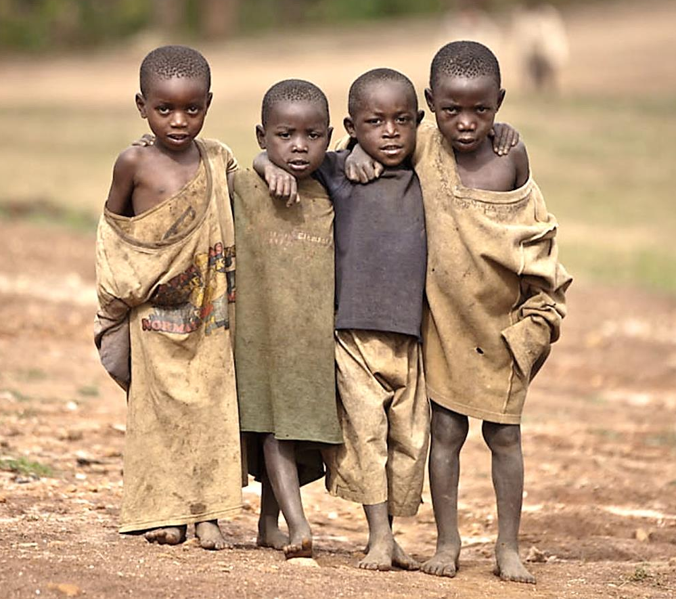
Walking with the Poor
-book by Bryant Myers
Yes, we need your help. But don’t just give us things. That only reinforces our sense of inferiority, and doesn’t really solve anything.
Rather, come, walk with us. Join us in our journey out of poverty. Be part of our story, and we will be part of yours.


Slide 7

We Have Something to Give
We have joy and hope for the future. We have ideas and resources. We want to do great things, and we need your help.
We understand poverty and have the street smarts to survive. Teach and empower us to change our world. And we will teach you many things, too.
If we band together, we will all benefit. We can make great music, and sing, and dance, and celebrate life.


Slide 8

How Does WV Fight Poverty?
Video
Community
Development

Slide 9
How Does WV Fight Poverty?
Listen
Develop
Act
Train
Understand the problems and goals
Plan how we will work together
Address the root causes of poverty
Build capacity to ensure sustainability
Define
Measure
Analyse
Improve
Control


Slide 10

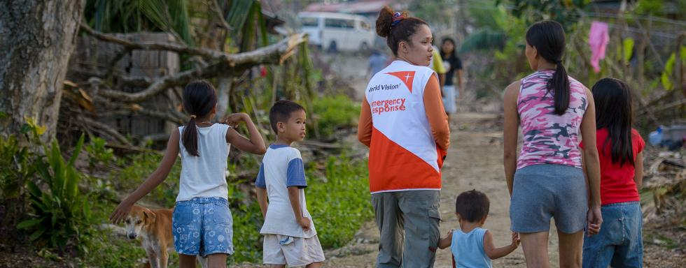
Transformational Development
We join their story and walk with the poor…
  To recover identity and discover vocation
  To promote just and peaceful relationships

Slide 11
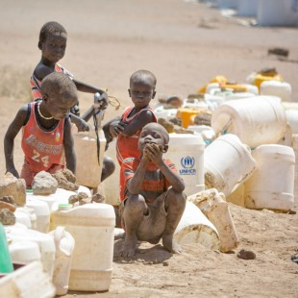
Fighting Poverty is Hard!
Historical, political and cultural barriers
Multiple causes of poverty
Uncontrollable events
Dangerous contexts
Working with people
Transforming lives

Slide 12
And Very Rewarding…
Video
Disaster
Relief

Slide 13

Common problems…
Unpredictable problems and crises
Delays in hiring people and procurement
Long travel distances over poor terrain
Materials are too expensive
Excessive approvals
Poorly defined processes
Waste, variation and frustration


Slide 14
WV Process Excellence
Effective
Impact
Efficient
Performance
Corporate World
Lean, Six Sigma,
Business Process
Management…
Continuously
Improving
Appropriate
To Context
Empowering
Stakeholders
World Vision/NGO
WV Core Values,
Partner Principles,
Strategic
Mandates


Slide 15
WV Process Excellence
Effective
Our processes are reliable
and timely, and enable
transformation
Efficient
Our processes are simple, standard, and integrated
Continuously
Improving
We are accountable,
correct problems quickly,
and apply learning
Appropriate
We respect all stakeholders,
are flexible, and use
appropriate technology
Empowering
We make decisions locally,
partner with stakeholders,
and have needed
capacity


Slide 16
WV Process Excellence Goal
To deliver the greatest value with the fewest resources
at the right time and in the right way


Slide 17
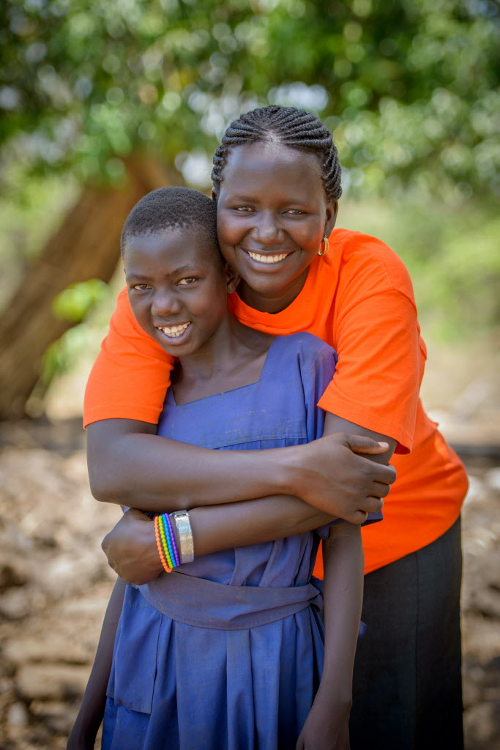
How Can LSS Fight Poverty?
Help me,
us fight


Slide 18


Process Excellence means…
More girls going to school
More children immunised
More children protected
More clean water
More life!


Slide 19
A Few Facts About East Africa

Slide 20
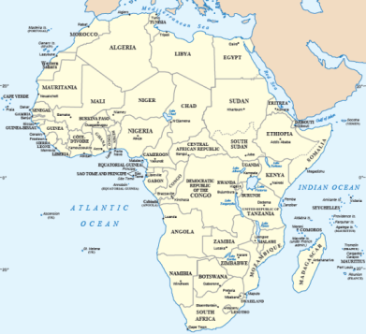
East Africa - Geography
World Vision operates in 9 East African countries


Slide 21
East Africa – Key Indicators (UNDP, 2012)


Slide 22
LSS Fighting Poverty in East Africa

Slide 23




LSS in WV East Africa
56 LSS Green Belts
and 11 Black Belts
(PI Leads for Office)
450 Staff and Leaders Energised
for Process Excellence
33 PIPs, 32 WMIBs
Contributing to:
Reduced underspending
Transformed culture
Improved reputation
Mobilisation of resources
Reduced span time by average 59%
(on targeted processes)
Reduced annual costs
by over $1.5 Million


Slide 24
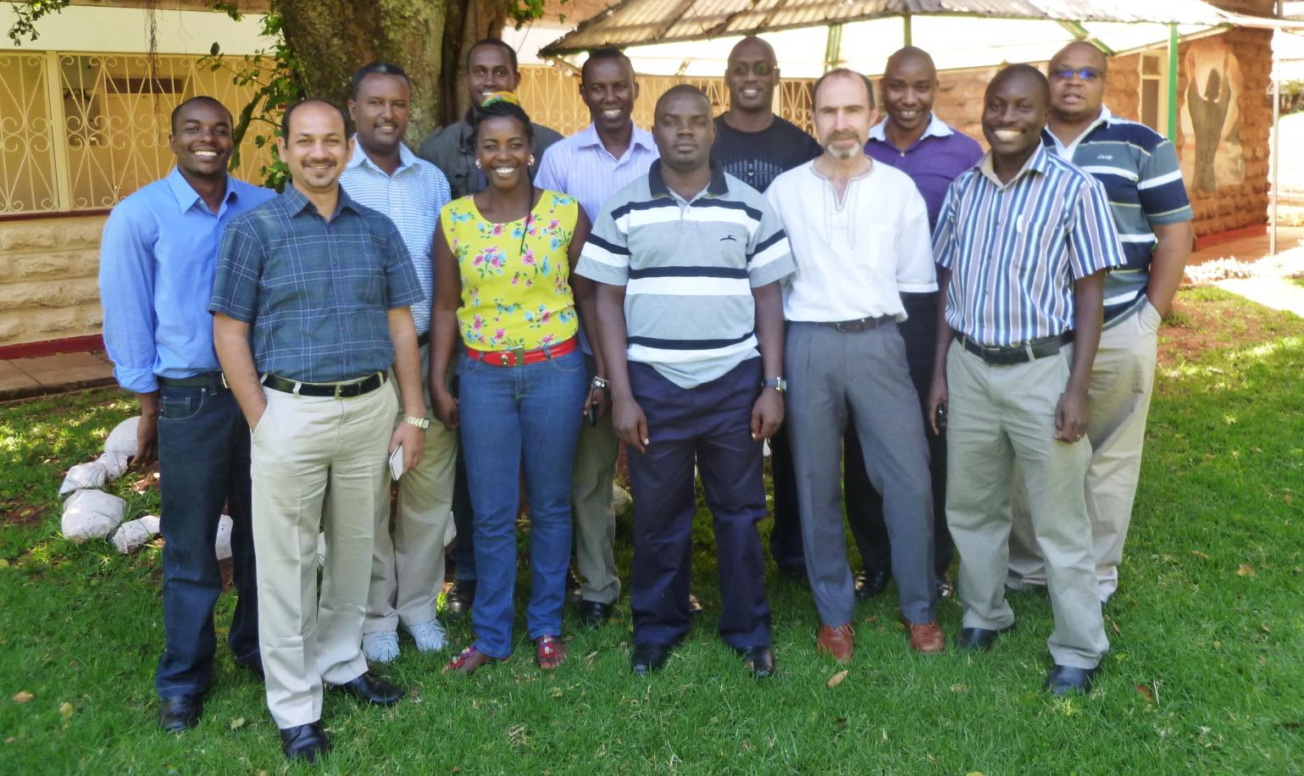
My L6σ Black Belts

Slide 25
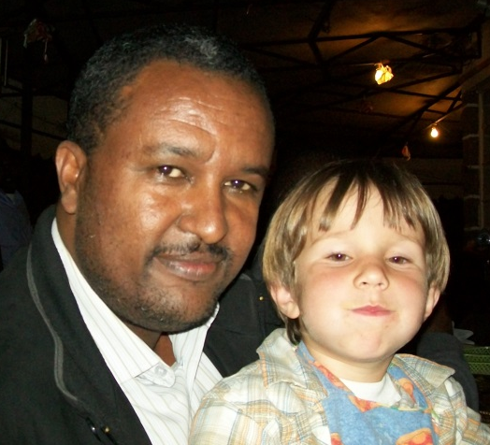
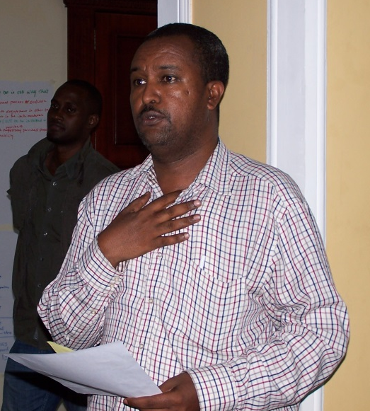
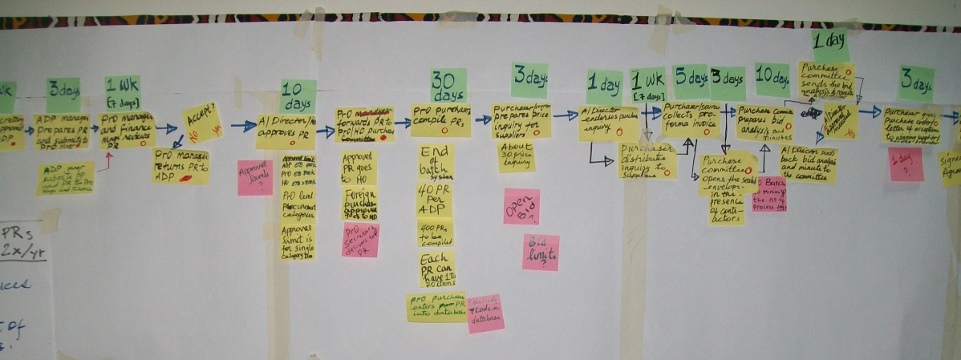
Abebe Nigatu (Ethiopia)
Worked in gov’t with BPR
Championed 6 PI projects
Recruitment:
130 → 41 days!

Slide 26

Darine Ndihokubwayo
(Burundi)
Lead role in Procurement project
  $140K annual cost red.
More projects than any other office (16)
Visual mgmt. in food distribution in S Sudan

Slide 27
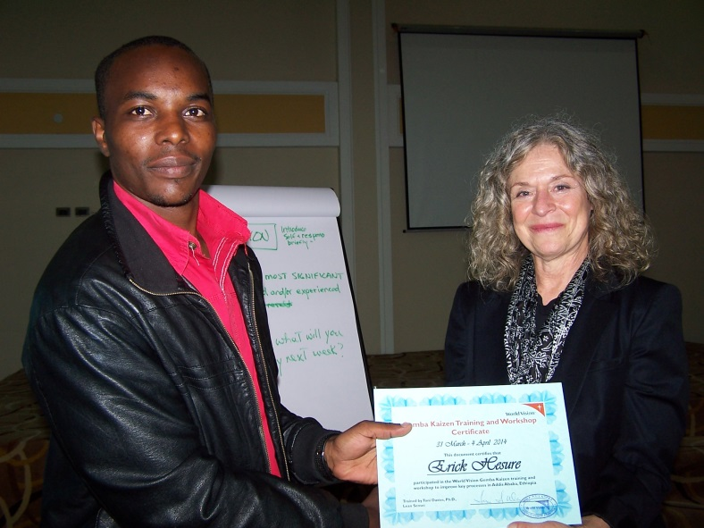
Erick Gesure (Kenya)
Overtime → project time
6 mo assignment with FPMG
Travelling to train and facilitate

Slide 28
How Can You Help the Fight?

Slide 29
CSR
Triple
Bottom Line
Corporate Social Responsibility
  Corporate initiative to assess and take responsibility for the company’s effects on the environment and impact on social welfare.
  …beyond what may be required by regulators or environmental protection groups.
  (Investopedia)
Profit
Planet
People


Slide 30
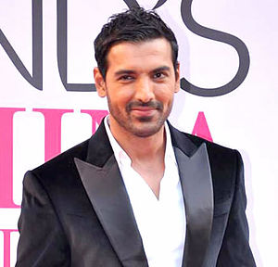
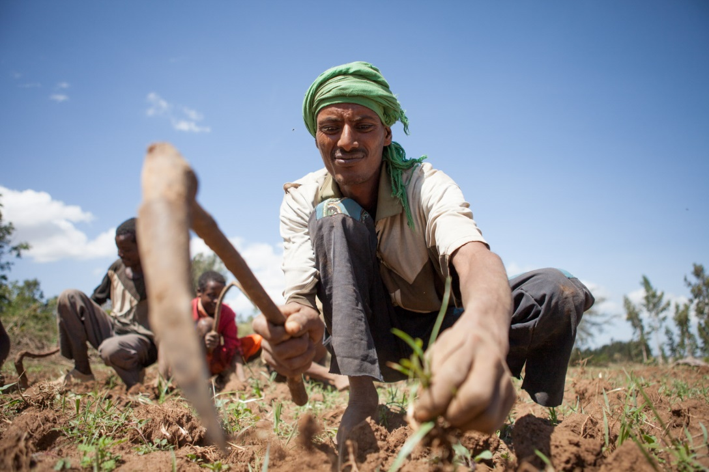
Why CSR?
To look good?
OR
To do good?
John Abraham (Wikipedia)
Mailu Terefa, VisionFund client in Ethiopia

Notes:
John Abraham (actor in India) - Wikipedia
Nelson Acut, father of Nancy Amua, plows his field with oxen purchased from a Gift Notification from Nancy's sponsor.

Slide 31
Donor demands of NGOs
Evidence of impact!
Innovation!
Partner with the private sector!
Increasing value for money!


Slide 32
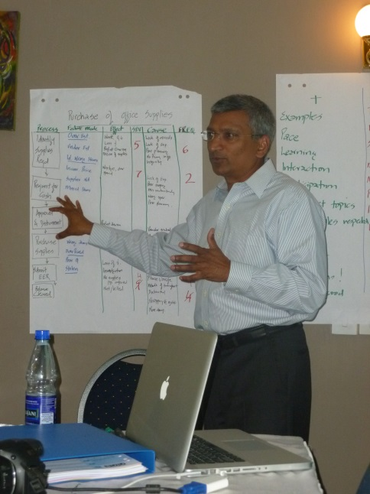




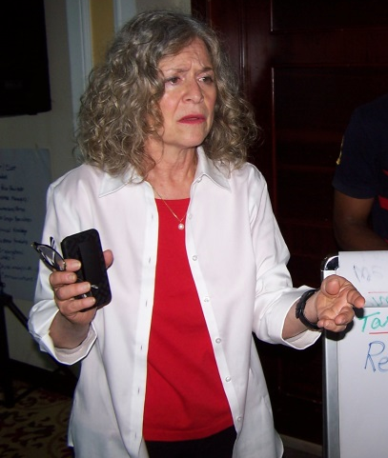



CSR Options
Partnership
to build Capacity
Environmental
Social
Meals per Hour
http://www.tssc.com/
Financial


Slide 33
What Do You Have to Offer?
Expertise in…
Finance
Lean Six Sigma
Innovation
Marketing
Strategy
HR
Technology
Distribution
Warehousing
Your Skill & Passion


Slide 34
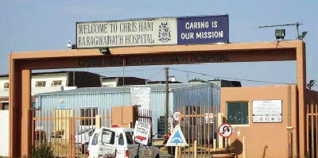



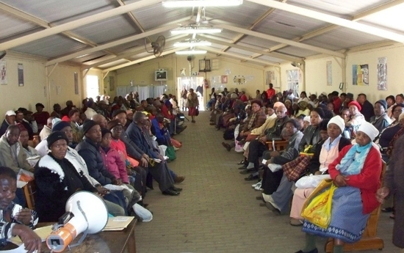

Where Can You Fight?
And anywhere in-between!
Chris Hani Baragwanath Hospital
(In South Africa, with BMGI)
These two photos are not from WV, but were found online
MIT
www.lean4ngo.org


Slide 35

Please take a moment…
To discuss at your tables
Brainstorm partnering ideas
  What do you have to share?
  Who may be potential partners?
Identify next steps

Slide 36



Dream of a better world
Make a difference
Join the fight
Thank you
Andrew_Parris@wvi.org


Slide 37
Details of
World Vision Process Excellence

Slide 38
World Vision Process Excellence
Effective: Our processes are reliable and timely, and enable transformation
Reliable: They consistently and safely deliver quality, valued outputs and results
Timely: They flow smoothly (minimum hand-offs, delays, rework) to provide output when it is needed
Transformation: They contribute to or facilitate contribution to “Life in all its fullness”
Efficient: Our processes are simple, standard, and integrated
Simple: They are intuitive, clear, concise, visually organised, and easy to perform correctly
Standard: They use defined, common workflows, tools, roles & responsibilities, policies, and expectations
Integrated: They seamlessly integrate with other processes and into a larger, optimised system
Appropriate: We respect all stakeholders, are flexible, and use appropriate technology
Respect: We honour all who are involved in or affected by our work, and their values and beliefs
Flexibility: We adapt to different contexts and respond easily to changing situations
Technology: We use reliable technology that is appropriate to the purpose, user, and use environment
Empowering: We make decisions locally, partner with stakeholders, and have needed capacity
Local Decisions: We make decisions transparently and as close to the action as possible
Partnering: We work with stakeholders to increase capacity, teamwork, outputs, and results
Capacity: We have the tools, skills, knowledge, and work culture we need to achieve outputs and results
Continuously Improving: We are accountable, correct problems quickly, and apply learning
Accountability: We own, measure, report, review, and act on process performance, outputs, and results
Correcting Problems Quickly: We make problems visible, promptly investigate them, and address root causes
Learning: We reflect, and proactively develop, apply, and share learning, best practices, and innovation
Notes:
38
Technology includes not just techniques, equipment, machines, and IT software and systems. Technology also includes the knowledge and practices that people have, and all the tools and systems that people put in place to deal with their problems or to find solutions.

