Slide 1
Health of Women, Adolescents and Children in Aleppo & Idleb Governorates
World Vision Turkey with
Hand in Hand, Syria Relief, Syria Relief and Development, Syrian Charity, and Violet
Core Group presentation
Tuesday 18th October
Hussein Assaf & Claire Beck

Slide 2
World Vision Turkey in partnership with Syrians
WV Turkey has been working in Northern Syria since 2013.
Aleppo Governorate: Jarablus & Manbej Districts
Health, WASH, Protection, NFI, Food Security.
With local partners
Hand in Hand,
Syria Relief,
Syria Relief and Development,
Syrian Charity,
Violet

Slide 3
Health needs women, adolescents and children
Because of the crisis over 1 million children under five have not been reached by routine immunization services, out of an estimated 2.9 million. Where services available access to vaccines can be limited.
Increasing number of child marriages.
Lack of medicines and treatment for chronic illnesses, including hypertension, diabetes, TB
The number of people seeking mental health care is increasing, especially those suffering from depression, anxiety, psychosis and stress related conditions.
Most of families have experienced the loss of a family member or close friend due to continued fighting.

Slide 4
Nutrition 2016
3.16 million children under five years of age and pregnant and lactating women (PLW) in Syria are at risk of malnutrition.
86,000 children aged 6-59 months suffer from acute malnutrition.
Over 600,000 children aged 6-59 months have micro-nutrient deficiencies.
1.8 million children under five years of age require supplementary feeding support to ensure an adequate nutrition status.

Slide 5
SRH issues
An estimated 300,000 women are pregnant and need targeted support – deliveries, emergency obstetric care, ante and post natal services.
A severe shortage in skilled-birth attendants, including obstetricians, resulting in major obstacles to providing care to an pregnant women who need targeted support.
Many clinics and maternity facilities staffed by nurses and midwives rather than doctors.
Women still want to deliver in hospital or midwife homes, but sanitation can be poor.
Limited post natal care – as women reluctant to visit hospital for complications.
Increasing number of women and girls needing post rape support and treatment.

Slide 6
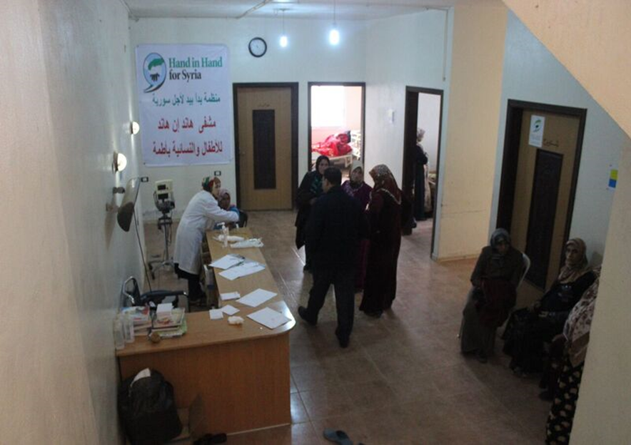
Health care services
Continued attack on health facilities and medical staff, and most health facilities are operating in buildings not designed for health service delivery.
The shortage of specialized medical staff, ambulances, equipment and medical supplies led to an increased number of preventable deaths.
Exodus of qualified healthcare workers, a 60 per cent drop in local production of pharmaceuticals, and a 50 per cent increase in prices of locally produced pharmaceuticals.
Only 10 per cent of primary health care centers provide basic mental health services.

Slide 7
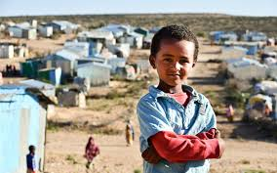
Living conditions
Lack of basic services including electricity, fuel, safe drinking water and basic sanitation services lead to increased vulnerability to disease outbreaks.
Living conditions are crowded due to living with host communities, in unfinished buildings or tents with little protection from the environmental factors (heat in summer and cold in winter). Plus constant movement to safer locations.
Limited access to basic needs - nutritious food, fuel for cooking and heating, livelihoods, education and social support.
Many households have sent male family members to Turkey or Jordan in hope for work and receiving remittances.

Slide 8
Atmeh Women’s and Children's hospital
Covers the need of women and children in the border camps and a radius of up to 80 Km.
Women’s Health Services include
Comprehensive reproductive health services
Pre and post natal care
Gynecologic surgery
Labour and delivery
In-patient unit with 20 beds
A separate women's outpatient clinic
Staffing includes: a gynecologist, resident doctor, senior midwives and nursing staff

Slide 9
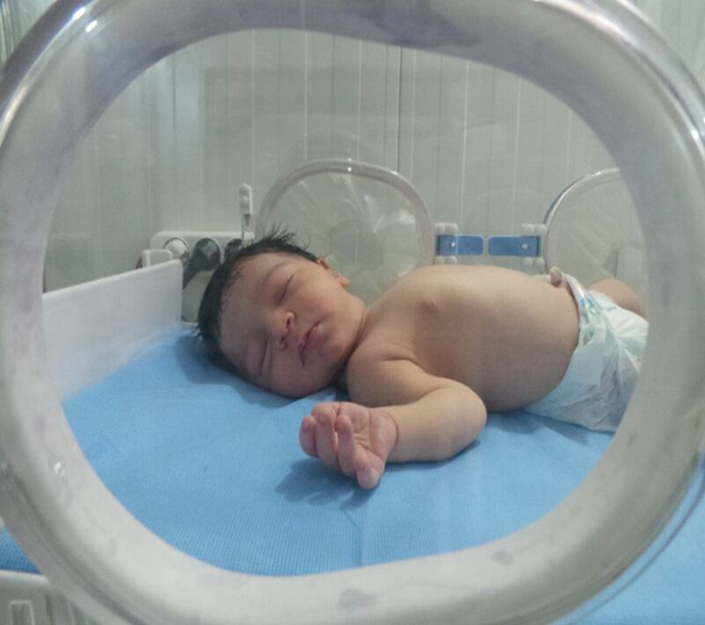
Atmeh Hospital cont.
Child Health and pediatric services include
22 beds for inpatients
The neo-natal unit with 14 incubators and 3 phototherapy units
Outpatient clinic for routine and emergency cases with referral to inpatient ward
IMCI clinic
Treatment for acute malnutrition

Slide 10
WV interventions in Northern Syria
Support the running and management of a number of Hospitals
Train/refresh hospital staff on evidence-based interventions (CEmONC, IMNCI, IYCF-e, CMAM)
Distribute clean delivery kits
Support WAYCS
Support of WASH facilities in camps communities and health facilities

Slide 11
WAYCS
Community outreach by CHW – IYCF,CMAM, IMCI, RH,PFA
Support to Women and children through health and nutrition and protection education IYCF – including
Breastfeeding and relactation support
Only 20-40% children <6months are exclusively breastfeeding
Approximately half the children 0-5 months receive formula or raw milk
Between 35-60% children < 6 months received water in addition to breast milk
Complementary feeding.
Screening for acute malnutrition and referral to Atmeh and Azaz hospitals

Slide 12
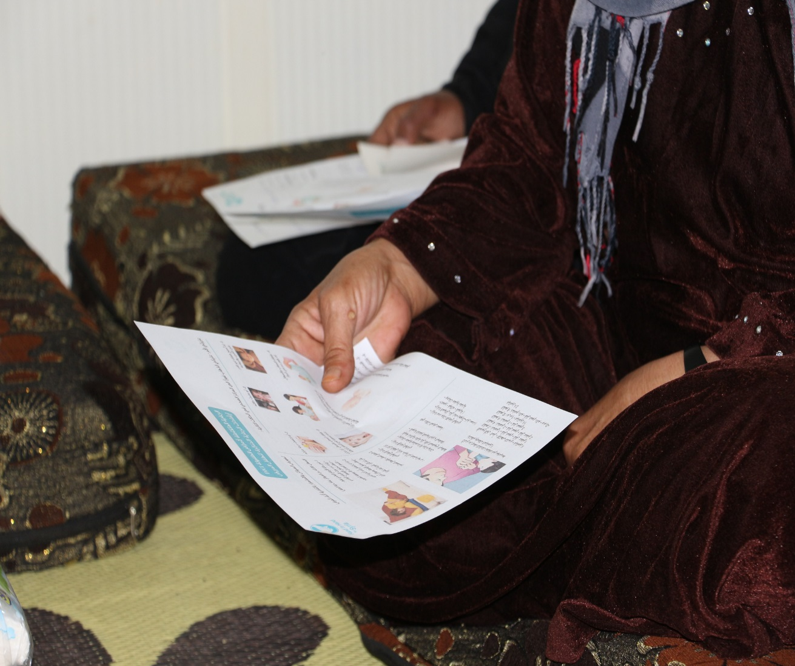
WAYCS continued
Antenatal care and pre birth education.
Nutrition education for pregnant and lactating women and adolescents.
Privacy and a safe meeting space for women outside the tents and temporary shelter.
Support groups and counselling corner.
Referral for medical treatment.
Community information, protection education and support.

Slide 13
Challenges
Security Challenges: Bombing of Health Facilities and Ambulances.
Physical Access: to besieged areas and hard to reach areas.
Human Resources: the majority of health staff fled to the border area and neighboring countries.
Remote access: limited so the majority of staff in the field can not attend training in Turkey, and Turkey based staff can not visit the field for management and support.
Communications: limited phone coverage, limited internet access.

Slide 14
Thankyou for listening

