Slide 1
iCCM Project Model Orientation Series
July 2014

Slide 2
Overview of the
iCCM Project Model

Slide 3
What is CCM / iCCM?
CCM utilizes trained, supervised community members, linked to facility-based services, to deliver curative interventions in the community.
These community members can be formal Ministry of Health (MOH) outreach workers, paraprofessional Community Health Workers (CHWs), or private sector workers, among others. CHWs may perform their duties from their homes, a community-constructed building, or government or private health facility.
Integrated Community Case Management (iCCM) is a strategy to train, support, and supply community health workers (CHW) to provide diagnostics and treatment for multiple illnesses specifically pneumonia, diarrhea, and malaria for sick children of families with difficult access to case management at health facilities.

Slide 4
Rationale for iCCM
The formal facility-based health system in most developing countries achieves only about 40% coverage.
80% of children die at home under the care of the family
Many children live more than five kilometers from a health facility and are brought too late for care or not at all.
Many children either do not get treatment for common treatable diseases, or they get treatment of unknown quality:
Only 27% of children with suspected pneumonia would receive an antibiotic
Only 39% of children with diarrhea would get proper management with ORT
Only 34% of children with fever (suspected malaria) would receive antimalarial medicines
Notes:
I’ll go through one of the problem stories with you. This would be in the form of a flip book, with the narrative on the back. We can talk about the drawings themselves afterwards if you’d like.
Clara esta embarazada. Empieza su dia molendo su maiz. Su olla esta lista para que pueda cocinar la comida para el dia.
Biba is pregnant. She starts her day by grinding her maize. Her cooking pot is ready so she can begin to prepare food for the day

Slide 5
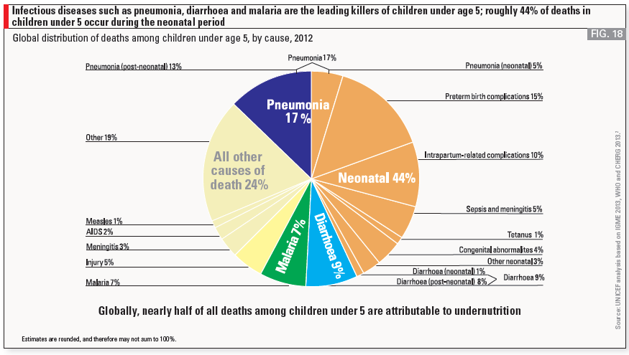
Leading causes of death

Slide 6
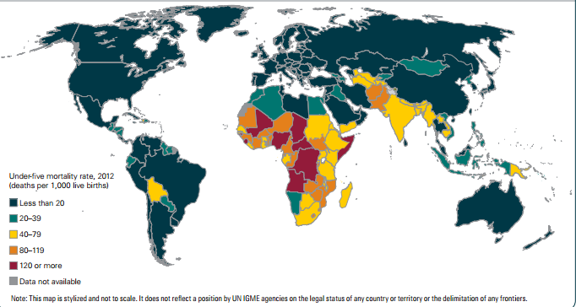
Why do we need iCCM?
Nearly half the world’s under-five deaths were concentrated in Sub-Saharan Africa in 2012.
Child mortality rates concentrated in HRH crisis countries, predominantly due to major killers; diarrhoea, pneumonia and malaria.
http://www.who.int/maternal_child_adolescent/documents/levels_trends_child_mortality_2013.pdf?ua=1

Slide 7
Why iCCM?
CCM targets the conditions that cause the most child death in developing countries. - pneumonia, diarrhoea, malaria, and neonatal causes.
CCM relies on evidence-based and one of the most cost effective child survival interventions - proven to save the lives of newborns and children under five, at a price that is affordable in developing countries.
CCM brings curative health care to children in those communities that are hardest to reach.
CCM is consistent with practices recommended by WHO, UNICEF, and other international health agencies. WHO, UNICEF, and other international agencies have jointly called on countries to adopt and promote policies and programs that have strong community-based components to deliver interventions for diarrhoea, malaria, pneumonia, newborn care, and acute severe malnutrition, while improving services at first-level health facilities.

Slide 8
Infectious Diseases within 7- 11 Strategy
Maternal health | Child health (0-24 months)
Adequate diet | Appropriate breastfeeding
Iron-folate supplements | Essential newborn care
Tetanus toxoid immunisation | Hand washing
Malaria prevention and intermittent preventive treatment | Appropriate complementary feeding (6-24 months)
Healthy birth spacing and timing | Adequate iron
De-worming | Vitamin A supplements
Access to antenatal care, skilled birth attendance, prevention of mother to child transmission, HIV and STI screening | Oral rehydration therapy/Zinc
 | Care seeking for fever
 | Full immunisation coverage for age
 | Malaria prevention
 | De-worming (+12 months)
Direct Infectious Disease interventions are highlighted in blue and interventions which contribute to prevention and reduction of infectious disease are highlighted in grey.

Slide 9
iCCM Strategy:
World Vision’s Approach

Slide 10
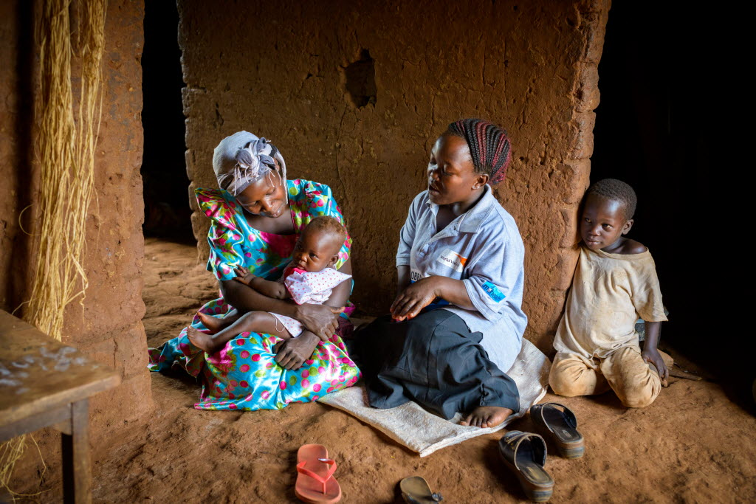
Target groups for iCCM interventions
Population living five kilometers away from health facilities in our ADPs
Poor and vulnerable households (most of these are beyond five kilometers of health facilities)

Slide 11
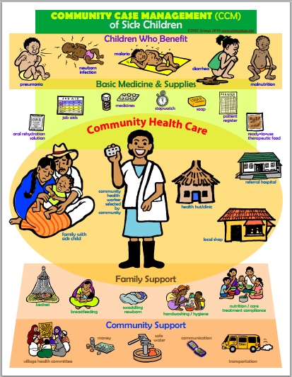
360⁰ of support: households to
health systems
Family support
Demand
Preventive practices
Community systems
Supply chains
Referral, transport and communication
Training and supervision
IMCI based facility level secondary management

Slide 12
WHAT: iCCM Programming Strategy
Four building blocks
Access (effective access): defined as access to trained providers and to appropriate medicines
Quality: standard protocols for services delivered, a quality assurance plan based on supervision and refresher trainings
Demand: CCM increases care seeking behavior by addressing common barriers to care seeking e.g. cost, transport, loss of productive time, and shortened distance
National Policy: seeking to influence the formulation (and implementation) of national policies that promote ICCM integration and scale up within the health services.

Slide 13
iCCM Strategic Framework
To reduce mortality among children under 5 from common childhood illnesses by increasing the use of curative and preventive interventions.
Demand
Access
Quality
Systems
Outcome 1.
Caregivers demand for essential health services
Outcome 2.
Children receive treatment in a prompt and timely manner
Outcome 3.
Improved quality of services at the community level
Outcome 4.
Local health services are linked to and supportive of quality CCM.
Output 1.1
Caregivers counselled on recognition and detection of symptoms of child illness
Output 2.1
CCM treatment coverage by CHWs increased
Output 3.1
CHWs knowledge on case management increased
Output 4.1
Health systems and local partners have increased operational structures to support CCM
Output 1.2
Caregivers counselled on optimal practices for home based care of the sick child
Output 2.2
Caregivers enact timely and appropriate referral for severe cases (referral compliance)
Output 3.2
Trained CCM CHWs are routinely supervised
Output 4.2
(HMIS) Data monitoring systems include CCM indicators and are used for evidence based management and supervision
Output 3.3
Community health structures provide oversight and management of CCM services
Output 1.3
CHWs conduct follow up visits for counselling and treatment adherence
Output 2.3
Sick children receive appropriate home-based and post referral follow up by the CHW
Output 4.3
CHW supervisors utilise improved CHW management systems, tools and job aids
Output 3.4
Community leaders promote awareness, uptake and quality of CCM services.
Output 2.4
Children or households at high risk of child death are identified and regularly monitored.
Output 4.4
Medical supply chains are functional and continuous with no stock outs at facility levels
Think: Sustainable systems not interventions
Output 3.5
Community medicines and stocks are well managed and are available to the CHWs

Slide 14
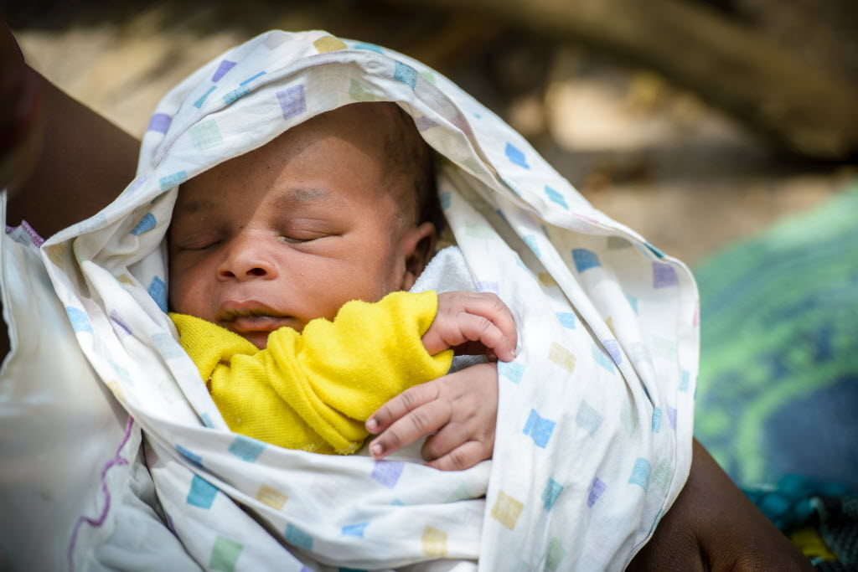
iCCM Technical approaches - Integration of newborns
Where policy permits:
Improved training on recognition and referral of newborn infections
Integration of chlorhexidine cleaning of the cord stump
Improved detection and referral of breastfeeding difficulties
Antibiotic treatment of newborn sepsis
Where policies are lacking
Engage advocacy efforts
Partner up
Further research needed...

Slide 15
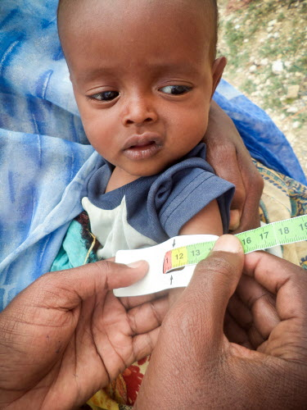
Integration contd
Integrating nutrition, HIV & TB
Support the recognition and referral of acute malnutrition or GMP
Integrate support for paediatric HIV and TB case identification and referral
Improve nutrition practices for infants and children through ttC or similar
Integrate nutrition treatment protcols where possible
Strengthen referral and counter referral communication
Ensure linkages between iCCM CHWs and HIV / CMAM facility based programmes
Further research needed.....

Slide 16
Package of services
Community
Promote demand for quality services and uptake of iCCM
Education on the detection of childhood infections
CHWs
Initial and ongoing training, on the job mentoring
Equipment, resources and job aids
Medicines and stock management
Monitoring and supportive supervision
Systems strengthening
IMCI based severe case management
Supply chain management
COMMs support
Referral support
Linkage and communication with health services

Slide 17
CHW AIM Framework
Direct / financial support
Community engagement
Advocacy role

Slide 18
Our Approach
Current Technical Approaches
Integrated rather than single disease approaches
Include newborns in the iCCM model where policies allow
For high hunger contexts, the integration of CMAM and iCCM
Paediatric TB & HIV treatment should be integrated where possible
Applying CHW PoP -Principles of practice
Formal recognition and pushing up the cadre
Promoting country ownership and leadership of the model and formal integration into health service
Sustainable systems approach
Harmonize approaches amongst partners & consortia – not ‘going it alone’
iCCM is a health systems strengthening activity rather than a project
Consider grant-based programmes as ‘start-up’ with the aim to lead into integration

Slide 19
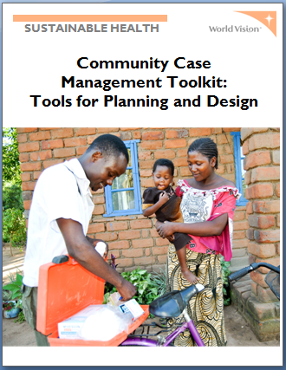
The CCM Toolkit
https://www.wvcentral.org/community/health/Pages/CCM.aspx
https://www.wvcentral.org/community/health/HNH%20Wiki/Community%20Case%20Management%20Toolkit.aspx

Slide 20
Preparatory tools (Deployment & Policy)
CHW principles of practice
CHW AIM & CHW programming standards
CCM Implementation standards
CCM results framework & indicators
Are globally applicable
Used to guide World Vision programming
Set precedents and standards
Not for adaptation
Identify programming and policy weaknesses
Identify key areas for advocacy

Slide 21
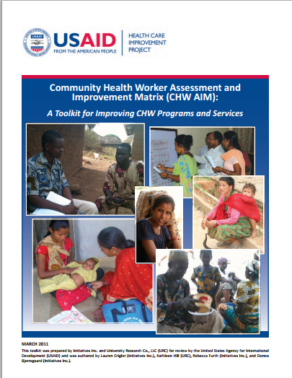
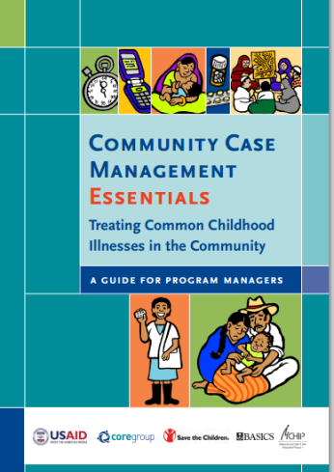
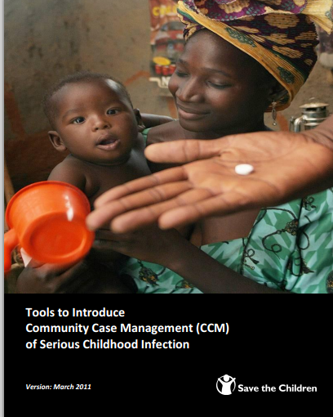

External tools
CHW AIM – USAID
CCM Essentials guide - The Core Group guide for programmer managers implementing CCM. Covers all key areas of design, supervision, and implementing CCM
Save the Child CCM Toolbox
Tools to Introduce community case management of serious childhood infection, March 2011
Also - see
CCM Central – core indicators, benchmarks (policy and planning)
Supply Chain and CCM Resources

Slide 22
Operational tools (quality & access)
Supervision tools
Basic tools sample set (stocks & records)
Referral / counter referral tools
High risk household targeting
Examples
Can be completely contexualised to your country
To take home and discuss with your MoH and National coordinating bodies.

Slide 23
CCM Toolkit
Provides you with sample tools you require for iCCM roll out
ICCM Quality Standards
Generic results framework
Generic M&E tool
Commodities quantification tool
Always work with local MOH to develop and introduce programming tools

Slide 24
Global Status of iCCM
in World Vision

Slide 25
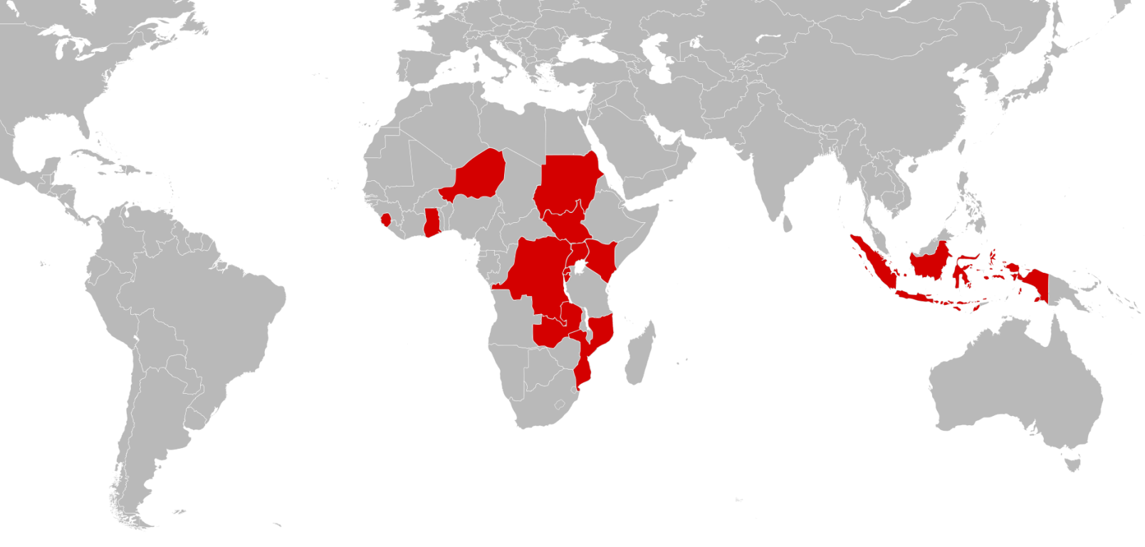
Where is iCCM happening?
Sudan, South Sudan, Uganda, Kenya, Rwanda, Burundi, Zambia, Mozambique, DRC, Niger, Ghana, Sierra Leone, Indonesia

Slide 26
iCCM Roll Out
National Office | Level of roll out
Burundi | ICCM part of Technical Approach National dialogue Secured $1.2M funding from Korea
Ghana | National level discussions Partnering with
Kenya | National level engagement iCCM part of GIK policy Five ADPs prioritized for iCCM Clear scale up plan in place
Mozambique
Niger | WHO $10M RAcE grant – not in WV operational areas

Slide 27
NOs with iCCM roll out
National Office | Level of roll out
Rwanda | iCCM in Technical Approach
Sierra Leone | All ADPs budgeted for iCCM
Sudan | Received Irish Aid/Unicef grant with iCCM
S. Sudan | iCCM grant
Uganda | ICCM in Technical Approach Model adopted by ADPs National level engagement Lobbied to be included in the pilot phase of central government system iCCM – one WV district included
Zambia | ADP Implementation National level discussions

Slide 28
iCCM START UP: Challenges and feedback
Resources – Commodities
Quality of medicines – alignment with essential medicines list
Must apply standards
iCCM is not cheap; it is not about software; it is about filling a treatment gap, and this gap has to be filled with commodities!”
Weak health systems for ease of roll out
Supply chain management
Supportive supervision and quality control
Changing landscape - Uganda
Budget constraints for easy integration

Slide 29
iCCM: Better practices identified
CHW AIM functionality tool
Integration with existing systems
Solving the supervisor gap:
Group supervision methods
Lead CHWs/ buddying
Mobile TTC development

Slide 30
Where are we heading?
Alignment between National Strategies, procurement plans and iCCM role out
Matching the pharmaceutical resources to the need – essential commodities to where its needed
Promote quality standards in procurement and distribution for iCCM
Long term planning – on what, where & how?
Health Systems - feeding into the local supply chains?
Sustainability – buffer stocks, cost recovery
Harmonization with partners?

Slide 31
Financing Model
for iCCM

Slide 32
How much does it cost?

Slide 33
iCCM COSTING AND FINANCING TOOL
Total <5 Population in iCCM Coverage Areas
Incidence Rates for iCCM Treatments
Total Expected Caseload
Direct CHW Time per Case
Other Direct Resource per Case (medicine etc.)
Total Direct Resources Required
Total Direct Salary Costs
Total # of CHWs Needed
Time Available on iCCM per CHW
Total Medicine and Supply Costs
Total Program Startup (Training Costs)
Total Indirect Costs (Supervision etc.)
Total Direct Salary Costs
Total Program Startup (Training) Costs
Total Medicine and Supply Costs
TOTAL iCCM PROGRAM COSTS

Slide 34
Costing, Cost-effectiveness and Financing of i-CCM programs Lessons
Not all iCCM programs are created equally; costing must accurately account for variations due to contextual factors and different iCCM models
Costing exercises must occur in conjunction with planning and policymaking
The importance of linking cots to progress through good M&E is also crucial
Developing a clear and realistic financing plan is critical to achieving sustainability

Slide 36
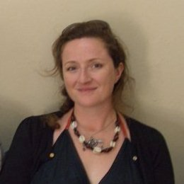
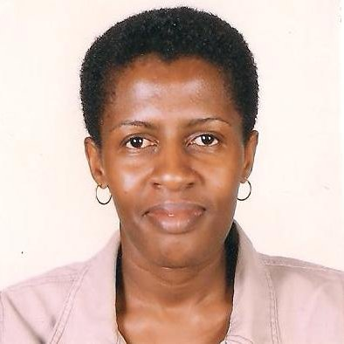
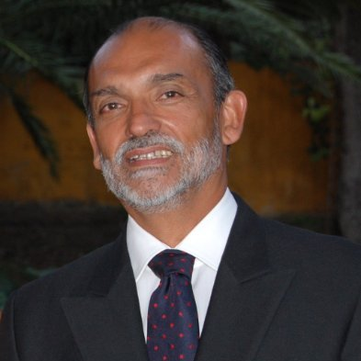
Who are the Champions?
GTRN Registered iCCM Strategists:
Joan Mugenzi
Polly Walker
Alfonso Rosales
iCCM Technical Working group : Champions:
Gagik Karapetyan
Abena Thomas
Azadeh Baghaki
Ann Claxton (GF)
Dan Irvine (Pharma)
Register to be an iCCM practitioner / trainer / strategist on GTRN!!!

Slide 37
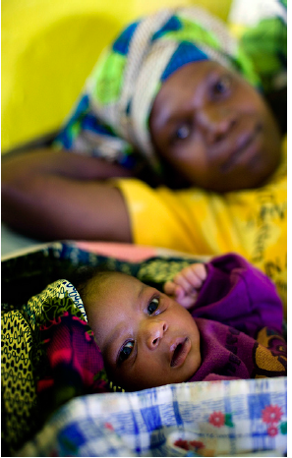
Thank You & Questions

