Slide 1
Can we integrate newborn care into iCCM?
Sue England
GC MNCH Technical Director
CHW IG meeting 13 August 2013

Slide 2
Overview of Session
Slow progress NMR within MDG 4
Reminder - causes of newborn deaths
Global experiences – community newborn care
WV experiences – South Sudan iCCM plus, Papua MNCH Indonesia, Mozambique, Afghanistan
Potential for improving newborn actions & integration into all WV technical approaches – strengthen ttC, iCCM, cPMTCT, nutrition

Slide 7
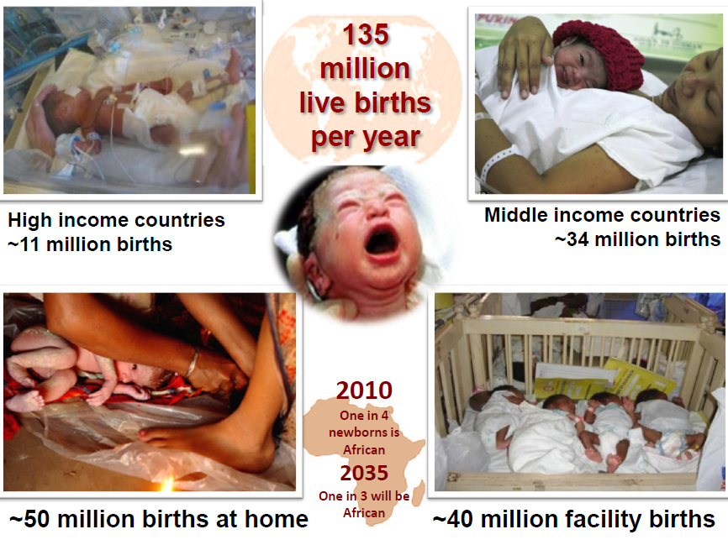

Slide 9
Essential Commodities for MNCH

Slide 10
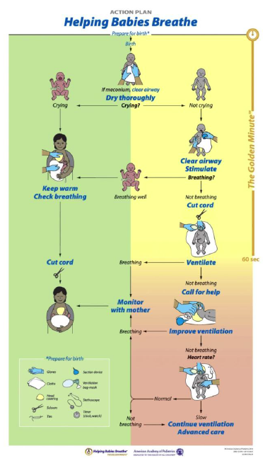

Slide 11
New Lancet series on nutrition
Reviewed Newborn interventions
Delayed cord clamping
Early initiation BF
Vit K
Neonatal Vit A supplementation
Kangaroo Mother Care

Slide 12
Can CHWs deliver newborn care?
WHO - Task shifting advice
Studies currently underway to simplify treatment regimes for newborn sepsis
Discussions with designers of HBB re teaching cadres like CHWs/TBAs
Need to study implementation by CHWs
This is our space!

Slide 13
Ethiopia – COMBINE study

Slide 15
How to Simplify Community based treatment of neonatal infection?

Slide 17
WV experiences
ttC being implemented now in 36 countries

Slide 18
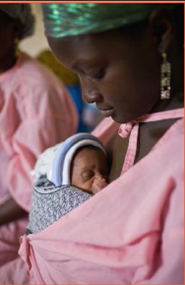
How can we reach more newborns?
Prevention strategies
Treatment strategies
Strengthen our core 7-11 CHW/TBA approaches to newborn care
Review ttC module 2 – Home visit number 5
Deliver chlorhexidine in last pregnancy HH visit
Review CoH MNCH
Review cPMTCT
Advocacy & Policy includes newborns – CHN, inputs into global ENAP
Strengthen nutritional approaches (maternal & newborn)
Strengthen iCCM to be more inclusive of newborns
Strengthen cIMCI
Introduce KMC module
Strengthen nutritional approaches to newborns (Vit K, Vit A)
Conduct Implementation research
Strengthen Monitoring and reporting CWBO #2

Slide 19
Thank You & Questions

