Slide 1
Working with Key Populations- Zimbabwe Global Fund Programme
Presented by: Sifiso Ndlovu
Behaviour Change Programme Coordinator

Slide 2
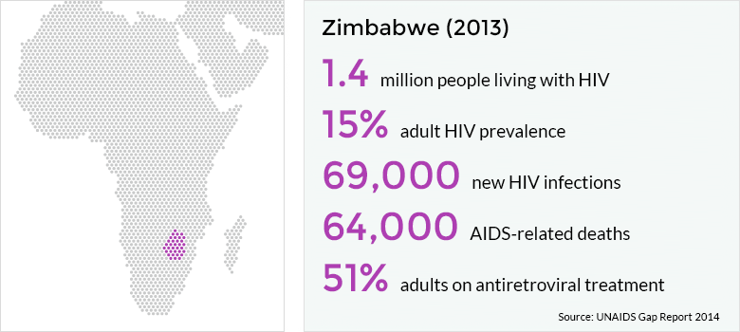
HIV in Zimbabwe
Notes:
-Zimbabwe has the fifth highest HIV prevalence in Sub-Saharan Africa at 14.7%( MICS 2014).
-1.4 million people are living with HIV including 170,000 children, equating to 4% of the global total.
-New infections dropped to 69,000 in 2013 a 34% decrease from 2005. Behaviour change communication and high treatment coverage are thought to be responsible.
-In the same year, there were 64,000 deaths from AIDS-related illnesses, a 57% reduction since 2005.
-890,000 children are orphaned due to AIDS.

Slide 3
Key affected Populations
The Zimbabwean HIV epidemic is largely driven by unprotected heterosexual sex.
There are now growing epidemics among key populations who are at higher risk of HIV.
National data on these populations is sparse, with data collection and reporting not featuring in national documents.

Slide 4
Sex Work in Zimbabwe
Sex workers and organisations representing them are not involved in the Zimbabwean response to HIV. This marginalises them and prevents them from accessing services.
Including this group in HIV prevention initiatives would have a much greater outcome on the health of sex workers and the population as a whole.
HIV prevalence between 50% and 70% in Victoria Falls, Hwange and Mutare.
Sex work is illegal, police use power to intimidate, arrest and harass sex workers, and possession of condoms is used as proof of sex work,
Confiscation of condoms hampers sex workers' ability to negotiate condom use with clients and heightens their risk of HIV.
Notes:
Around half of all sex workers in Zimbabwe are living with HIV. Smaller-scale studies have found much higher HIV prevalence among sex workers, such as between 50 and 70% in Victoria Falls, Hwange and Mutare. Half of those who tested positive during the study did not know they were positive. Only 25-30% of sex workers who tested positive during the study were accessing antiretroviral treatment. This is concerning in an environment where condoms are being confiscated and gender inequality makes condom negotiation difficult.
Sex work is illegal in the country, with police often using their powers to intimidate, arrest and harass sex workers. The possession of condoms is used as proof of sex work, with many sex workers reporting being arrested due to their work, or having their condoms confiscated. This hampers sex workers' ability to negotiate condom use with clients, if they haven't got any condoms of their own, heightening their risk of HIV.
Sex workers, and the organisations representing them, are not involved in the Zimbabwean response to HIV, marginalising them and preventing them from accessing services. Including this group in HIV prevention initiatives would have a much greater outcome on the health of sex workers and the population as a whole.

Slide 5
Women and HIV in Zimbabwe
Only 68% of men believe a woman has the right to refuse sexual intercourse if she knows he has sex with other women.
Only 8 out of 10 women believe women have the right to ask their partner to use a condom if he has a sexually transmitted infection (STI).
Notes:
720,000 women are living with HIV in Zimbabwe, of whom 70,000 are pregnant. The patriarchal society of Zimbabwe helps explain women's greater vulnerability to HIV.
Gender inequality is present within relationships and marriages, with only 68% of men believing a woman has the right to refuse sexual intercourse if she knows he has sex with other women. Similarly, only 8 out of 10 women believe women have the right to ask their partner to use a condom if he has a sexually transmitted infection (STI).
More than a quarter of women with a married or stable partner have experienced physical or sexual violence from their partner. This prevents women from being able to negotiate using a condom, and puts her at higher biological risk of HIV.
22% of women report that their first sexual intercourse was forced or against their will. This rises to 28% among women whose first sexual experience was under the age of 15.

Slide 6
Embedded within the NAC’s
Behaviour Change Programme
Overall goals
Reduce HIV acquisition among SWs
Reduce HIV transmission to their clients
Improve the rights of SWs
Sex Work and Behaviour Change Programme
Support group model from the Centre for Sexual and Reproductive Health and Rights (CeSHHAR)
Self Awareness
Physical Awareness
Financial Awareness
Assertiveness
Good Communication
Negotiation skills
Notes:
Overall Goals
-Increase uptake of integrated HIV prevention services especially among young people and key populations.
Sex Work and Behaviour Change Programme
-Follows a support group model adopted from the Centre for Sexual and Reproductive Health and Rights (CeSHHAR)
-Self Awareness
-Physical awareness
-Financial Awareness
-Assertiveness
-Good Communication
-Negotiation skills

Slide 7
target group mobilisation
World Vision and CeSHHAR identified peer educators. In places with no organisation doing sex work- they were identified through the community department from the Ministry of Health.
Target of 24 peer educators to cover the 2 provinces
(Mat-South and Bulawayo) as outlined in the DIP
Demographic Information
The programme works with sex workers between the ages of 15-49 with increasing concern of adolescent sex work.
In 2015, the programme reached out to 307 sex workers since programme inception
Notes:
World Vision worked with CeSHHAR to identify peer educators from the ladies that had fallen out during their initial mobilisation for their sex work programme. In places that did not have an organisation doing sex work- these were identified through the community department from the Ministry of Health.
Recruitment was based on interest and the intrinsic push to volunteerism.
This followed a stipulated target of 24 peer educators to cover the 2 provinces( Mat-South and Bulawayo) as outlined in the DIP
Demographic Information
The programme works with sex workers between the ages of 15-49.
Adolescent sex work is becoming a concerning issue in the operational areas
In 2015, the programme reached out to 307 sex workers ( 180- Mat-South and 127 Bulawayo) since programme inception across Bulawayo and Mat-South.
Between January- March 83 for Mat-South and 200 for Bulawayo

Slide 8
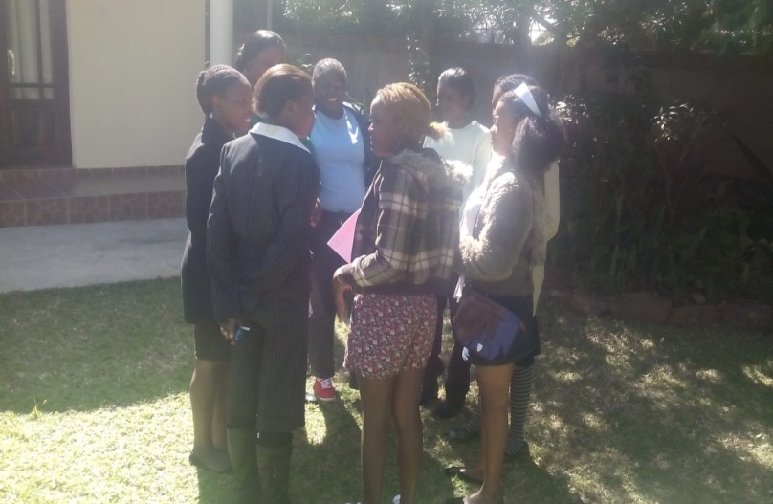
Steps to support Group Formation
Peer educators during training
1 Week Training of 24 peer group leaders on demand generation for SRH and support group formation facilitated by:
  Ministry of Health and Child Care,
  National AIDS Council, and
  CeSHHAR
Formed 15 member support groups
Receive support from programme staff to monitor group processes.
Notes:
The 24 peer group leaders were taken through a week long training on demand generation for SRH and support group formation being facilitated by the Ministry of Health and Child Care, National AIDS Council, CeSHHAR amongst other key Behaviour Change Programme Stakeholders.
The 24 peer group leaders went on to form support groups of 15 members each as guided by the support group formation principles.
They would receive frequent support from Programme staff just to monitor the initial group processes. External facilitators would also be invited to discuss technical SRH issues.

Slide 9
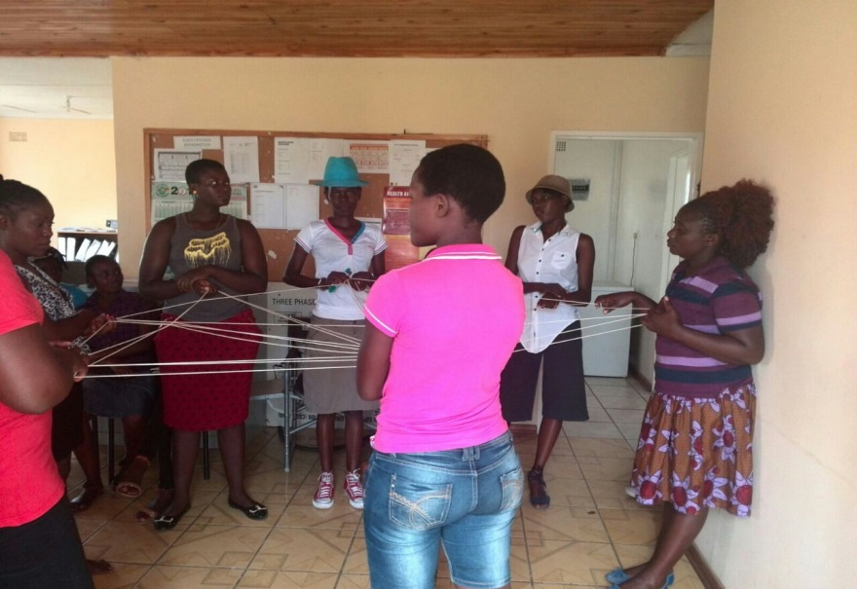
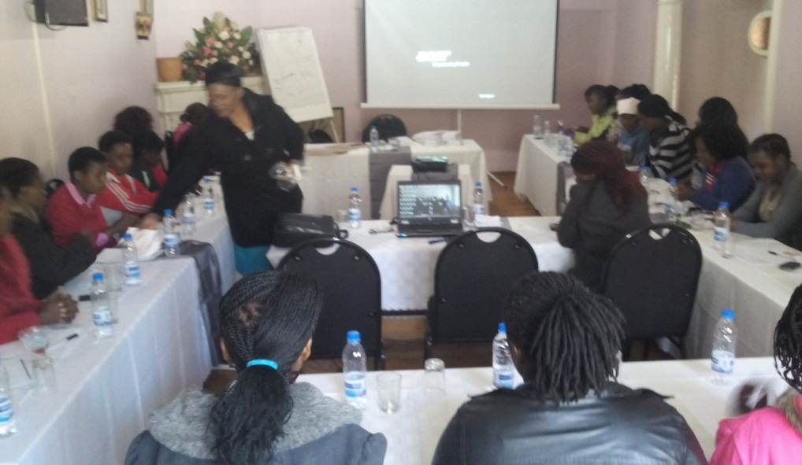
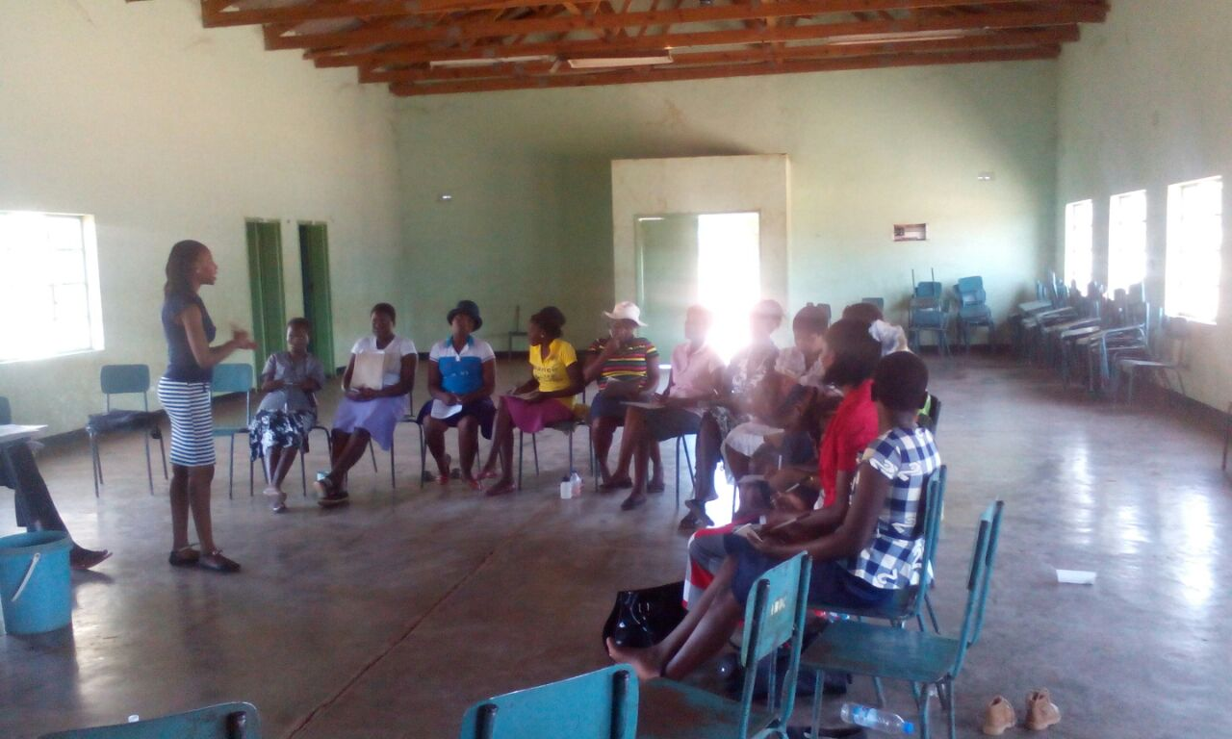
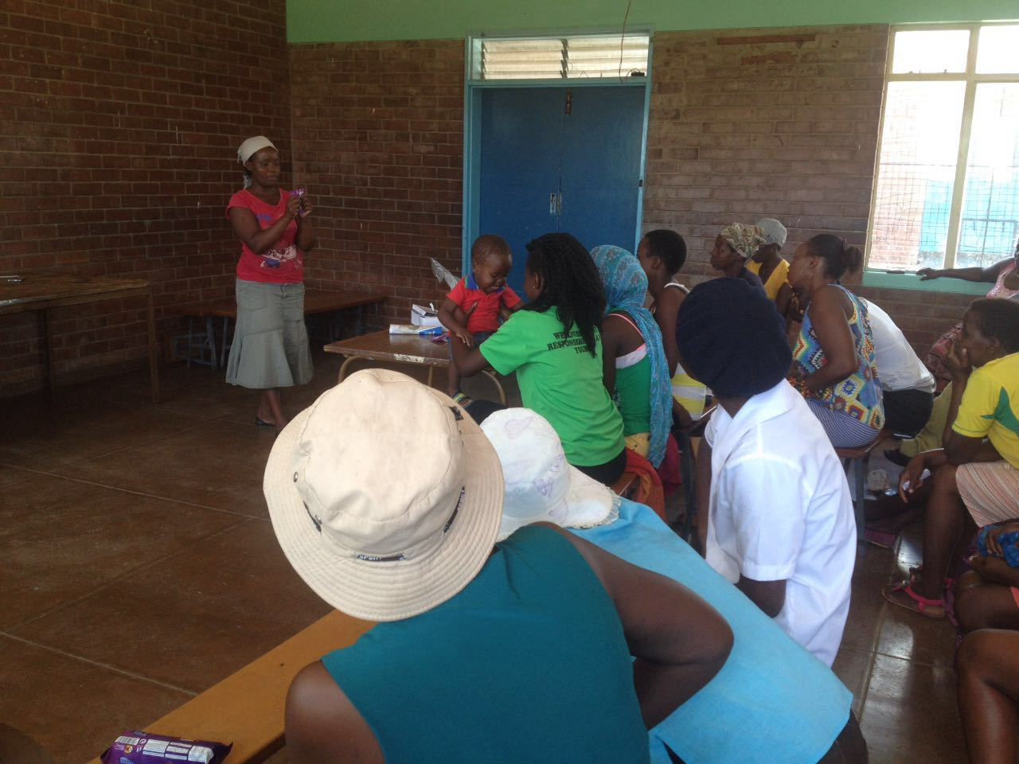
Trainings and Support group sessions in Pictures
Notes:
FREQUENCY OF MEETINGS AND SUPPORT FROM WORLD VISION
They meet twice a month being led by the peer educator
The BC programme provides refreshments and mobilises external facilitators to assist during discussions.
World Vision also engages service providers in cases where health services are required eg, booking appointments for cervical cancer screening

Slide 10
World Vision strives to ensure Members:
Are aware of their individual and collective vulnerability and are motivated to act.
Have practical knowledge of options to reduce their vulnerability.
Take action within their capability, applying their own strengths and investing their own resources (i.e. money, labour, materials, etc.)
Participate in decision-making on what actions to take, evaluate the results, and take responsibility for success and failure.
Notes:
Through the Support Group Model, World Vision Strives to Ensure That:
Members are aware, in a detailed and realistic way, of their individual and collective vulnerability to HIV and AIDS
• Members are motivated to do something about this vulnerability
• Members have practical knowledge of the different options they can take to reduce their vulnerability
• members take action within their capability, applying their own strengths and investing their own resources, including money, labour, materials or whatever else they have to contribute
• Members participate in decision-making on what actions to take, evaluate the results, and take responsibility for both success and failure

Slide 11
how World Vision Zimbabwe Interacts with Sex Workers :
Ensures active participation by this target group as possible
Facilitate for equal partnership and mutual respect within the society
Build capacity on sexual and reproductive health issues
Build on the realities of living with HIV and AIDS while maintaining hope based on community collective action
Meaningfully involve sex workers as agents of change

Slide 12
support group women are referred for:
Free condoms and contraception
HIV testing and counselling
Anti retroviral Therapy
Syndromic management of STIS
Safer sex counselling
Contraception
Legal advice
Support from peer educators

Slide 13
Change noted so far
Members have received cervical cancer screening
Reports on the adoption of condom use for safe sex
Participated in PMTCT
Report issues to do with Gender Based Violence
Access SRH services from referral centres such as:
  CeSHHAR,
  PSI, and
  Other public health service providers
Notes:
Support group members have undergone cervical cancer screening through Government hospitals and NGOs such as Population Services International(PSI)(72 went for cervical cancer screening between Jan-March 2016 for Mat-South and 94 for Bulawayo facilitating HTS for the same.
There has been reports on the adoption of the condom for safe sex (captured through human interest stories)
They have taken part in PMTCT
They can now report issues to do with Gender Based Violence
They can now access SRH services from referral centres such as CeSHHAR, PSI and public health service providers. Plumtree is facing challenges since the pulling away by CeSHHAR in 2015

Slide 14
Key Learnings
Conclusions
The sex work programme needs to go with incentives to keep this group motivated to attend meetings.
There is need for peer educator incentives in line with other community volunteers
Continuous training of peer educators is important if mobility challenges are to be contained.
How to uphold the rights and dignity of these women as mothers in promoting the uptake of Maternal and Child Health services
By and large, the support group model has proven to work as health education platform and sex workers have reported to have benefited immensely from information shared.

