Slide 1
Lightning presentation – UNICEF Satellite session
HSR Symposium Vancouver – November 2016
David Collins, MSH

Slide 2
An Example of a Comprehensive Package of Services (Malawi)

Slide 3
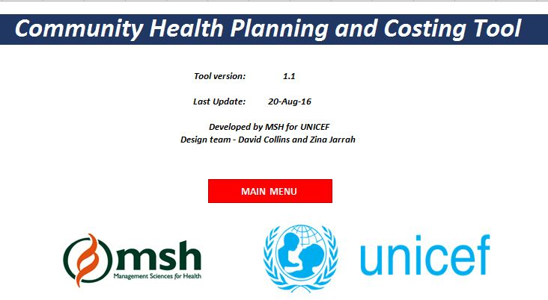
The Community Health Planning and Costing Tool
Title Page
Main Menu
Notes:
4 images: title page, main menu, part of coverage sheet, part of results-table sheet

Slide 4
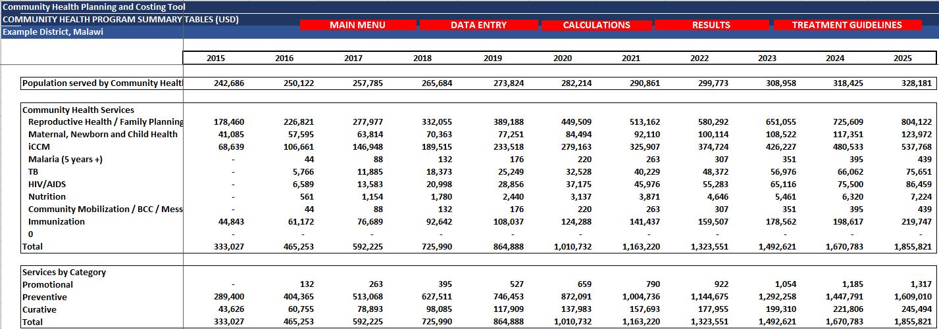
The tool has detailed tables – most of which are populated automatically based on a few sets of key data. Services and costs can be projected for 10 years.
Coverage Sheet
Results Table
Notes:
4 images: title page, main menu, part of coverage sheet, part of results-table sheet

Slide 5
Tool Output Example: Results Chart – current and planned increases in numbers of services by program for a district
Notes:
Needs label for numbers of services and to show label for last program
LABELS: show clearly that these are outputs from the tool

Slide 6
Tool Output Example: Results Chart – Cost of Services Provided by Program for a District
EXAMPLE FIGURES – DO NOT QUOTE
Notes:
LABELS: show clearly that these are outputs from the tool

Slide 7
Tool Output Example: Results Chart – Cost of Services Provided by Input for a District
EXAMPLE FIGURES – DO NOT QUOTE
Notes:
LABELS: show clearly that these are outputs from the tool

Slide 8
Tool Output Example: Results Chart – Funding sources and gaps for a District
EXAMPLE FIGURES – DO NOT QUOTE

Slide 9
Finally…………………….
To prepare an investment case:
Costing and financing projections from this tool
Add Bottleneck analysis
Add Impact analysis – eg lives saved
Available on UNICEF & MSH websites:
The tool and a user guide
Promotional video for tool
Country pilot reports.
For more information:
Jerôme Pfaffmann: jpfaffmann@unicef.org
David Collins: dcollins@msh.org

