Slide 1
Introduction for project staff:
Mother-led MUAC
Screening and diagnosis of malnutrition by mothers
…to reduce mortality and morbidity related to malnutrition
August 2016

Slide 2
For CHW and Mother training
Plastic bags filled with soil
MUAC tapes

Slide 3
Justification
Context
Training for mothers
Planning the training
Example of group training for Mother-led MUAC

Slide 4
Justification: Studies have shown that…
Mothers can classify their children according to the colour of the tape in the same way as Community Health Workers (according to a pilot study undertaken in Niger)
The precision of the method is not affected by the choice of arm (left or right), nor by the way the midpoint is chosen (by eye or by measurement)
Mothers / caregivers who have been trained have shown they are equally as capable of taking the MUAC and identifying oedema as health workers
SAM is detected earlier by mothers and less hospitalisation is necessary for children screened by their mothers
Screening costs are considerably reduced by working with mothers compared to a Community Health Worker based strategy

Slide 5
Context
  The feasibility of training mothers to screen their children for malnutrition has been studied by other organisations since 2011
  Mothers are trained how to use the MUAC tape to measure the Mid-Upper Arm Circumference (MUAC) and to identify oedema

Slide 6
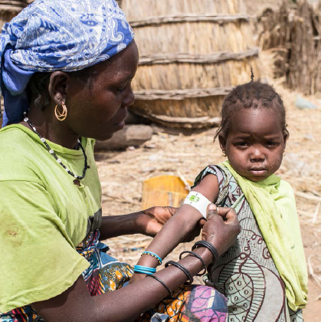
Context
Put mothers at the centre of screening strategy
  Recognise they can most quickly detect the first signs of malnutrition in their children and they want to improve their health
Address 2 recurring problems of nutritional programmes :
  Late diagnosis of malnourished children
  Coverage less than 50%

Slide 7
Screening by Community Health Workers is the norm
→ Children are screened
less than once a month
→ Mothers are less involved and less aware of malnutrition
→ training family members improves coverage considerably and encourages early detection which reduces the risk of death and medical complications

Slide 8
Why the Mid-Upper Arm Circumference (MUAC)?
The Mid-Upper Arm Circumference is a better predictor of mortality for children aged 6 to 59 months than the weight for height ratio, particularly if it is used regularly
The MUAC is simple to understand and to use
Regular screening in the community has shown that earlier detection occurs thereby reducing the risk of mortality and morbidity

Slide 9
Training for mothers
Those to be trained:
  Mothers of children aged 6 to 59 months
  Anyone who looks after children e.g. grandparents, uncles, aunts
  Young mothers and pregnant women
  Any interested person e.g. adolescents
  Husbands, fathers
Trainers:
  CHW or former CHW
  Health promoters
  Nutrition assistants
  Nurses
The Community Health Workers continue to play an important role in the community. It seems more appropriate to train them to instruct mothers than to screen children themselves.

Slide 10
Training for mothers
Objectives:
  Train mothers in screening techniques
  After a practical demonstration in how to use the MUAC tape and identify oedema, the mothers practice
Content:
  Short presentation describing malnutrition, how to diagnose and treat (using videos, drawings, pictures)
  Demonstration and practice of screening techniques
Key Messages are simple, clear and in the local language

Slide 11
Training for mothers
The training location:
  Individual or group training in all health centres (easy to integrate into pre-existing programmes)
  Cascade training for the community at the health centre and for the health centre at the hospital – reinforcing key messages and actions
    Community level: mass training campaign with group training in the villages and individual training in homes [2 weeks], training incorporated into screening campaigns (vaccination, malaria…), identify lead mothers to train small groups
    Health Centre level: training during triage/in the waiting area, after triage for cases who don’t need any treatment, during cooking demonstrations, health promotion activities, after exiting the programme
    Hospital level: during hospitalisation as soon as the child has stabilised, individual training on exit
    Media: training via radio or video

Slide 12
Monitoring and evaluation
Evaluating the effectiveness of the training and the screening capability of mothers:
  Random tests in homes several weeks after the initial training by a supervisor + refresher session if 25% of results are unsatisfactory
  Compare the colour reported by the mother on arrival at the health centre or hospital and the measurement taken by a health professional (supervisor should record the percentage which ‘correlate’ and organise refresher sessions, if <90%)
  Supervisor must monitor the median on admission to the programme (close to 115 and 125mm?)
  Reminders about screening: media (radio…), text message, public criers, women’s meetings, posters in the health centre

Slide 13
Preparation

Slide 14
Planning the training
1

Slide 15
Planning the training
2

Slide 16
Planning the training
3

Slide 17
Planning the training
4

Slide 18
Planning the training
5

Slide 19
Planning the training
6

Slide 20
Example of training for a group of mothers
Welcome the mothers and explain the aims of Mother-led MUAC
What is malnutrition ?
How do you recognise the first signs of malnutrition?
What is the difference between wasting and oedematous malnutrition?
What are the advantages of Mother-led MUAC ?
How to check the MUAC in 3 steps
What to do depending on the colour of your child’s MUAC
How to detect oedema in 2 steps
When to measure the MUAC and check for oedema
It is important to remind mothers : they can always go to the health centre or the hospital if they think their child is sick irrespective of the MUAC

Slide 21
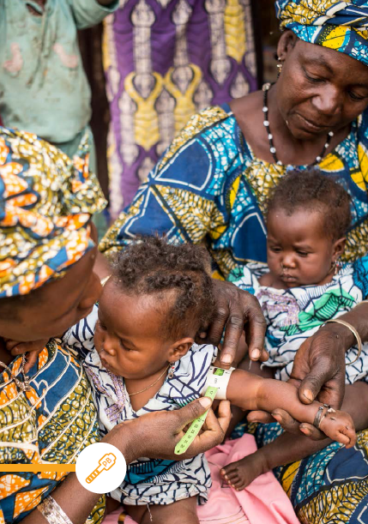
Thank you!

