Slide 1
Integrating Care for
Early Child Development (ECD)
into TTCv2
Notes:
Maternal psychosocial concerns, including depression, anxiety and Gender based violence serve as significant risk factors, negatively influencing children’s health and development outcomes. Community Health Workers (CHWs) commonly encounter caregivers experiencing such risk factors and thus must be responsibly equipped to respond to distress. Research has found that CHW can be trained in simple psychosocial interventions found to be effective in reducing symptoms of maternal depression and anxiety, in addition to distress related to GBV. Therefore WV has included maternal mental health considerations within TTC v.2. During this training we will explore maternal mental health concerns, including risk factors and interventions included within TTC v.2 to assist CHW in supporting women experiencing such concerns.

Slide 2
ECD Training: Agenda
Rationale for ECD inclusion into ttC curriculum
Orientation to Module 3, Session 4
Interactions with Caregivers
Communication and Play at Ages and Stages (0-2)
Role of Father
Brain Development Activity
Counselling the Family on ECD
Barriers and Enablers for ECD
Summarizing what we have learned

Slide 3
ECD : Learning Objectives
Understand and explain why communication and play with young children (ages 0-2: newborns, infants and toddlers) is as important to child development as good health and nutrition.
Explain how to counsel the family (mother, father, and any other primary adult caregivers) on age-appropriate play and communication activities
Describe how the family’s practices, behaviours and psychosocial dynamics in the home can influence early child development.
Identify potential areas for improvement in caregiver- child interactions (counsel) and/or developmental concerns (refer).

Slide 4

ECD for ttC: Evidence Base
Lancet (2005, 2007 & 2011); Pediatrics Journal (2012); Harvard Center for Developing Child; New York Academy of Sciences; World Bank; World Health Organization; UNICEF
200 million children < 5 fail to reach full developmental potential due to poverty, poor health and nutrition, and inadequate care
Adverse experiences in the first 1,000 days of life lead to reduced: physiological response (immune & nutritional uptake), cognitive, language, and social emotional attainment….resulting in lower adult functioning.
Positive, supportive, responsive caregiving experiences in the first 1,000 days of life serve as protective, preventative, promotive factors for healthy lifelong

Slide 5

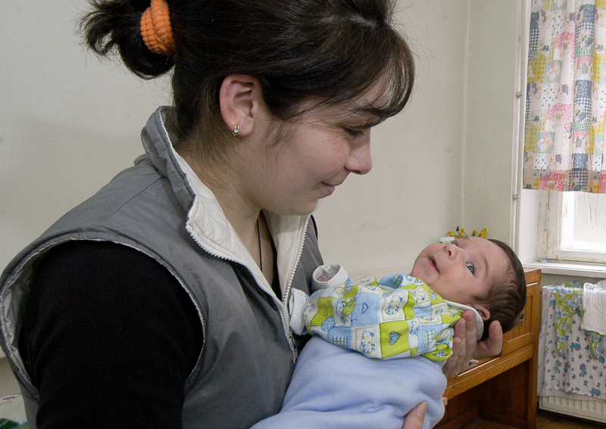
ECD: Why do we need to integrate into ttC?
Babies and toddlers SURVIVING AND THRIVING
Positive early experiences are the foundation for LIFELONG HEALTH:
biological systems strengthening
absorption of nutrients
resistance to infection
development of internal resiliency
coping with adversity
maintaining strong relationships with others
interacting with environment in productive ways
“It is easier to build strong children than to repair broken men.”
^{- Frederick Douglass}
Notes:
Health is more than merely the absence of disease or disability – complete state of physical & mental well-being
Globally 19 out of 20 children survive to first birthday (IMR = number of infant deaths for every 1,000 live births = 49.4 Global IMR)
Well children who fulfill their optimal potential and enjoy the fullness of life
Evolving human resource that helps children and adults adapt to the challenges of everyday life, resist infections, cope with adversity, feel a sense of personal well-being, and interact with their surroundings in ways that promote successful development.

Slide 6

Why include ECD in ttCv2?

Slide 7
What do we mean by child “development”?
A process of change in which a child learns to handle ever more difficult levels of moving, thinking, speaking, feeling and relating to others (Myers 1995).
Each child is unique at birth, growing and developing at an individual rate. Still…development is:
Patterned
Continual
Interactive
Integral
Embedded in cultural values and customs

Slide 8
Early Childhood Development (ECD): What is it all about?
Physical
Cognitive
Social-Emotional
Positive Caregiving
Health & Nutrition
Gross & Fine Motor
Child Protection
Self-regulation
Executive Functioning
Early Education
Language/
Communication
Behavior
Notes:
Addressing ECD means creating the conditions for children – from gestation to 8 years of age – to thrive in their physical, social, emotional,
and cognitive development.

Slide 9
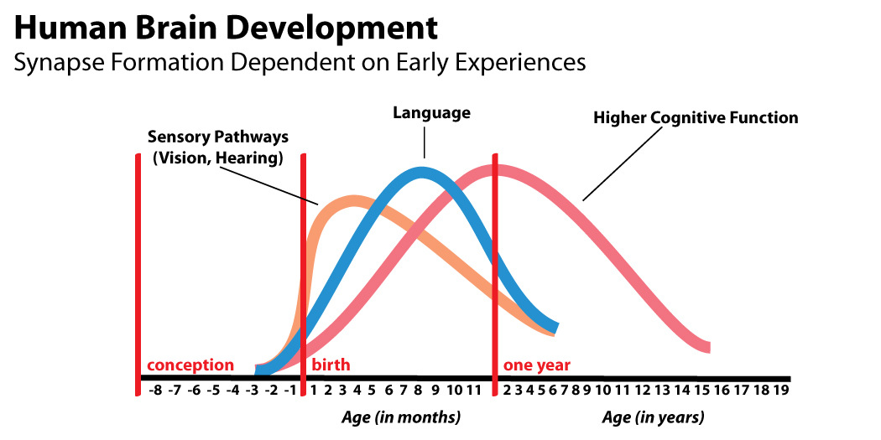
What’s so critical about 0 – 2?
Babies’ brains at birth are not fully mature. The “back & forth” interaction between baby and caregiver helps to build the developing brain and prepare them for life. Birth to 2 is the period in which brain is most sensitive to positive and negative environmental inputs.

Slide 10
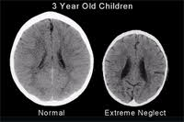
Consequences of Neglect in the First 3 Years of Life
"In order to develop normally, a child requires activity with one or more adults who have an irrational emotional relationship with the child. Somebody's got to be crazy about that kid. That's number one. First, last, and always.“ (Urie Bronfenner)
Source: Perry and Pollard 1997
Brain development is inextricably linked with the attachments children have with their main caregivers. A secure attachment is the best way of enabling a child to become independent in its own time. A child who is not attached has less ability to relate to others and is more likely to develop mental health problems later on in life.
Factors that contribute to insecure attachment may include, family breakdown, abusive or neglectful parents, alcohol abuse, parental depression and a lack of parenting skills.
Notes:
A loved child will be able to explore the world from a secure and loving base. A secure attachment is the best way of enabling a child to become independent in its own time. A child who is not attached has less ability to relate to others and is more likely to develop mental health problems later on in life.

Slide 11
Key Principles of ECD
Much of what children learn, they learn when they are very young (i.e. under 2 years of age)
Children need a safe environment as they learn
Children need consistent loving attention from at least one person
Children learn by playing and trying things out, and by observing & copying what others do

Slide 12




ttC Home Visitor Actions: Watch and encourage parents to do these things with their baby, beginning at birth
LOOK & SMILE at BABY! Newborn babies are able to see at birth fairly clearly (about the distance between the mother’s face and the baby’s face while the mother is breastfeeding) – they love eye contact, faces and smiles.
TALK & SING to BABY! Newborn babies are able to hear well, learn sounds, and communicate vocally and with body language. Talking and singing are critical for the development of babies’ language and intellect, and for soothing.
HUG & TOUCH BABY! Newborn babies love feeling mom’s body – her touch, heat, sounds that the baby used to live in while in the womb.
PLAY with BABY! For their brains to develop, babies need body movement, positive human interactions, and opportunities to touch, explore and play with age-appropriate toys.
READ to BABY! Babies love the sound of language, looking at pictures, and the intimacy of interaction with caregivers during reading.

Slide 13
Still Face Experiment

