Slide 1
Psychological First Aid (PFA)
for TTCv2
Maternal Mental Health, Well-being
& Psychosocial Support
Notes:
Maternal psychosocial concerns, including depression, anxiety and Gender based violence serve as significant risk factors, negatively influencing children’s health and development outcomes. Community Health Workers (CHWs) commonly encounter caregivers experiencing such risk factors and thus must be responsibly equipped to respond to distress. Research has found that CHW can be trained in simple psychosocial interventions found to be effective in reducing symptoms of maternal depression and anxiety, in addition to distress related to GBV. Therefore WV has included maternal mental health considerations within TTC v.2. During this training we will explore maternal mental health concerns, including risk factors and interventions included within TTC v.2 to assist CHW in supporting women experiencing such concerns.

Slide 2
PFA Training: Agenda
Rationale for MHPSS inclusion into ttC curriculum
Overview of PFA in ttC Methodology and Modules
Activity 1: Determining what is already known
Activity 2: Identifying signs of maternal distress
Activity 3: Applying PFA action principles in ttC
Activity 4: Identifying coping strategies (both +/-)
Activity 5: Practicing Look, Listen, Link
Activity 6: Calming techniques
Summarizing what we have learned

Slide 3
PFA : Learning Objectives
Understand the link between maternal mental health and infant/child health outcomes
Recognise at least three signs that a mother may be experiencing maternal mental health or psychosocial difficulties
Respond to mothers showing signs of emotional distress using the action principles of Psychological First Aid (PFA)
Describe positive and negative coping strategies for mental health and wellbeing
Teach mothers about simple calming and stress-reduction techniques.

Slide 4
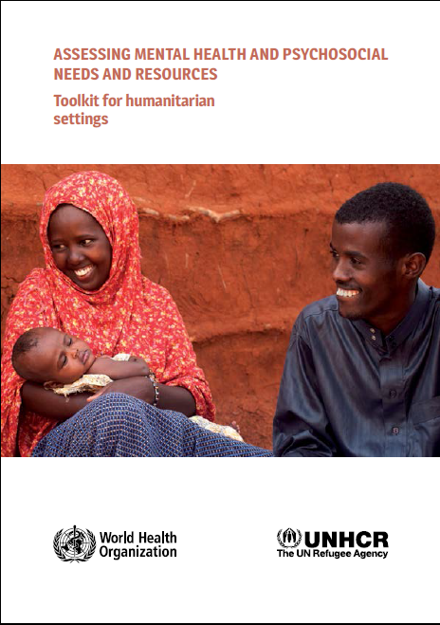
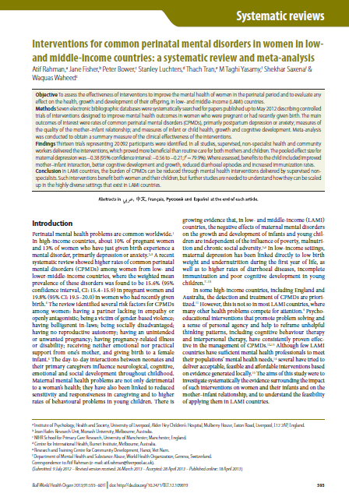
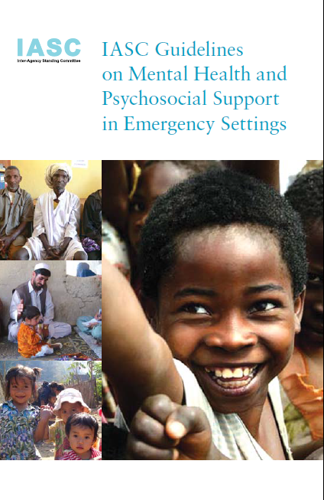
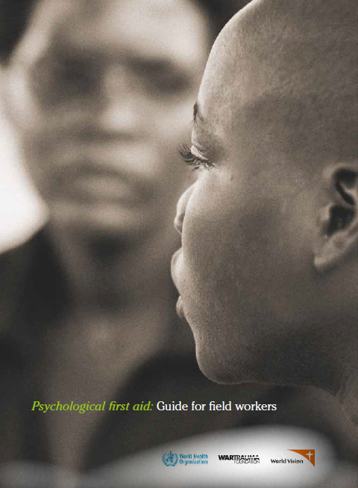
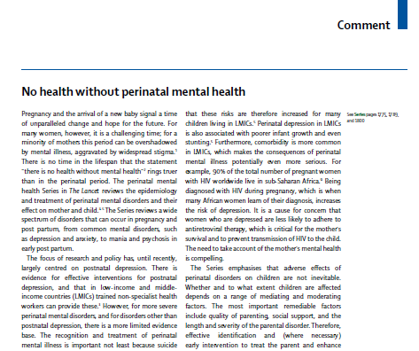
Why include MHPSS in ttCv2?

Slide 5
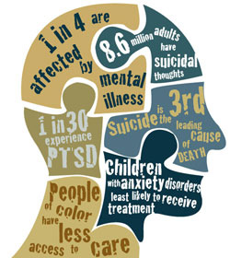
Why is addressing mental health so important?
Mental health is an integral and essential component of health.
"Health is a state of complete physical, mental and social well-being and not merely the absence of disease or infirmity.“ (WHO constitution)
Currently, depression is the 4th leading cause of disability…
…by 2030, depression is predicated to be the leading cause of disability globally (overtaking cardiovascular disease)

Slide 6
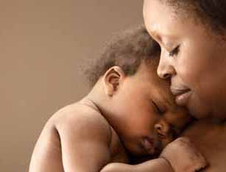
What do we mean by maternal mental health,
well-being and psychosocial support?
“A state of well-being in which a mother realizes her own abilities, can cope with the normal stresses of life, can work productively and fruitfully, and is able to make a contribution to her community” (WHO)
Encompasses the psychological (e.g., mental health, distress, anxiety, depression, coping, problem solving) and social (e.g., family and community support, empowerment, culture) aspects of motherhood.
Notes:
What then do we mean by maternal mental health? WHO defines maternal mental health as a state of well-being in which a mother realizes her own abilities, can cope with the normal stresses of life, can work productively and fruitfully, and is able to make a contribution to her community.

Slide 7
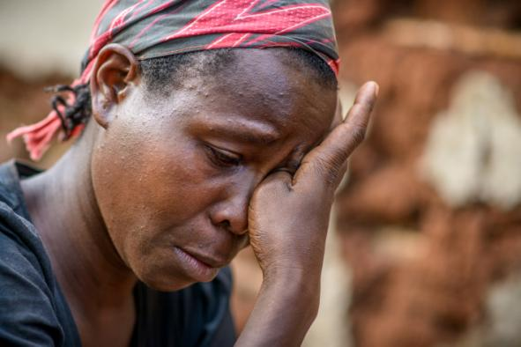
Why is addressing maternal mental health so important?
Women are twice as likely as men to experience depression and anxiety; highest rates in the lifecycle are during the childbearing years.
Maternal depression prevalence globally: 10-20%
15-28% in Africa and Asia
28-57% in Pakistan
35-50% in Latin America
At each age period, children of depressed mothers
show difficulties in achieving age-appropriate:
physical health milestones
developmental tasks in cognitive and language development
social emotional functioning
Notes:
Rates are higher in LAMIC possibly representing the greater prevalence and exposure to multiple depression-related risk factors by women: poverty, economic stress, domestic violence, lack of status and lack of control in family decision making.

Slide 8
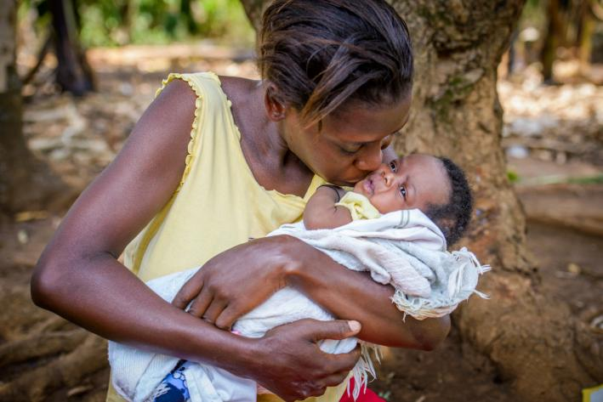
Maternal mental health links to newborn/child health
Maternal depression and exposure to violence are key psychosocial risks to newborn and child health: distressed and/or anxious women are less able to care for themselves, and thus their children.
In low-resource settings, maternal depression (especially among those experiencing social disadvantage) is directly linked to:
pre-term birth and low birthweight
early cessation of breastfeeding
undernutrition in the first year of life
and higher rates of stunting
higher rates of diarrhoeal diseases
lower completion of recommended
immunization

Slide 9
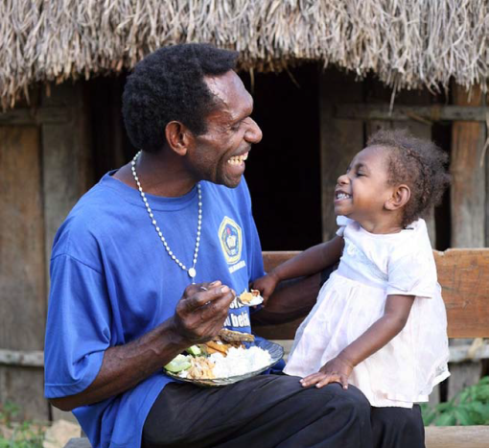
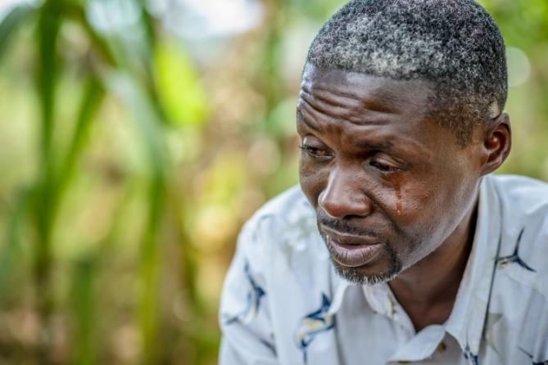
Involving fathers
Fathers are key supporters to mothers with MMH difficulties: their understanding response is important to the mothers recovery
Growing evidence suggests that the fathers’ mental health is also associated with child developmental disturbances
Notes:
Both children and mothers benefit from fathers involvement. Research shows that a lack of intimate partner support has links with perinatal depression in mothers. Although in some cultures men's involvement in childcare may be frowned upon, fathers should be encouraged to take on care of children to allow mothers rest & to build a relationship with the child. It is also important to note that fathers are also at risk of developing peri-natal mental disorders such as depression and anxiety and psychosocial distress more broadly due to the rapid changes a child brings to the household. Therefore ttc home visitors should also be encouraged to look for signs of distress in males and offer support if appropriate to do so.

Slide 10
What is Psychological First Aid (PFA)?
A humane, supportive response to a fellow human being who is suffering and who may need support.
Involves the following themes:
Practical care and support that does not intrude
Assessing needs and concerns
Helping people to access basic needs (e.g. medical support)
Comforting people and helping them to feel calm
Helping people connect to information, services and social support
Protecting people from further harm
Notes:
PFA is for distressed people who have been recently exposed to an extremely distressing event (illness/ death of a child/mother/ family member, natural disaster)
Not everyone who experiences a crisis event will need or want PFA.
PFA is done as part of everyday life or work- it is not an extra activity

Slide 11
Why PFA?
“Community Health Workers deal with these kinds of issues every day of their work, it’s just that at the moment, they don’t know how to respond”
World Vision Kenya,
MoH representative

Slide 12
Safety
Basic needs
Signs of distress

Slide 13
Sensitive
Active
Validate
Explore

Slide 14
Encourage
Support
Calm
Service

Slide 15
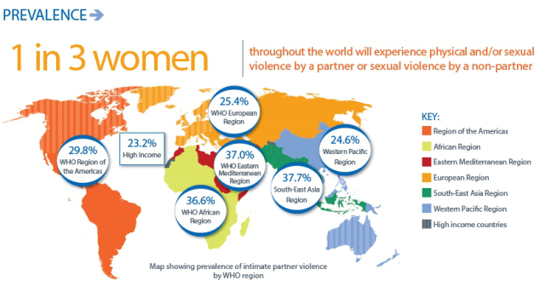
Gender Based Violence
Notes:
GVB rates are disturbingly high, and research has found that the risk of GVB increases significantly during the peri-natal period. WHO estimates that the global average is around 1 in 3 women … however these statistics vary by country and studies show wide variation in the % of women experiencing intimate partner violence, sexual violence in their lifetimes. An alarming fact is that up to 28% of women experience violence during a pregnancy, and evidence shows that overall a woman’s risk of violence increases during pregnancy, with adolescents 7 times more likely to expereience violence than other women.
When considered together with perinatal mental health issues, the extent of women experiencing serious or acute psychosocial difficulties during and after pregnancy is very high.
TTC home visitors interact with families on a day to day basis. They hold a position of trust with those individuals and may be the first to become aware of a serious issue within a family. Of course serious cases of GBV and other forms of violence do require specialist care, and training to respond and support or listen to a woman expereiencing such difficulties is not an adequate response on its own. However, CHWs, given their high level of exposure, must have a basic set of supportive response skills which will enable them to respond appropriately when such crises arrive. The prevalence statistics suggest an endemic problem, especially in the communities world vision works, and so equipping health care workers with these skills is very importance.

Slide 16
Bad Communication – Things NOT to say and do
Don’t pressure someone to tell their story. Don’t interrupt or rush someone’s story (e.g., don’t look at your watch or speak too rapidly). Don’t touch the person if you’re not sure it is appropriate to do so. Don’t judge what they have or haven’t done, or how they are feeling. Don’t say: “You shouldn’t feel that way,” or “You should feel lucky you survived.” Don’t make up things you don’t know. Don’t use too technical terms. Don’t tell them someone else’s story. Don’t talk about your own troubles. Don’t give false promises or false reassurances. Don’t think and act as if you must solve all the person’s problems for them. Don’t take away the person’s strength and sense of being able to care for themselves. Don’t talk about people in negative terms (e.g., “crazy” or “mad”).
Notes:
Communication seems like a basic skill, however good communication can often be hampered by some common negative communication behaviours. To avoid communicating in an unhelpful way… (read out slide)

Slide 17
Good Communication – Things TO say and do
Try to find a quiet place to talk, and minimize outside distractions. Respect the person’s privacy and confidentiality, as appropriate. Stay near the person but keep an appropriate distance depending on their age, gender and culture. Let them know you hear them; for example, nod your head or say “hmmmm….” Be patient and calm. Provide factual information, IF you have it. Be honest about what you know and don’t know. “I don’t know, but I will try to find out about that for you.” Give information in a way the person can understand – keep it simple. Acknowledge how they are feeling, and any losses or important events they share with you, such as loss of home or death of a loved one. “I’m so sorry. It sounds like this is very sad for you.” Acknowledge the person’s strengths and how they have helped themselves. Allow for silence.
Notes:
To communicate in a positive way … (read slide)

Slide 18
PFA Recap/Feedback: Stand up if you agree:
Providing practical care and support (agree)
Assessing peoples needs and concerns (agree)
Comforting people and helping them to feel calm (agree)
It is pressing people to tell you details about what happened that was distressing or how they feel (disagree)
Helping people connect to information, social supports, or services (agree)
It is professional counseling (disagree)
It is something only professionals can do (disagree)
Helping people to access basic needs (agree)
Protecting people from further harm (agree)

