Slide 1
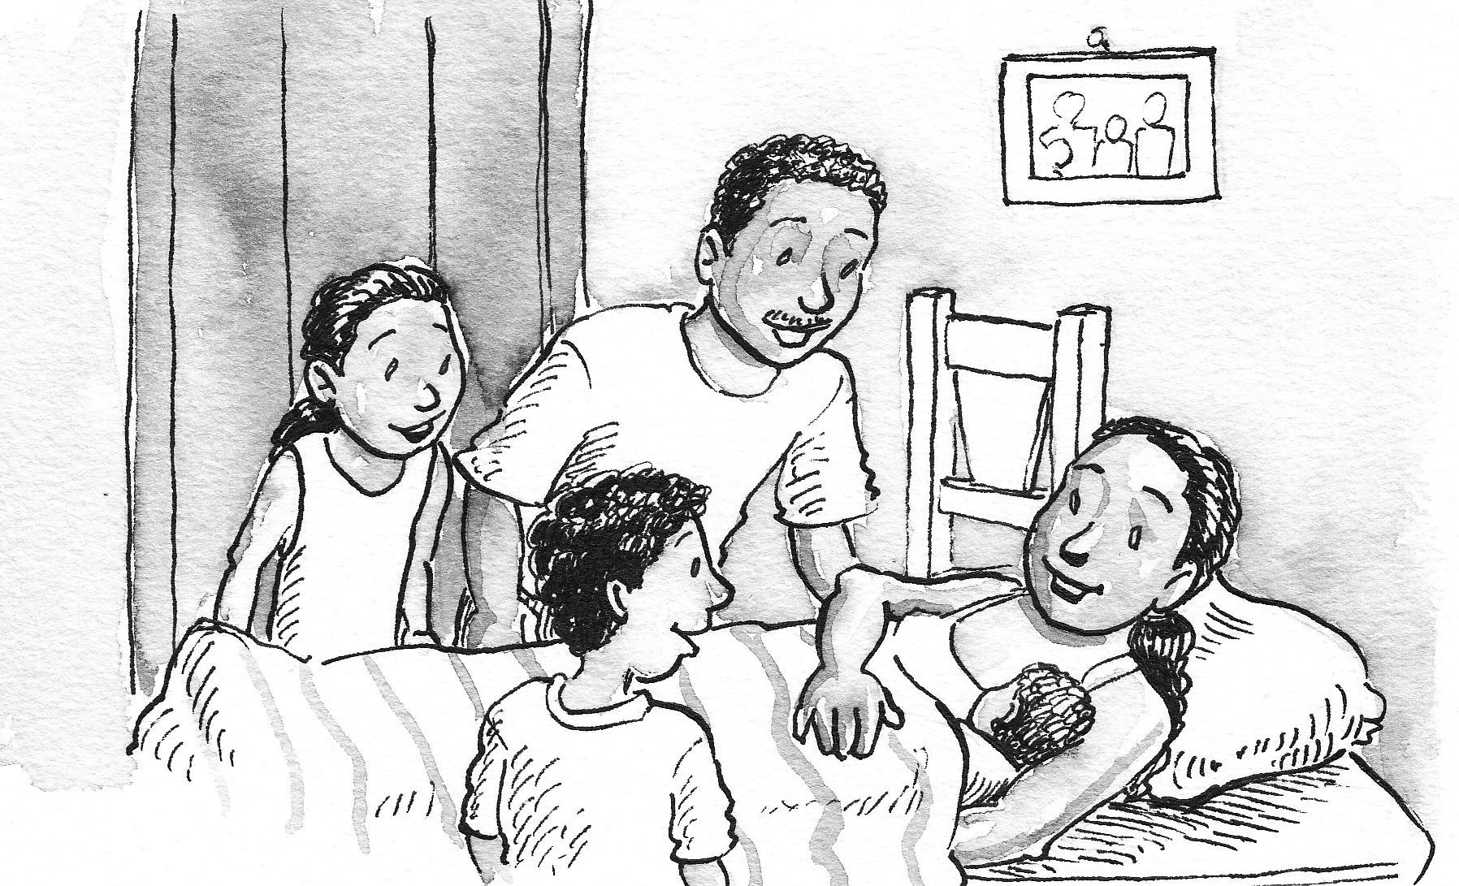
Guatemala´s TTC implementation

Slide 2
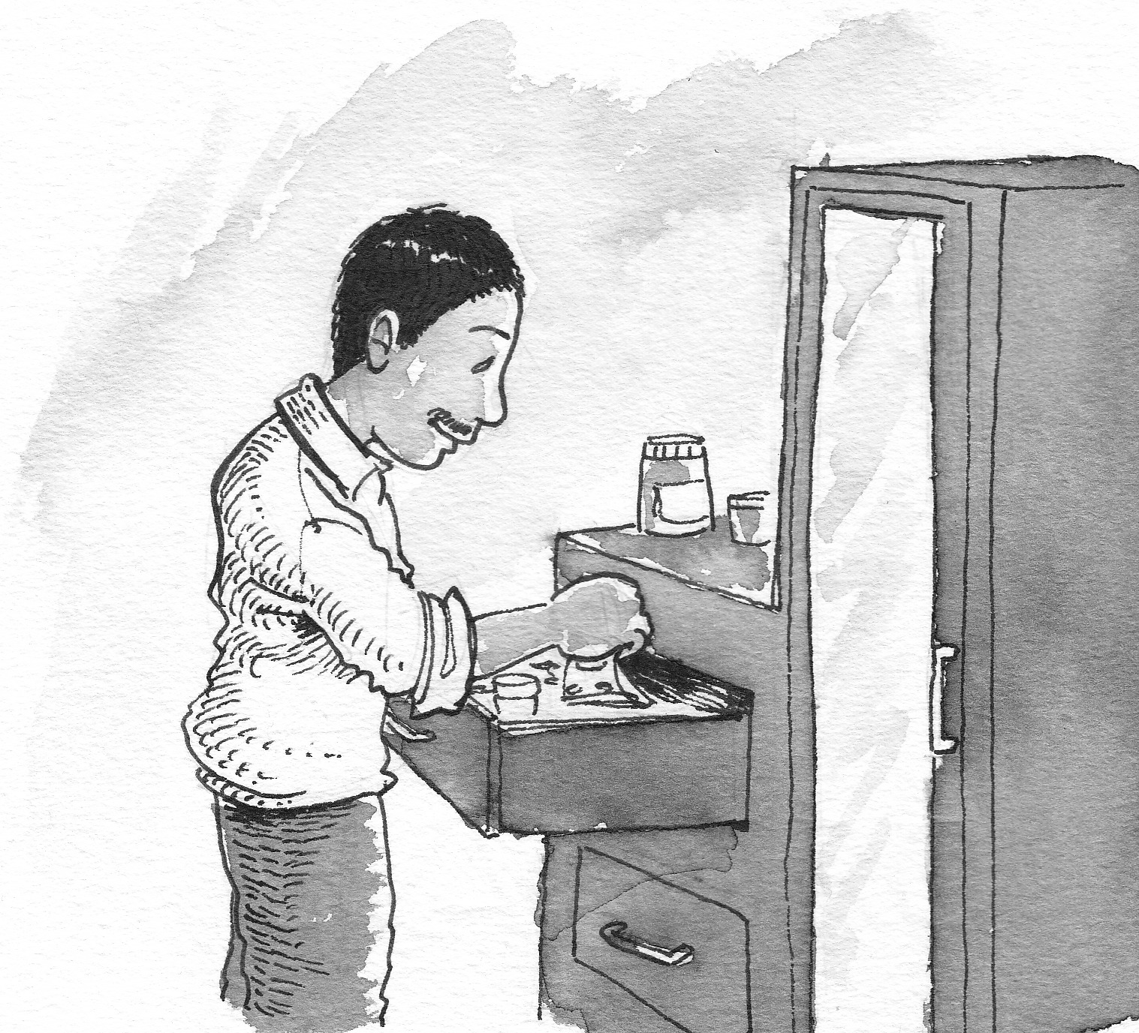
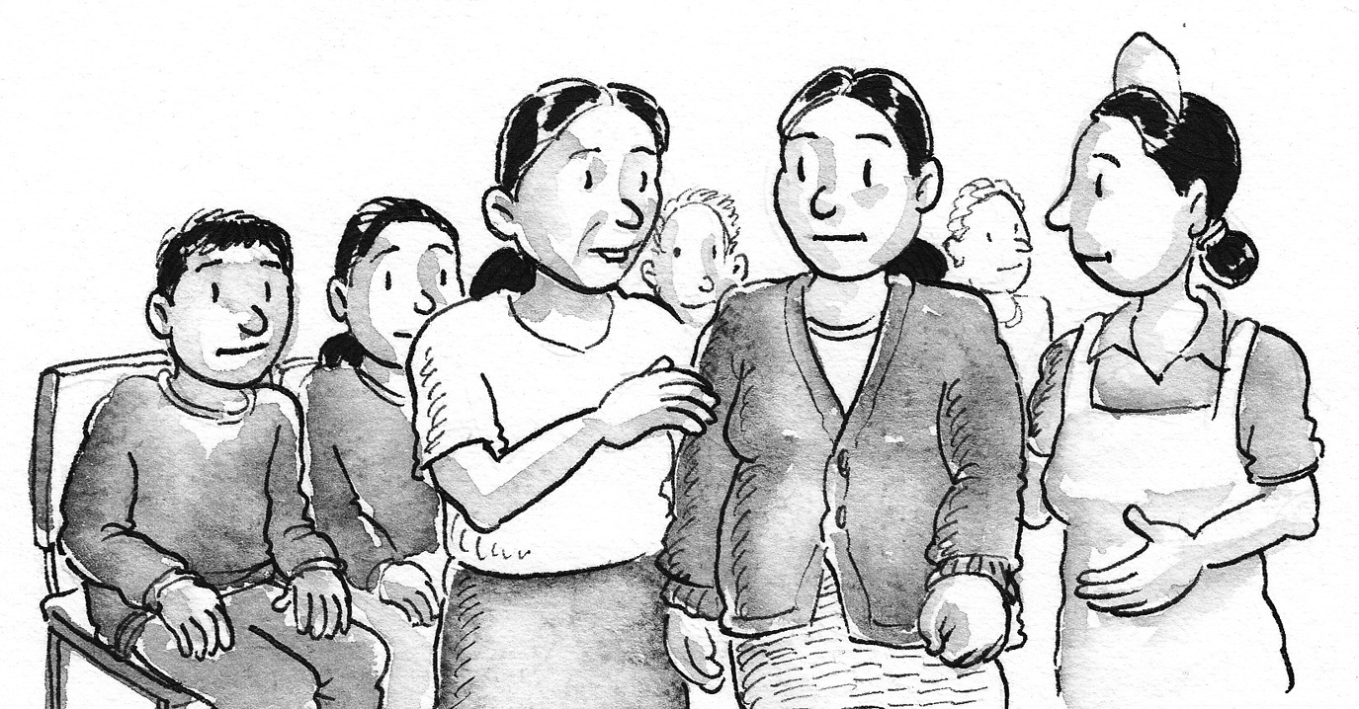
The first steps we took in TTC implementation was to contextualize all the material. We changed the images and adapt the stories to the MoH standards.

Slide 3
43 Facilitators of 16 ADP are trained to implement TTC. We have done 3 group of training, the first ones were the people form the CHTIS.
CHTIS has 2 ADP with the metodology and we have started with 14 more ADP. In the future National Estrategic Plan, this model will be part of the core program of the intervention in health and nutrition.

Slide 4
In Guatemala the people who does the visits are volunteers named "mother guides". We have not linked TTC with the MoH because in this moment, they don´t have a community health workers structure. We started to talk with another partners like churchs and Municipalities but we do not have specific plans yet.

Slide 5
6 ADP have trained their mothers guides in module one and they are already visiting the pregnant mothers.
10 ADP are training their mothers guides in this FY15 and are planning to start the visits in FY16.
In May the facilitators from this 16 ADP are going to be trained in the module 2 y 3 so they can train the mothers guides.

Slide 6
We have 214 mothers guides trained in the module 1 in 47 communities around the country.

Slide 7
With Michelle´s help we decided the monitoring and supervision strategy and we shared with the facilitators from the 16 APD. Every ADP has their plan to implement TTC in the FY 15 and FY 16 including the structure for the monitoring.
CHTIS will be using a virtual platform to register the tool and the other ADP will be starting doing only in paper.

Slide 8
Guatemala´s monitoring and supervision strategy

Slide 9
17 calle 5-90, zona 11· Colonia Mariscal
Apto. Postal 326A
PBX: (502) 2411-5000
E-mail: guatemala@wvi.org
www.wvi.org/es/guatemala

