Slide 1
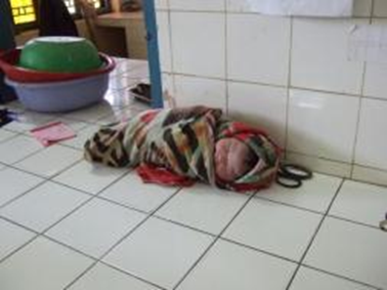
ttC Ed 2 Newborn Care Session
ttC 2.0 curriculum updated for newborn care
Danger signs
Essential immediate newborn care
Chlorhexidine for umbilical cord care
Improved postnatal visit actions
Newborns were put aside

Slide 2
Overview of Session
At the end of this session trainers will be able to:
Discuss the evidence
Describe newborn care included in Module 2 and job aids
Describe and demonstrate newborn care competencies expected of ttC- HVs
Discuss and consider country policy and possible adaptations for newborns

Slide 3

We’ve made significant progress toward MDGs 4 & 5, but newborn survival is lagging behind
 | Average annual rate reduction 1990-2012
Maternal mortality ratio* | 4.2%
Children aged 1- 59 months | 3.4%
Neonatal mortality (newborn, first 4 weeks after birth) | 2.1%
Stillbirths (last 3 months of pregnancy) | 1.0% (1995-2009)
At least 40% slower for newborn survival and slower still for stillbirths
Source: Adapted from Lawn J,E. et al. 2012. Newborn survival: a multi-country analysis of a decade of change. Health Policy and Planning. 27(Suppl. 3): iii6-ii28. Data sources: UNICEF 2012 www.childinfo.org , UN MMR estimates 2012
* Maternal mortality ratio annual rate reduction 190-2010
Notes:
In the past two decades, there has been rapid progress in the survival of mothers (4.2% reduction per year) and children after the neonatal period (3.4% reduction per year). However, newborn survival has lagged behind (2.1% reduction per year) and progress for stillbirth reduction has been even slower (1% per year). Newborn deaths now account for 44% of all deaths among children under age five.

Slide 4
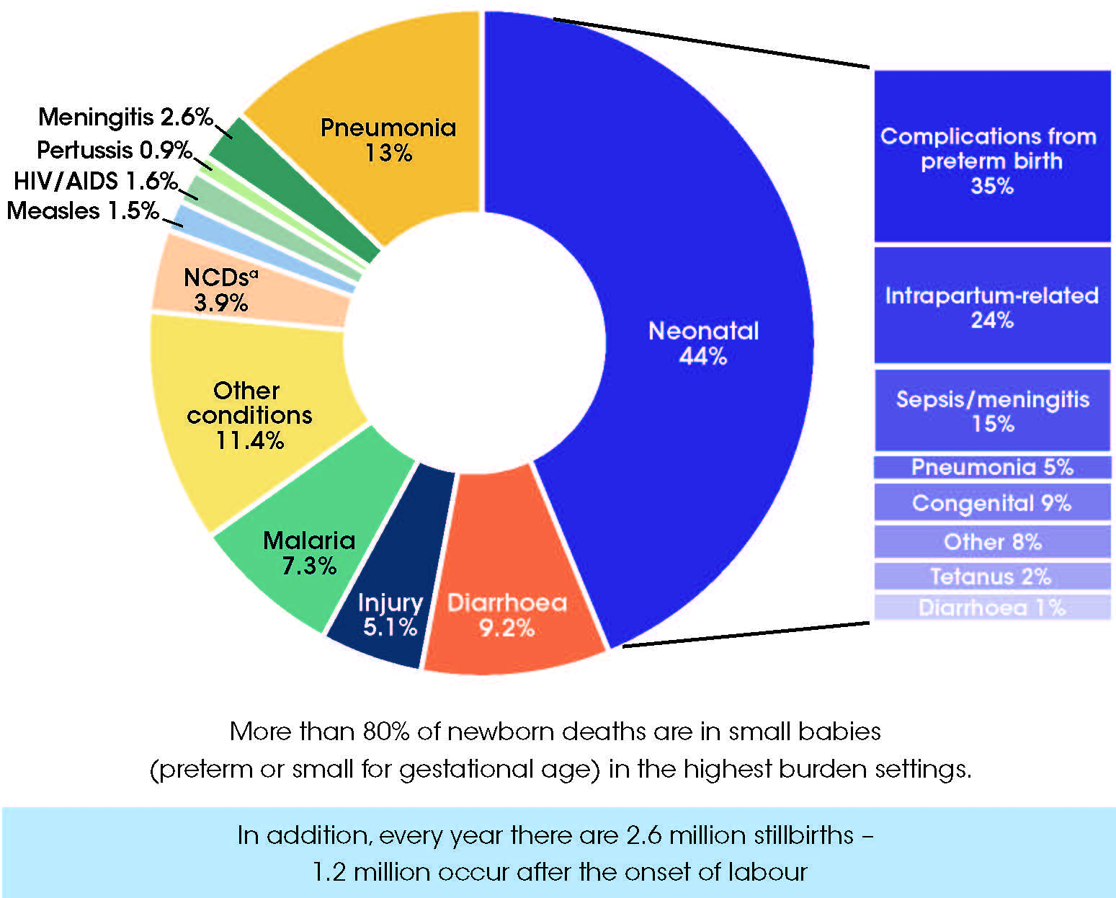
Causes of under five deaths
44% are from neonatal causes
3 main killers to address:
Preterm birth
Birth complications
Neonatal infections
Two-thirds of neonatal deaths
are preventable
Data source: Cause of death - WHO. Global Health Observatory http://www.who.int/gho/child_health/en/index.html); Child deaths - UN Inter-agency Group for Child Mortality Estimates. Levels and Trends in Child Mortality. Report 2013; Stillbirths - Lawn et al The Lancet stillbirth series 2011. 377 (9775) p1448 – 1463
4
Notes:
We know the causes of newborn deaths
Four out of five newborn deaths result from three preventable and treatable conditions:
Complications from preterm birth, infections, complications during childbirth
Ten years ago newborn deaths were invisible in the global estimates but included since 2005 and now visible.

Slide 5
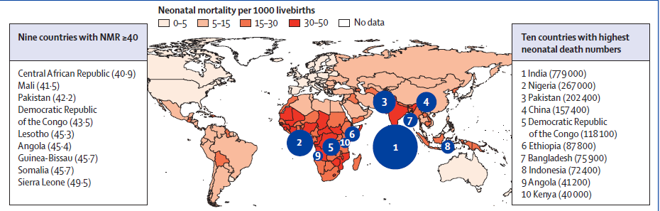
Sub Saharan Africa and Asia have the highest burden
Notes:
Source: The Lancet – 2014 Every newborn executive summary

Slide 6
We must get it right from the start:
Age at death for Neonates (0-28 days)
2 out of 3 newborn deaths occur in the 3 days of life
What we do then affects the rest of the newborn's life

Slide 7
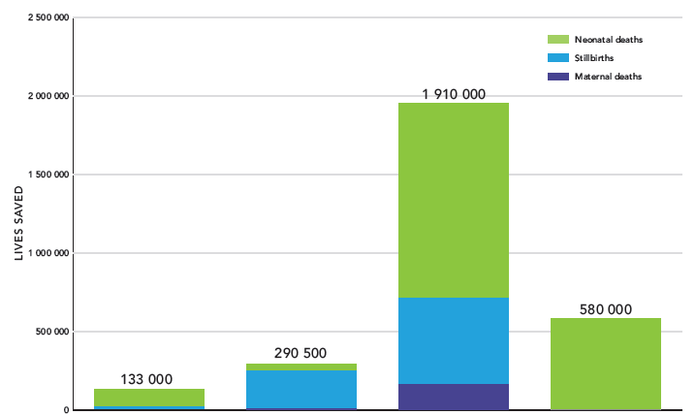
Lives that could be saved per year with universal coverage
Childbirth
up to 7 days
Care of
Small/PT
Pre-
conception
ANC
Source: The Lancet Every Newborn series, paper 3

Slide 8

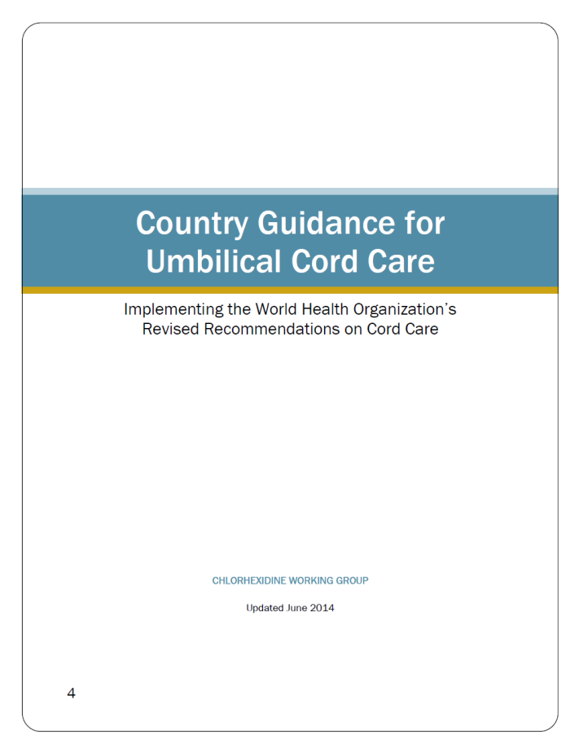
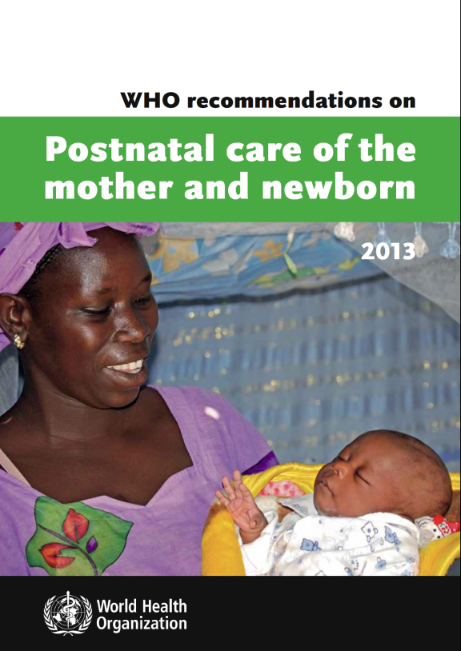

Country Guidelines

Slide 9





Every Newborn Series
Building from evidence to action
5 papers, 6 comments
55 authors from 18+ countries
60+ partner organizations
Published May 2014
www.thelancet.com/series/everynewborn
Main funders: Bill & Melinda Gates Foundation, USAID, Children’s Investment Fund Foundation
Every Newborn Action Plan
Based on the evidence from the Series
Co-led by UNICEF & WHO
World Health Assembly 2014 resolution
Over 300 experts consulted
60+ partner organization
Launched 30th June 2014
40+ commitments to EWEC

Slide 10
PMNCH – there are proven interventions within the continuum of care
Notes:
The EWEC was developed by UNSG in 2010 with more than 165 partners making commitments. WV made a commitment of $1.5bn over 5 years.
The new Global Strategy is being discussed now with multiple global partners ensuring MNCH stays on the agenda and that equity and reaching the most vulnerable is key to meeting the new targets.
The Lancet newborn series 2014 outlined the proven interventions acorss the continuum of care for RMNCH.

Slide 11
Recent evidence of community interventions
Lassi et al. Reproductive Health 2014, 11 (Suppl 2):52
Reports findings from 43 Systematic reviews
Home visiting significantly improved ANC, TT, immunisation, referral and early initiation of BF
Task shifting to midwives and CHWs improves all indicators
Training of TBAs as part of a community package has significant impact on referrals, MM, NM and perinatal mortality
Community groups, home visits & community mobilisation have maximum potential
Effect of outreach mass media and education as stand alone interventions not clear
In limited resource settings where highest burden exists training and supporting CHW is recommended

Slide 12
WVI Every Newborn Action Plan
Commitments (1 – 4)
Reviewing, sharpening & prioritising newborns in our MNCH&N program with a focus on first week of life
Support 100,000 CHWs in 40 countries and integrate PNC and ENC interventions in first week of life
Scale up home visiting approaches (ttC) in 16 high burden countries
Integrate newborn care into iCCM and implement in 15 countries

Slide 13
WVI ENAP
Advocacy commitments (5 – 7)
Empowering families and communities to demand better health for mothers, newborns and young children
Ensuring accountability for the commitments made to Every Newborn
Advocating for the survival and well-being of every woman, every newborn and every child

Slide 14
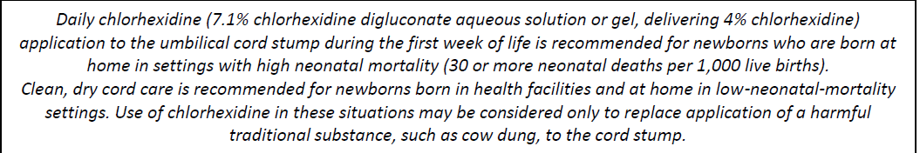
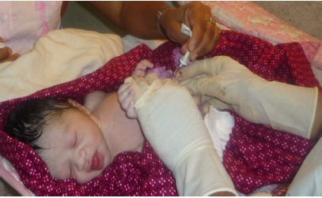
Guidance on Chlorhexidine for cord care from CHX WG & WHO

Slide 15
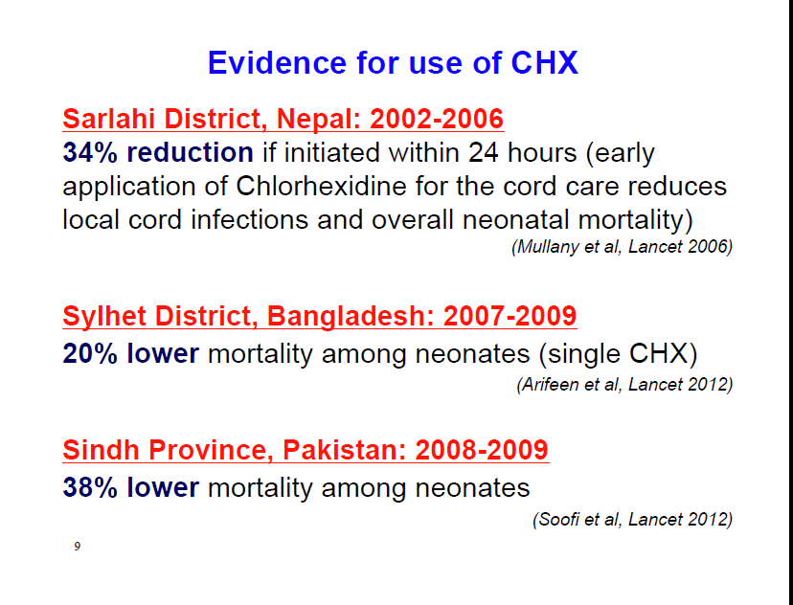

Slide 16
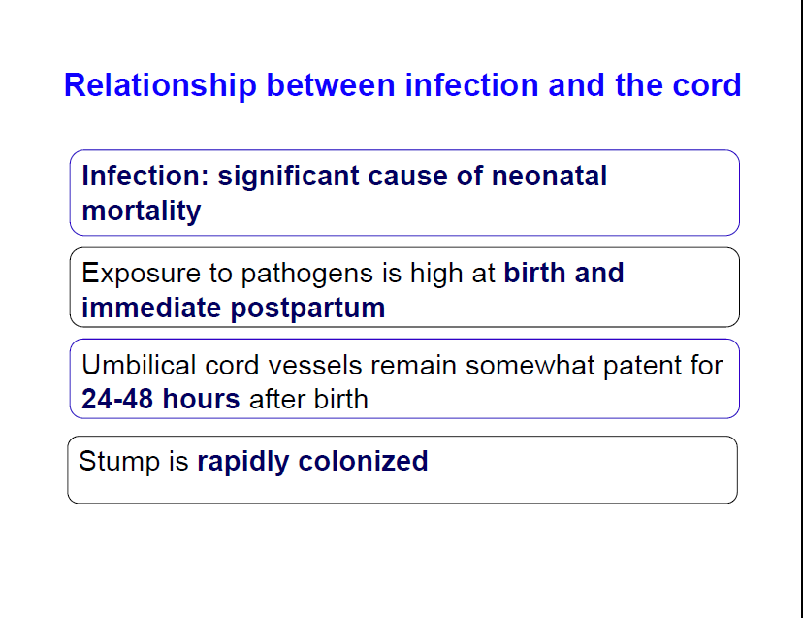

Slide 17
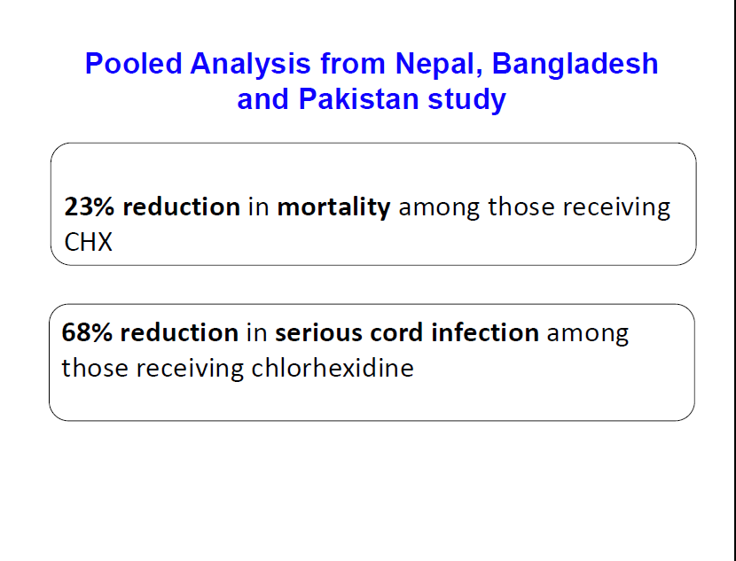

Slide 18
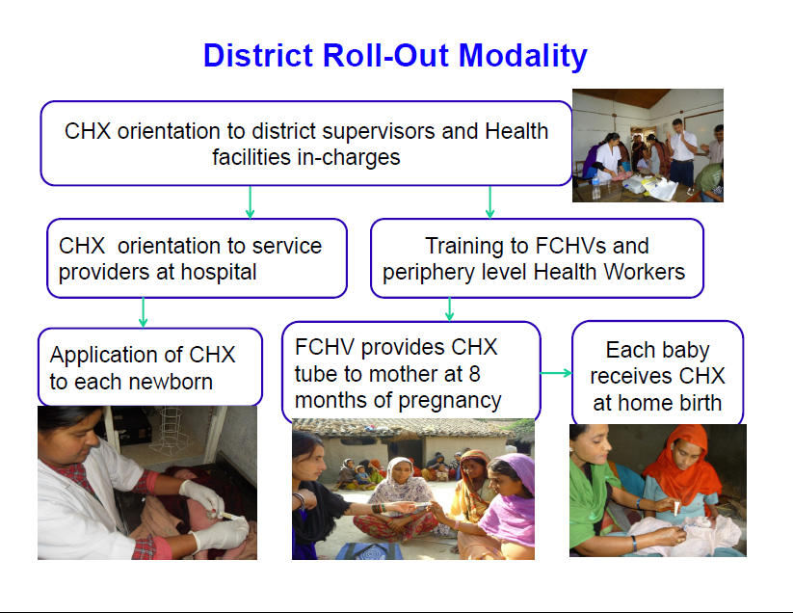
Nepal experience

Slide 19
Special Care of the Small Baby Session 11
Evidence for Kangaroo Mother Care (KMC) practiced in health facility settings is very strong but has been slow to be applied in LMIC
Cochrane review of 16 randomized trials, kangaroo mother care in preterm neonates was associated with a 40% reduction in the risk of mortality, a 58% reduction in nosocomial infections or sepsis, and a 77% reduction in the prevalence of hypothermia
Birth weight determines newborn survival
Evidence for KMC in community is weak…what happens when this baby goes home from the facility or never reaches the facility after birth? A definition of KMC in community settings is missing

Slide 20
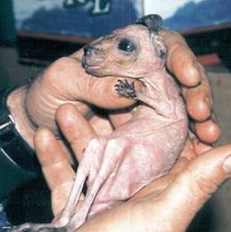
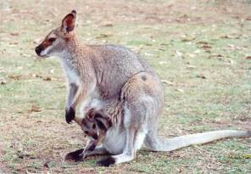
Care of the Small Baby
Kangaroo Mother Care
A newborn baby kangaroo (joey) is very immature at birth and very small in size
The mother kangaroo’s pouch provides warmth, safety and a constant supply of food (milk) to the joey
Similar to kangaroo care giving the human infant is also immature and especially the LBW infant benefits from skin-to-skin care because it provides warmth, safety and food
Whitelaw 1985, Malawi KMC Training Manual

Slide 21
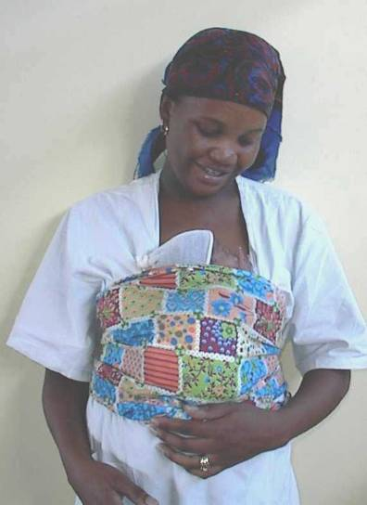
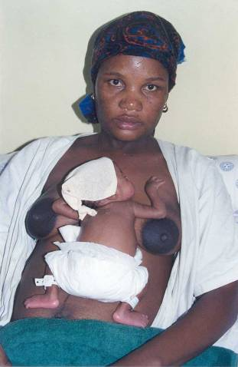
Kangaroo Position demo
Skin-to-skin on mother’s chest “frog like”
Turn babies head to side
Continuous 24/7 & share between family members

Slide 22
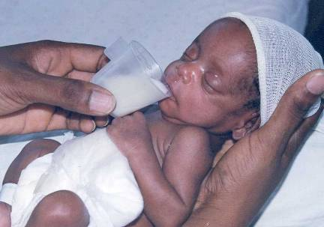
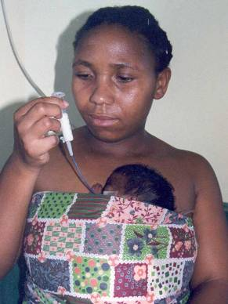
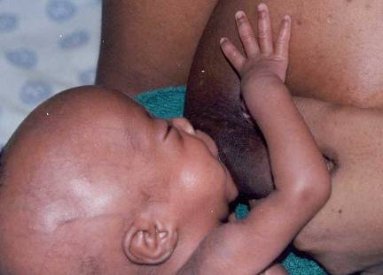
Kangaroo Nutrition
Exclusive breastfeeding
Initially tube or cup feeding before breastfeeding is established

