Slide 1
The TTC Behaviour Change Methodology

Slide 2
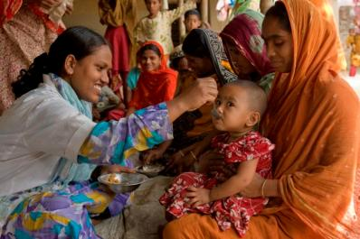
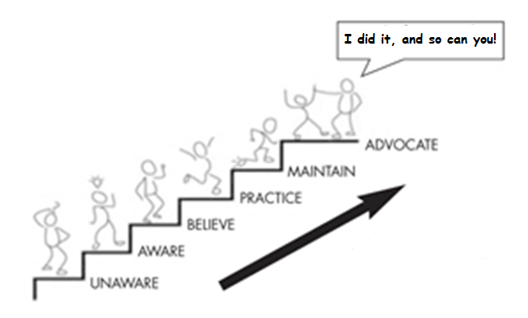
Process of Behaviour Change
Notes:
The process of behaviour change isnt simple. We don’t just wake up one day and say “oh, I’m going to quit smoking, or I’m going to go to the gym twice a week”, and then suddenly the change just happens. And similarly, the communities we work with will find some new habits and practices, especially where they go against cultural norms, or are challenging to take on board.
Knowledge is the first step, then really internalising that information and believing it. From that point the person begins to put the new behaviour into practice. Sometimes getting to this point is easy, right? Think about how long your new years resolutions usually last? So yes – maintenance of the new practice is often where things really fall down. That’s when TTC can really come in handy -0 the home visitor can support them through that process of change until the family are able to sustain and maintain the new practices and mothers feel confident in their own ability to keep it up. The great thing in this model – when we are working with care groups and peer mothers we can support those mums to become volunteers who go on to advocate for others, then we really see behviour change empowerment in action.

Slide 3
TTC Methodology: Household Counselling Steps
Pre-step:
Open dialogue – mother and family to raise worries, health problems (apply PFA)
Step 1:
Review previous meeting and actions that the household agreed to try
Step 2:
Problem Story and Guiding Questions (Guiding Qs lead users from analyzing as outsiders, to personalizing the issues)
Step 3:
Positive Story and Guiding Questions (Guiding Qs lead users from understanding the benefits of the actions, to personalizing)
Step 4:
Dialogue and “Negotiation”, using Household Handbook (mark the actions)
Notes:
The process of each home visit follows the same sturcture. First and foremost, the home visitor has to begin the visit by giving the mother a space to talk and discuss her own concerns, health, nutrition, emotional or other that she may have experienced. The CHW should never just go right into the TTC rpocess without allowing her concerns to emerge first. That’s a first step in building an empathic counselling interaction.
Secondly they will rpoceed to review the last meeting and look specifially at any barriers and issues that emerged previously to see how the family have got along with implementing change.
The TTC storybooks are used to present first the negative and the the positive story, with guiding questions that can initate discussion around key issues.
Lastly each visit has a defined set of counselling points, which will be negotiated and monitored using the household handbook.

Slide 4
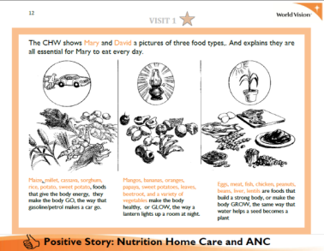
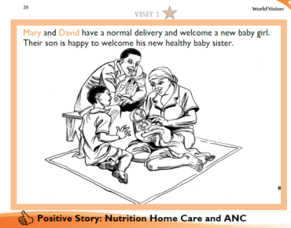
Stories at heart of counseling/ dialogue
Stories cover all health messages, with guiding questions to enable discussion
The stories link cause and consequence without over-personalizing
Stories show positive and negative male role models influencing the outcome for the family
Useful for addressing difficult issues, e.g. HIV, male behaviour, financial issues
Notes:
The stories are quite imporatnt to the process because they show the sequence of events that link the health practies to the possible consequences.
The TTC stories aim to highlight specifically the role of the father in both positive and negative light which will engage the partner in considering his own attitutdes and actions.
Lastly, the stories can help over come the challenges of dealing with awkward issues like money, stigma and depersonalise them whilst allowing for a deeper exploration of their consequences. The problem story allows them to reflect on issues first as if they are happening to someone else, which enables a more objective and less emotional analysis of the problem than if we immediately say "these are your problems". The guiding questions follow a sequence that moves from analyzing the problems as an outsider, to asking about the overall community situation regarding the problems, and finally personalizing it to the family themselves
The positive stories contain all of the 7-11 messages

Slide 5
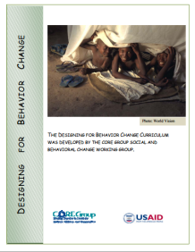
Most common barriers to behaviour change
Knowledge & skills: I don’t think I can do it, I don’t know how to do it (I don’t have the knowledge or skills)
Family / community influence – Other people don’t think I should do it (my family or community won’t approve). This is against my culture.
Access – I cannot get there, it is too expensive or if I get there the facility won’t have it.
Fear – I think it might be dangerous to do it, e.g. if I deliver in the facility it will be more dangerous, if I go for HIV testing, I’m afraid my husband will reject / blame me.
Beliefs about behaviour and risks – If I do X it won’t be effective, it won’t happen to me. E.g. if my child gets diarrhoea, it won’t be a serious problem.
Reminders / cues – people forget to do the behaviour unless they are reminded, e.g. forget to wash hands with soap unless they are reminded e.g. forget to attend a clinic on a date.
Notes:
These are some of the most common ‘barrier’ to behaviour change, and in TTC we create a space for exploring the common barriers to each of the 7-11 behaviours. If you want to learn more about identifying abrriers – read the Designing for behaviour change curriculum by Core group, which covers these in more depth. Click this link to access on the core group website. Many of these concepts have been used in the TTC approach.

Slide 6
Using dialogue – to get to the root causes
WHY-WHY question – getting to the underlying causes
However – remember that judgmental questions can often be taken badly. For this reason we recommend the question:
“What makes this difficult?” followed by “and why do you think that is?” (repeat until you get to the root).
Identify the issue
Underlying reason
Root cause
Root cause
Underlying reason
Root cause
Root cause
Why?
Why?
Notes:
When you speak to mothers about health practices you need to aim to get to the root cause of the barrier, this means the real reason the woman cannot currently do that behaviour. Draw a diagram like the one shown below. When we have identified an issue it often takes at least two steps to get to the root cause of the problem. A common way to do this in conversation would be to follow a WHY-WHY route of questioning.

Slide 7
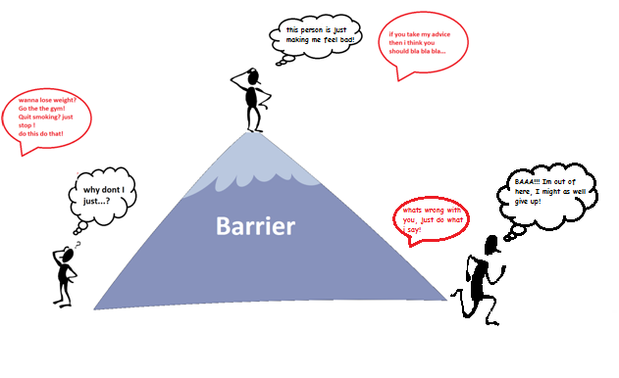
Giving unsolicited advice….
Notes:
When you start a dialogue by hearing what the problem is, and then jumping straight in to tell people what to do, its like you are trying to tunnel through the mountain to get quickly to the solution on the other side. It probably wont work, because that person may have already considered many of the options you suggest, and they could even feel offended that you’ve given them advice without trying to understand their circumstances first. They may even feel judged or criticised, and be more likely to give up.

Slide 8
Empowering to find a solution
Notes:
Empowering to find a solution is very different. You are asking neutral questions to help the person understand their own challenges, and then motivate them towards finding the solution. This is a technique used extensively in really challenging behaviour change settings such as drug and alcohol counselling, often known as ‘motivational interviewing’
Try it out for yourself and see what you think. You can even try it out with your staff – you never know they might come away from the conversation thinking “Hey, my boss is really supportive, I feel like they really listened to me!”

Slide 9
Household Counseling Steps
Record what they are already doing
– and praise their efforts
If they are not doing a practice, begin the dialogue
What makes it difficult to do this?
Why is that
What might make is easier for you to do?
How can i/we/ your family or community support you to help that to happen?
Agree the action to be taken and record – praise their decision
ENCOURAGE
BARRIER ANALYSIS
ROOT CAUSE DISCOVERY
EMPOWER
SUPPORT
AFFIRM
Notes:
The negotaition steps is very simple

Slide 10
Not all problems have solutions
Link to COMM
Link to CVA
Enable them to be heard

