Slide 1
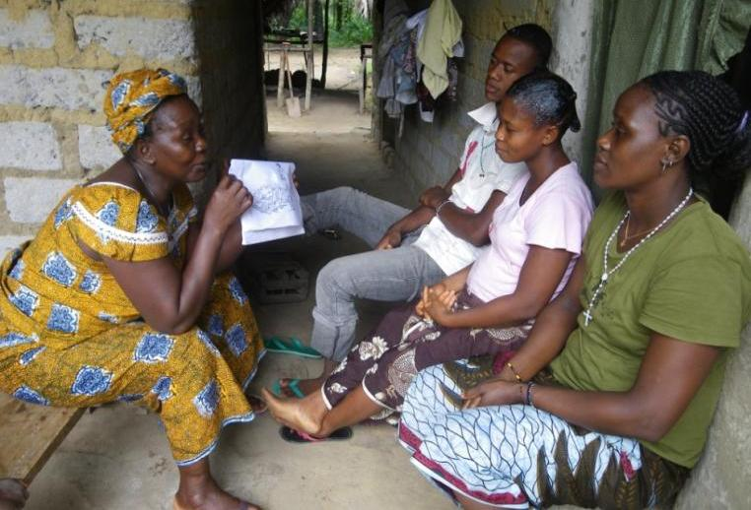
TTC 2nd edition
A family-centred psychosocial approach to household health visiting

Slide 2
TTC is (behaviour change) “Counselling”
Generic health promotion messaging has limited impact on behaviour, especially where there are personal, cultural, financial and geographic barriers to adopting a healthy practice.
Engages the family in discussions on current health practices, identifies barriers to the preferred practice through dialogue, and then negotiates a feasible change to current practice based on their individual circumstances. They then follow up to confirm if new practice was adopted.
If there isn’t a dialogue, it isn’t ttC!

Slide 3
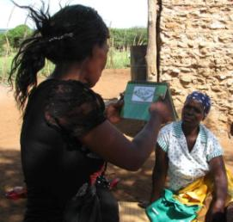
Individual Health Promotion – the ‘classic’ CHW model
  Pros:
  CHWs often deliver health messages to families
  Gets to the home and individuals that need information including most vulnerable
  Gives the message at the right time
  If KNOWLEDGE IS THE BARRIER this may be enough
  Still not considering individual needs and circumstances in a systematic way
  Limitations:
  Lecturing doesn’t change behaviour
  Especially when the barrier is not knowledge

Slide 4
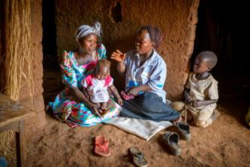
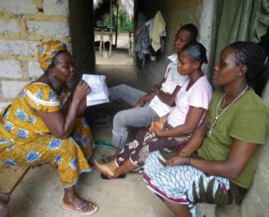
TTC Counselling...
Considers individual circumstances
Establishes rapport and trust with the family
Identify the BARRIERS to health practices
Targets the decision makers in the home
Garner support for behaviour change
Empower families to take their own decisions without ‘giving instructions’

Slide 5
TTC 2nd edition new content options
7 Interventions for Pregnant Women | 11 Interventions for Children under 2
Psychological first aid (PFA) for supportive counselling of women experiencing perinatal mental health or psychosocial difficulties Recommendations for supportive care of the most vulnerable pregnancies (e.g. adolescents, HIV positive, women with disabilities or health problems, women experiencing psychosocial difficulties in pregnancy) Registration of eligible women and girls | Chlorhexidine cord care for the newborn Supportive home care for the small baby Counselling caregivers for child development (birth to two years) Involve the father in ECCD Supportive care for vulnerable children (birth to two years) MUAC screening and detection of complications of malnutrition Early detection of HIV positive infants Updates to the PMTCT recommendations Essential newborn care

Slide 6


Integration of Perinatal Mental Health and Psychosocial support (MHPSS)
Detect and respond appropriately to MHPSS
This is not a mental health intervention
Works on the “Do No Harm” principle
Psychological first aid skills
Recognise signs of mental health & psychosocial problems
Causes / risk factors for MHPS issues such as violence, support issues, perinatal mental health
Positive and negative coping strategies
Supporting the most vulnerable cases

Slide 7

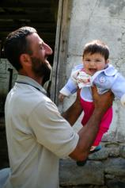

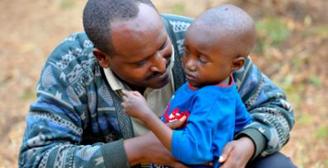
Promoting Male Involvement in TTC
The neglected parent -
  Are financial decision makers
  Influence the psychological wellbeing of mother and baby
  Experience psychosocial challenges during and after their partner gives birth
  Have impact on early child development cognitive and motor skills
  Can be perpetrators of violence in the home which damages maternal and child meant health

Slide 8
How to involve men in TTC
Stories include positive male role models
Include father in accountability to household handbooks actions
Engage and ensure male participation from the start
Monitor male involvement as a key performance indicators of the HV and programme.
Targeted counselling approach on engaging fathers in ECD

Slide 9

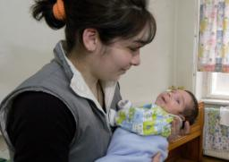
Promoting Early Child Development in ttC
  Counsel the family on ECD messages from birth
  Promoting engagement of the father in ECD from birth
Counsel / identify barriers to child development
Understand the effects of neglect, abuse and violence in the home have on the growing child.
Identify and counsel on problems observed in attachment and caregiving
“It is easier to build strong children than to repair broken men.”
^{- Frederick Douglass}

Slide 10




ttC Home Visitor Actions: Watch and encourage parents to do these things with their baby, beginning at birth
LOOK & SMILE at BABY! Newborn babies are able to see at birth fairly clearly (about the distance between the mother’s face and the baby’s face while the mother is breastfeeding) – they love eye contact, faces and smiles.
TALK & SING to BABY! Newborn babies are able to hear well, learn sounds, and communicate vocally and with body language. Talking and singing are critical for the development of babies’ language and intellect, and for soothing.
HUG & TOUCH BABY! Newborn babies love feeling mom’s body – her touch, heat, sounds that the baby used to live in while in the womb.
PLAY with BABY! For their brains to develop, babies need body movement, positive human interactions, and opportunities to touch, explore and play with age-appropriate toys.
READ to BABY! Babies love the sound of language, looking at pictures, and the intimacy of interaction with caregivers during reading.

Slide 11
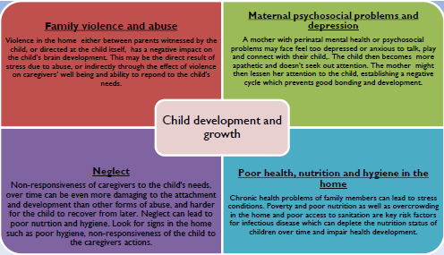
Consider and identify barriers to child development

Slide 12
Appreciative enquiry
Dialogue based counselling
Early child development
MHPSS and psychological first aid
Male involvement
Early detection and prevention of paediatric HIV
Social determinants and support for the most vulnerable
Essential Newborn care

