Slide 1
Designing for behavior change (DBC) in IMAGINE
Hygiene and Behavior Change
Nicole Weber
Hygiene and Behavior Change Delivery Manager nweber@mercycorps.org

Slide 2
IMAGINE Program
Urban WASH programme in Eastern DRC, currently underway in Goma and Bukavu
Financed by UKAID (2013-2019)
Objective: reduce diarrhoea in children under five
More than 1 million beneficiaries
Components include Infrastructure, good governance, service provision, and hygiene behaviour change
Gender is cross cutting and integrated across the components
Notes:
Built during colonial era
Deterioration due to neglect, conflict, 2002 eruption
No systematic revision or upgrade
Supplies water directly to less than half the population
Conflict and displacement in eastern Congo following 1994 Rwandan genocide and subsequent Congo wars
Populations of Bukavu, Goma, have mushroomed
Migrants settle marginal areas

Slide 3
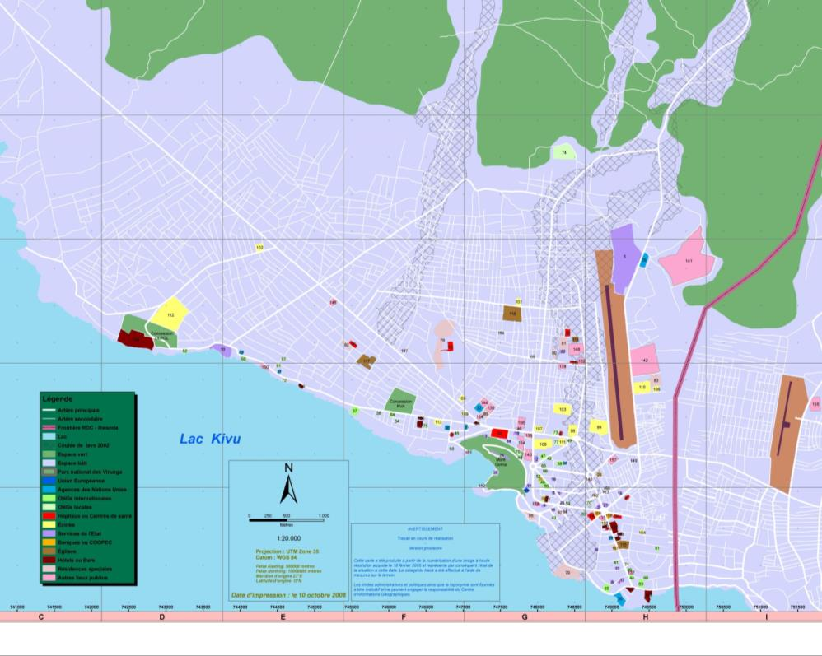
Notes:
3

Slide 4
Imagine BCC
Integrated care groups
Participatory street theatre
Radio campaigns and visual aids
Formative Research/DBC

Slide 5
Integrated care groups
IMAGINE BCC

Slide 6
DBC across components
Hygiene behavior change (9)
Infra/ Service Provision (1)
Gender
(3)
Joint decision making to purchase ORS
Good Governance (2)
Consult local authorities
Joint decision making to seek health care for a sick child
Boys collect water too!
Participate in community development activities
HHWS
water covered
ORS treatment
Exclusive breastfeeding
rapid care seeking
pay for water at tap stands
HHWT
Jerry can hygiene
Child feces disposal food storage

Slide 7
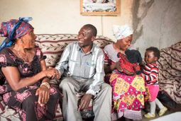
Key findings
Perceived self-efficacy and perceived social norms were found to be significant across towns and all behaviours.
Cues for action, and perceived positive or negative consequences were found to be significant for most behaviours in both towns.
Contrarily to what is commonly assumed, access was not the most common significant determinant
Mother in laws and husbands were identified as gatekeepers for several of the behaviours.
Photos taken by consultant Ramon Sanchez Orense

Slide 8
 | Exclusive breastfeed |  | Tap stand water |  | HHWT |  | Joint decision on ORS |  | Joint decision on health care |  | Boys collect water |  | Consult authorities (men) |  | Contribute to community development |  | Store perishable food covered |  | Clean jerry can |  | Children faeces management
Determinant | GO | BK | GO | BK | GO | BK | GO | BK | GO | BK | GO | BK | GO | BK | GO | BK | GO | BK | GO | BK | GO | BK
Perceived Self-Efficacy | X | X | X | X | X | X | X | X | N/A | X | X | X | X | N/A | X | N/A | X | X | X | X | X | X
Perceived Positive Consequences |  | X | X | X | X |  | X |  | N/A |  | X | X | X | N/A | X | N/A | X | X |  |  | X
Perceived Negative Consequences | X |  | X | X | X |  |  |  | N/A |  |  | X | X | N/A |  | N/A |  | X | X | x |  | X
Perceived Social Norms | X | X | X | X | X | X | X | X | N/A | X | X | X | X | N/A | X | N/A | X | X | X | X | X | X
Access | X | X |  | X |  |  |  |  | N/A |  |  |  | X | N/A | X | N/A | X | X | X | X | X | X
Cues for Action | X | X | X | X | X | X |  |  | N/A |  | X | X | X | N/A | X | N/A |  | X | X | X | X | X
Perceived Susceptibility | X | X |  | X |  |  | X | X | N/A | X | X | X |  | N/A |  | N/A |  | X |  |  |  | X
Perceived Severity | X |  | X |  |  |  |  |  | N/A | X |  |  |  | N/A | X | N/A
Perceived Action Efficacy |  |  |  |  |  |  | X | X | N/A |  | X |  |  | N/A | X | N/A |  |  |  |  | X | x
Perceived divine Will |  | X |  |  |  |  |  |  | N/A |  | X | X |  | N/A | X | N/A |  | X
Policy |  |  |  |  |  |  |  |  | N/A |  |  |  |  | N/A |  | N/A
Culture |  | X |  |  |  |  |  |  | N/A |  |  | X | X | N/A |  | N/A | X | X

Slide 9
HHWT
HHWT
SELF EFFICACY
“lack of time”
“lack of knowledge”
“nothing makes it difficult “
PERCEIVED SOCIAL NORMS
“mother in law approves”
PERCEIVED POSITIVE CONSEQUENCES
“I don’t know any advantages”
PERCEIVED NEGATIVE CONSEQUENCES “chlorine causes diseases”
ACCESS
“hard to get chlorine”
CUES TO ACTION
“hard to remember to chlorinate”
“Hard to remember HOW to chlorinate “

Slide 10
Boys collect water
Boys collect water too!
Self efficacy
Long distances makes it difficult
Not having the boys at home
Not having the mother at home
Social norms
Mothers and daughters approve
Cues to action
Difficult to remember to send boys to collect water
CONSEQUENCES POSITIVES PERCUS
toujours de l’eau en permanence dans la maison, les parents se sentent soulagés, respect et ordre dans la maison
Divine Power
God approves
Perceived Negative Consequences
Boys won’t grow up to be strong
Culture
Doesn’t approve

Slide 11
Mothers/ fathers HWWS in Goma
Mothers of children U5
Self efficacy
Negative consequences
Fathers of children U5
Self efficacy
Positive consequences
Access
Access
Culture
Social Norms
Cues to Action
Social Norms
Cues to Action
Action efficacy
Policy
Perceived Severity

Slide 12
Applying the results
Photos taken by consultant Ramon Sanchez Orense

Slide 13
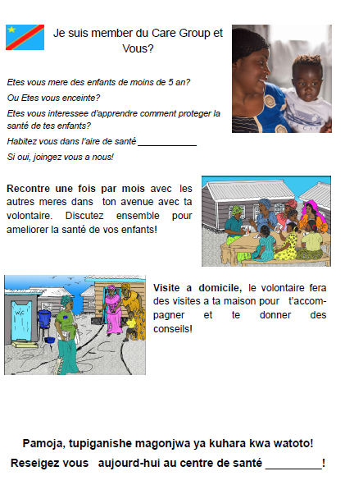
Integrated Care groups

Slide 14
Radio spots
Knock on the door
Mother: Neighbor, how are you doing?
Neighbor: it’s going well, come in.
Mother: what is going on? I see your baby is going to the bathroom everywhere!
Neighbor: yes I know but I don't have time to take her to the health center, it’s too far!
Mother: Too far, my dear. It is right in our neighborhood. Come, let me walk with you! No distance is to far to save our kid’s lives.
Moms! Your health center is close and can treat the illnesses of your kids. Diarrhea can kill! Bring your child to the health center when he has the diarrhea. More than three liquid stools a day or stools with blood need rapid health care. Don’t wait!

Slide 15
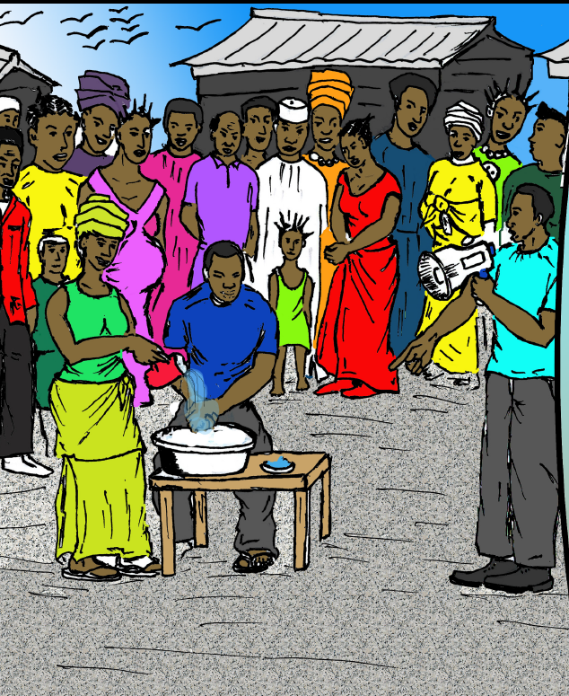
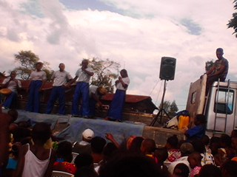
Theatre

Slide 16
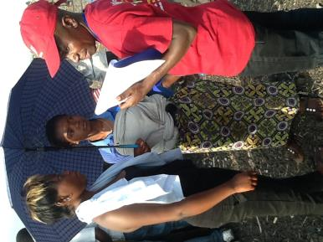
Quality control checklists on DBC application
B. QUALITY OF THE PERFORMANCE
Is the behavior identifiable ? Mothers of children under five wash their hands with soap in the five key moments?
Are mothers of U5 specifically targeted and named by the actors ?
Is the perception reinforced That hand washing in the five key moments : dosent take too much time ? that the husband encourages hand washing with soap ? Isn’t a waste of water? That everyone can access soap or ash?
Are the proper steps and techniques of hand washing explained
Is ash offered as an alternative to soap for hand washing in the five key moments?

Slide 17
Early lessons learned
Need to really define and pre-test “uncommon” behaviors
Challenges and time needed to dedicate to proper translation and translation of concepts
Research conducted on mothers of children <5 (and fathers), however the majority of participants in the theatre are older brothers and sisters of children under five
Training troupes/actors and production studio on determinant based messaging vs guarding creativity

Slide 18
Thanks
Nicole weber
nweber@mercycorps.org

