Slide 1

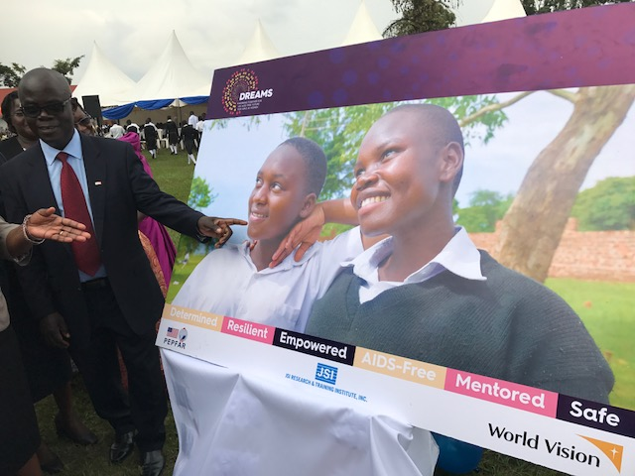
Adolescent HIV and AIDS
Programs In World Vision
Controlling the Epidemic
for an HIV-Free Generation
Dennis Cherian
Senior Director, Health
International Programs Group
World Vision, US

Slide 2
At a Glance
THE CHALLENGE
1.1 Billion adolescent girls in the world today
18.8 million women and girls are living with HIV
870,000 new infections occur every year.
Everyday, more than 1,000 AGYW are infected with HIV.
Girls and young women account for 75% of new HIV infections in Sub-Saharan Africa.
Young men under 35 years of age who do not know their status and are not on treatment fuel the HIV epidemic in young women 15-24 years and young men 25-35 years.
CURRENT TRENDS
Call for Accountability Transparency and Impact
Adolescent Girls Initiative: DREAMS
UNAIDS Fast Track 90-90-90 targets
Men are still missing in access to HIV care and treatment
Potential PPP centered on men especially men under 35
Focus on key and priority populations
Engagement of faith based institutions to control the HIV Epidemic
PROMISING PRACTICES
Index Case Testing
Self –Testing
Same Day Initiation of Treatment
Flexible service schedule and times for men
Differentiated Service Delivery Model

Slide 3
Infection Cycle for Adolescent Girls and Young Women (AGYW)

Slide 4

DREAMS Core Package of Interventions

Slide 5
Select Adolescent HIV Programs in World Vision
World Vision is implementing DREAMS Initiative and Innovation Challenge programs in Kenya, Mozambique, Swaziland and Uganda
Mozambique
  DREAMS Project using Girls Roster, Girls Club and “Safe Spaces” to empower adolescent girls and young women for HIV prevention. More than 3,278 AGYW ages 15-24 years served in Zambezia Province.
  CoVIDA Project for OVCs in collaboration with other partners
Uganda
  DREAMS Innovation Challenge: School and Community Accountability for Girls Education (SAGE). Use of Early Warning System (EWS) and Stay in School Committees (SISC) to improve Girls retention in school, reduce drop outs and prevent HIV infection. 45, 000 AGYW targeted in the project.
Kenya
  DREAMS Project: Strengthening Families to support Adolescent Girls and Young Women (AGYW). Reached 33,392 AGYW ages 10-24 in the project.
Swaziland:
  DREAMS Project: Improve access to youth-friendly services (YFS) for HIV prevention, care, and treatment; address SGBV; social-asset building; and safe space for AGYW.

Slide 6
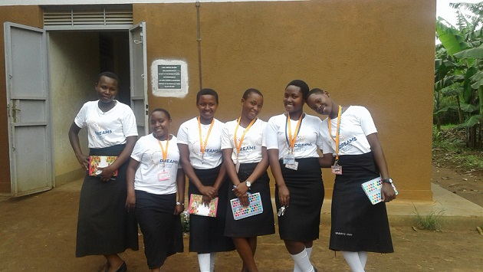
Thank You

