Slide 1

World Vision PNG - CHWs at scale
David Raminashvili MD, MPH
MNCHN Manager @ WV Papua New Guinea
Interim Health & Nutrition Manager @ WV Syria Crisis Response

Slide 2
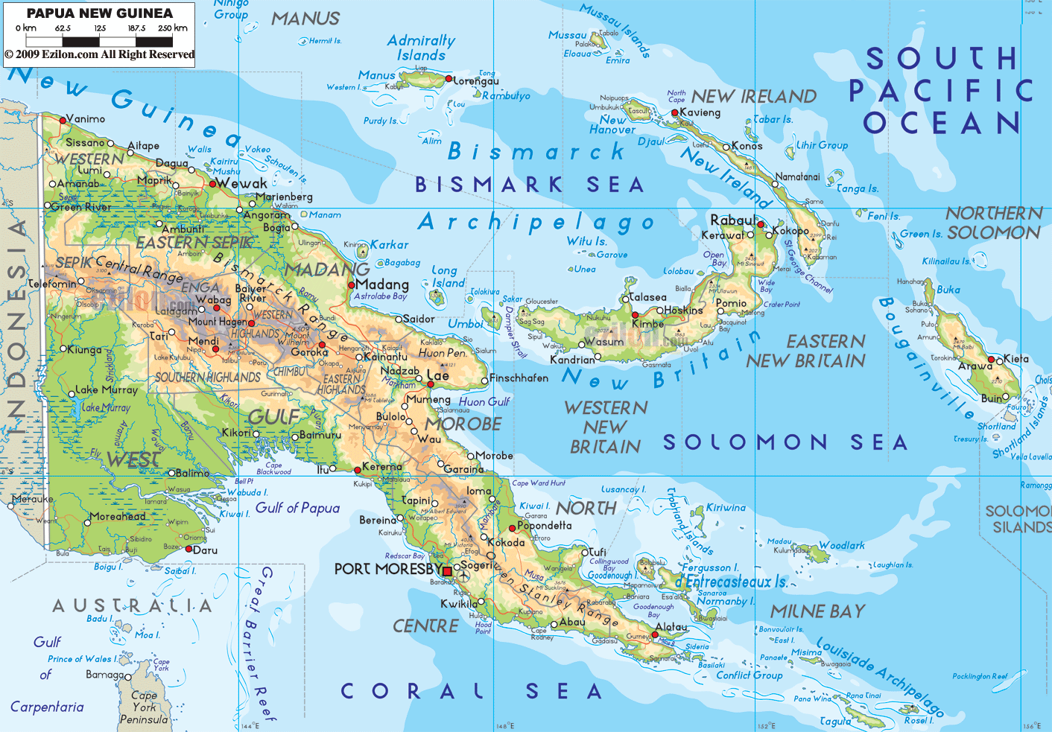

Slide 3
First CHW (VHV)Policy and Training Curriculum 2003-2012
Conference and Resolution in 2012 Supported by World Vision and Burnet Institute
Joint effort of NDoH RPHCSDP (ADB) and WV PNG
Established CHW (VHV) Advisory Committee
Consultancy work
VHV Policy development - CHW AIM workshop
VHV Policy development - Policy paper submission and 1st workshop
Way forward

Slide 4
First CHW (VHV)Policy and Training Curriculum 2002-2012
In the past, villagers worked together to carry out health related activities on their own-Village Health Initiatives.
In 1999, a collaborated forum and workshop was held by Family Health Unit of National Department of Health and Women & Child Health Project.
The forum gave direction for the future of health volunteer programs and the development of the policy.
The National Health Plan 2001-2010 had recognised the values of Village Health Initiatives, therefore NDoH develop a policy on the Village Health Volunteer Program.
In 2002 – 2003 the CHW (VHV)training curriculum was developed.
The program managed by NGO’s, churches, provincial& district health offices.

Slide 5
The name Village Health Volunteer is used to describe all village level health volunteers in PNG, including;
village birth attendant,
community based distributor,
marasin meri (medicine woman),
village health promoter,
men’s health educator,
village health assistant, etc.

Slide 6
PNG Village Health Volunteer National Conference in Feb 2012 Supported by World Vision and Burnet Institute
“Untapped potential: the role of the village health volunteer in
improving maternal, newborn and child health in PNG”
Objectives:
Enable sharing, learning and evidence building of the role of CHW (VHV) for maternal, newborn and child health.
To build to capacity and dialogue between participants of the conference to strengthening networks between Provinces, NDOH, and donor partners.
Develop opportunities for research enabling us to feedback information on CHW (VHV) programs and measure impact and to provide this information to donors and government.
Identify funding requirements for an effective CHW (VHV) service.

Slide 7
PNG Village Health Volunteer National Conference in Feb 2012 Supported by World Vision and Burnet Institute
“Untapped potential: the role of the village health volunteer in
improving maternal, newborn and child health in PNG”
Resolution:
The NDOH is recommitted to appointment of a National CHW (VHV) Coordinator
Establishment of a new CHW (VHV) Advisory Committee that includes church, NGO and provincial representation
National mapping of CHW (VHV) programs is essential to improve community health in PNG.
Revise national CHW (VHV) training curriculum

Slide 8
2012- 2014
After the conference per recommendation National CHW (VHV) Coordinator was appointed by the NDOH

Slide 9
Joint effort of NDoH RPHSDP (ADB) and WV PNG
During the stakeholder analysis in May 2014 NDoH Rural Primary Health Service Delivery Project (funded by ADB) was identified as key partner for VHV advocacy
Joint plan with NDoH National Department of Health Family Health Unit + RPHSDP + World Vision PNG
National CHW (VHV) Coordinator was deployed at RPHSDP office (next door to WV)

Slide 10
Established CHW (VHV) Advisory Committee
August -September 2014 - Establishment of a new CHW (VHV) Advisory Committee that includes church, NGOs, technical specialists, partner organizations, medical associations and provincial representation
October 2014– March 2015 CHW (VHV) Advisory Committee conducted regular monthly meetings to review the CHW (VHV)Trainers Guide -
5 sub groups were developed according on five modules of curriculum
CHW (VHV) Trainers Guide:
Being a volunteer
Learning about health
Safe Motherhood
Child Health
Self Help Health Care

Slide 11
Consultancy work
Coordination of Advisory committee was challenging in terms of timing and process was going slow
In March 2015 World Vision contracted the consultant to compile all reviews and contributions from all stakeholders and to put things together
March – June 2015 CHW (VHV) Trainers Guide was revised in coordination with technical advisors of RPHSDP , Burnett Institute, National department of Health and World Vision and in July was presented and discussed with committee at the workshop

Slide 12
Consultancy work
July 2015 - December 2015
CHW (VHV)program documents was developed by WV consultant in coordination with technical advisors of RPHSDP , Burnett Institute, National department of Health and World Vision :
CHW (VHV)TRAINER HANDBOOK/GUIDE
CHW (VHV)TRAINING TRAINERS HANDBOOK/GUIDE REVIEW
CHW (VHV)PARTICIPANT HANDBOOK REVIEW
CHW (VHV)MANAGEMENT HANDBOOK REVIEW including M&E framework and minimum standards
February – April 2016
Field Testing of training materials (4 weeks theory + 4 practical)

Slide 13
VHV Policy development
During the work on the program documents CHW (VHV) Advisory Committee recognised the need for Policy update/development
CHW (VHV) Assessment and Improvement Matrix Workshops in 2 provinces -Madang and Bougainville
Policy Provincial Group Discussions
CHW (VHV) policy committee meeting 20 January 2016

Slide 14
VHV Policy development - CHW AIM workshop
Step 1
Step 2
Step 3
Step 4
Adapt
Plan
Follow up
Conduct
Align CHW (VHV)Intervention Matrices with minimum package of interventions for VHVs as outlined in the CHW (VHV)program and health standards and guidelines
Ensure effective participant selection, technical facilitation & logistical arrangements in place
Discuss & agree on scores for 15 program functionality components, assess interventions, validate scores & identify actions to improve program functionality
Ensure that scores are validated, the action plan has buy in from key stakeholders and that measures are in place to monitor action implementation and results
Discuss & score each element in CHW (VHV)Program Functionality Matrix
Interview VHVs & community members to verify findings (if not already done as part of step 2)
Consult with Stakeholders
Arrange workshop
Align tool within local context & language
Invite participants and conduct training & assessments
Discuss & rate Intervention Matrices, calculate overall functionality
Adjust the action plan & score based on findings
Develop an improvement action plan
Develop strategies & monitoring plan for action plan achievements and regularly discuss progress & share effective interventions

Slide 15
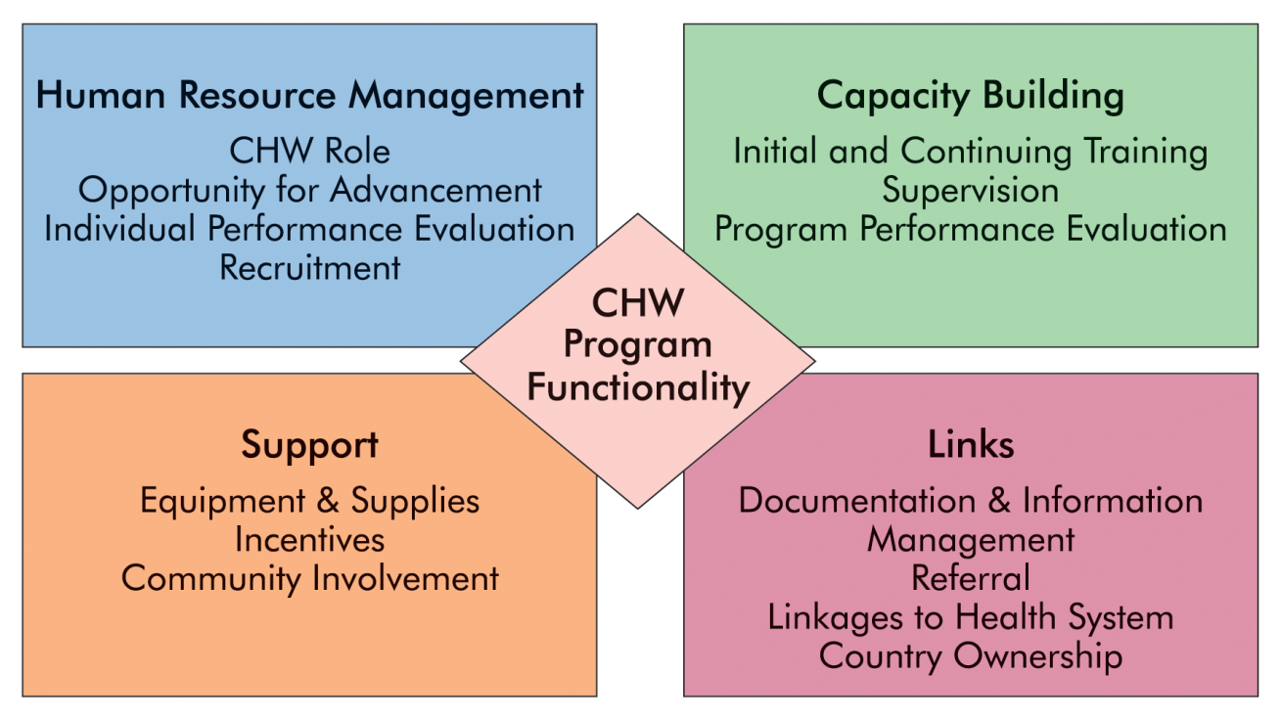
Functionality Model
VHV Policy development - CHW AIM workshop

Slide 16
VHV Policy development - CHW AIM workshop
The framework is around two key resources:
a program functionality matrix with 15 key components used by participants to assess the current status of their programs, and
service intervention matrices to determine how CHW (VHV)service delivery aligns with program and national guidelines.
The key health intervention matrices currently included address :
maternal, newborn, and child health (MNCH),
HIV/AIDS, and
Tuberculosis (TB);
additional services can be adapted for assessment.

Slide 17
VHV Policy development - CHW AIM workshop
Audience: implementing partners such as the NODH, PHA, non-governmental organisations, or other organizations that implement and manage CHW (VHV)programs.
Objectives: To provide a framework and process to enable governments and organizations to survey, assess, and improve the functionality of CHW (VHV)programs.

Slide 18
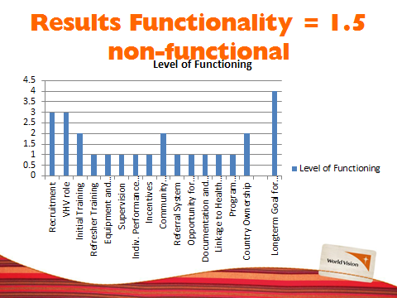
VHV Policy development - CHW AIM workshop
Madang

Slide 19
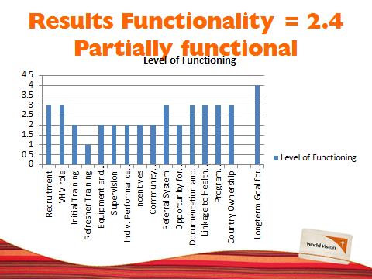
VHV Policy development - CHW AIM workshop
Bougainville

Slide 20
CHW (VHV) Policy Development Concept note Key Issues:
Definition of Village Health Volunteer (VHV)
Rewards or Incentives for Volunteers.
Pathway into formal education and employment in the health sector
Scope of Health Promotion Practice and potential Insurance – Litigation
Scope of Practice and Remuneration (refer also point 2 and 4)
Linkages between NDOH Programs
Interface & Collaboration between the Health Facility and the VHV
Supportive Supervision and Mentoring of VHV
NDOH Restructure and where the CHW (VHV)will be situated
Provincial and District Responsibility for CHW (VHV)Programs
Health Science and potential conflict with church teaching
Expected Life-span of CHW (VHV)
CHW (VHV)Pre-requisites
CHW (VHV)Activities and Data Collection

Slide 21
Way forward
May 2016
Final stage of editing and formatting based on field test
Preparation for field testing
June – July 2016
Training of trainers from each province
September- December 2016
Training of VHVs in all provinces (at least WV and RPHSDP coverage province)
Advocate with Provincial health offices
January – September 2016
Policy Development

Slide 22
Lessons Learned
Challenge: No action since 2012 Conference
Solution: Identifying key stakeholder for partnership
Challenge: Participation from relevant stakeholders
Solution: Mobilize key stakeholders for establishing advisory committee
Challenge: Coordination of Advisory committee was challenging in terms of timing and process was going slow
Solution: engaging the consultant to compile all reviews and contributions from all stakeholders and to put things together
Challenge: CHW (VHV) Advisory Committee recognised the need for Policy update/development
Solution: CHW (VHV) Assessment and Improvement Matrix Workshops

Slide 23
