Slide 1
World Vision’s “Timed and Targeted Counseling” Approach for Health and Nutrition

Slide 2
World Vision’s 7-11 strategy is based in part on a behavior change communication approach recognizing that the practice of key health and nutrition behaviors at the individual - household level is fundamental to achieving improved maternal and child outcomes.
Notes:
7-11 FG, pg.35
WV’s 360 degree approach embraces a continuum of care concept.

Slide 3
Targets | Pregnant Women: -9 months | Children: 0-24 months
Core interventions | Adequate Diet Iron/Folate Supplements Tetanus Toxoid Immunization Malaria Prevention and Intermittent Preventive Treatment Healthy Timing and Spacing of Pregnancy and Birth Preparedness De-worming Facilitate access to Maternal Health Service: ANC PNC, Skilled Birth Attendance, PMTCT, HIV/STI/TB Screening | Appropriate Breastfeeding Essential Newborn Care Hand Washing with soap Appropriate Complementary Feeding (6-24 months) Adequate Iron Vitamin A Supplementation Oral Re-Hydration Therapy/Zinc Prevention & Care Seeking for Malaria Full Immunization for Age Prevention & Care Seeking for ARI De-worming (+12 months)
Notes:
Focus on pregnant women and U2 cohorts, as most deaths occur in this period, the effects of malnutrition are irreversible, interventions can save lives
Mostly preventive, but also care-seeking
Translates into behaviors that we want to see pregnant women and caregivers of U2 children practicing. There’s a corresponding table of behavioral outcomes we want to see. There are sub-messages to all of these elements.
“Mandatory” to address all of these, unless assessment shows not relevant. Rests on the fact that a bundled and comprehensive approach is more effective than any of these in isolation.

Slide 4
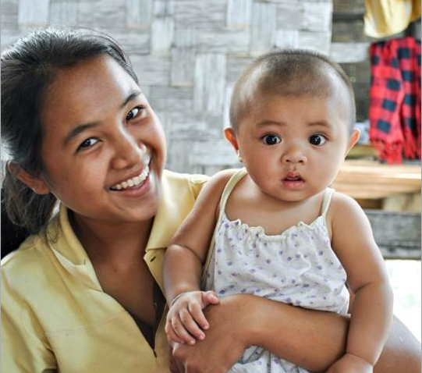
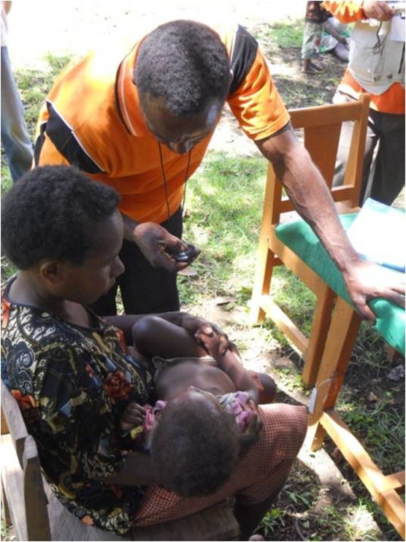
Environment
Community
Where does TTC fit in the overall 7-11 strategy?
Individual:
TTC
Notes:
The individual is supported within the community, and through an enabling environment, to practice positive behaviors. We call this 360 degrees of support for behavior change
In understanding the need to intervene at all three levels, there are core approaches at each level within the overall 7-11 strategy. There are also numerous additional approaches, beyond these core. These are not the only things that projects can do.
TTC is situated as the core approach at individual/hh level.
We work towards community systems strengthening with appropriately identified community groups as the core approach at community level. This is also a chance to focus on community norms.
At the enabling environment level we engage in some degree of health systems strengthening as a core approach, in order to address, to some extent, issues of supply. We are creating demand at the household level for services and need to be attentive to supply questions. (training in supervisory functions, supply chain management training – not yet completely defined or developed within the 7-11 strategy)
We also engage in local level advocacy, with links to national-level advocacy efforts, as the second core approach at environmental level. These are not the only factors that are important at the environmental level – we acknowledge political, economic, gender issues, and these can all be addressed as appropriate and as possible, within comprehensive design.
There are also numerous additional approaches, beyond these core. These are not the only things that projects can do. (Grandmother projects, micronutrient fortification programs, support groups, home based life saving skills, etc.)
This is as much as I’ll say about the overall framework of the 7-11 strategy. If this is an area where you have additional questions, we can talk about it more at the end.

Slide 5
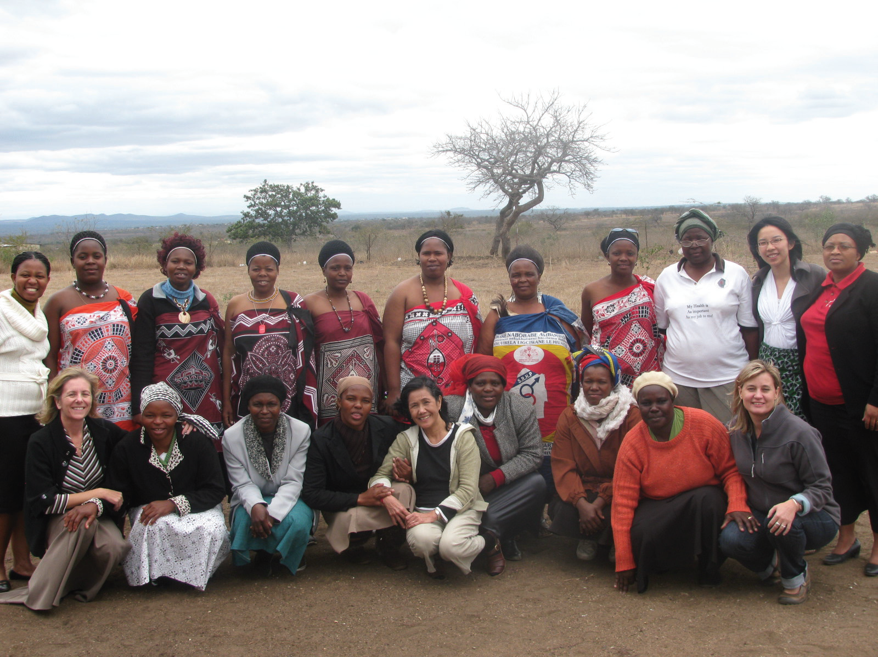
Timed and Targeted Counseling refers to a CHW/Volunteer approach to extending primary health care counseling to the household level.
Notes:
In essence, TTC then refers to a cohort and lifecycle-specific approach. Target the whole household – husband, in laws, influencers of behaviors
Interventions are needed at this level to promote:
issue awareness
knowledge
behavior change
demand for services
identification of social barriers
… empowering caregivers and children to keep themselves healthy.

Slide 6
What does this approach entail?
Cadres of volunteers who can deliver TTC include CHWs, care group / women’s group volunteers or other existing health voluntary cadre.
TTC home visitors make a series of visits to households where there are pregnant women, and through infancy, organizing all of the 7-11 messages to be communicated at the most appropriate times, using a counseling and dialogue-based approach.
Caregivers are provided with information, counseling and support to promote practice of a host of critical health and nutrition-related behaviors.
Notes:
The dialogue based approach has important ramifications of 1) avoiding a top-down counseling approach, and 2) learning about the traditional/socio-economic barriers to improved health practices

Slide 7
What does “Timed and Targeted” mean?
Notes:
ttC means that it is:
Designed to enable messages to be appropriately timed: neither too early, lest they be forgotten, nor too late for the behavior to be practiced,
and appropriately targeted to those who would practice these behaviors as well as to those who would influence the decision to adopt these behaviors.
You can see here the schedule of these visits during the first 1000 days (from pregnancy to 2 years of life)

Slide 8
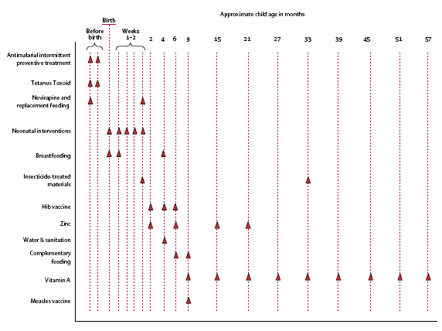
PMTCT
Notes:
This is from The Lancet. 2005. Can the world afford to save the lives of 6 million children each year, 365; 2193-2200.
And shows when specific behaviors/interventions are appropriate.

Slide 9
The TTC Package includes:
Introductory Package
TTC Programming Guidelines (TTC Toolkit)
CHW AIM Assessment Tool
Training TTC HVs & Job Aids
Facilitators Manual for TTC
TTC Workbook (for literate CHW / home visitors)
Visual Aids
TTC Job Aids: Flip-Book Stories (11 flip-book stories)
Household Handbooks (appx. 15 pages)
Training of Trainers
Training of Facilitator Guidelines/Materials
Training of Trainers Guidelines/Materials
Other
Data Collection and Monitoring System
Supervision Guide (in development)

Slide 10
Standardized Counseling Steps
Step 1:
Review previous meeting and actions that the household agreed to try
Step 2:
Problem Story and Guiding Questions (Guiding Qs lead users from analyzing as outsiders, to personalizing the issues)
Step 3:
Positive Story and Guiding Questions (Guiding Qs lead users from understanding the benefits of the actions, to personalizing)
Step 4:
Dialogue and “Negotiation”, using Household Handbook

Slide 11
Stories at heart of counseling/dialogue
Stories written to cover all messages for each household counseling visit
Stories told through use of visuals
Normally 1or 2 problem stories, and 1or 2 positive stories per visit
A structured process for telling stories, asking Guiding Qs, praising existing behaviors, negotiating new behaviors
Notes:
The problem story allows them to reflect on issues first as if they are happening to someone else, which enables a more objective and less emotional analysis of the problem than if we immediately say "these are your problems". The guiding questions follow a sequence that moves from analyzing the problems as an outsider, to asking about the overall community situation regarding the problems, and finally personalizing it to the family themselves
The positive stories contain all of the 7-11 messages

Slide 12
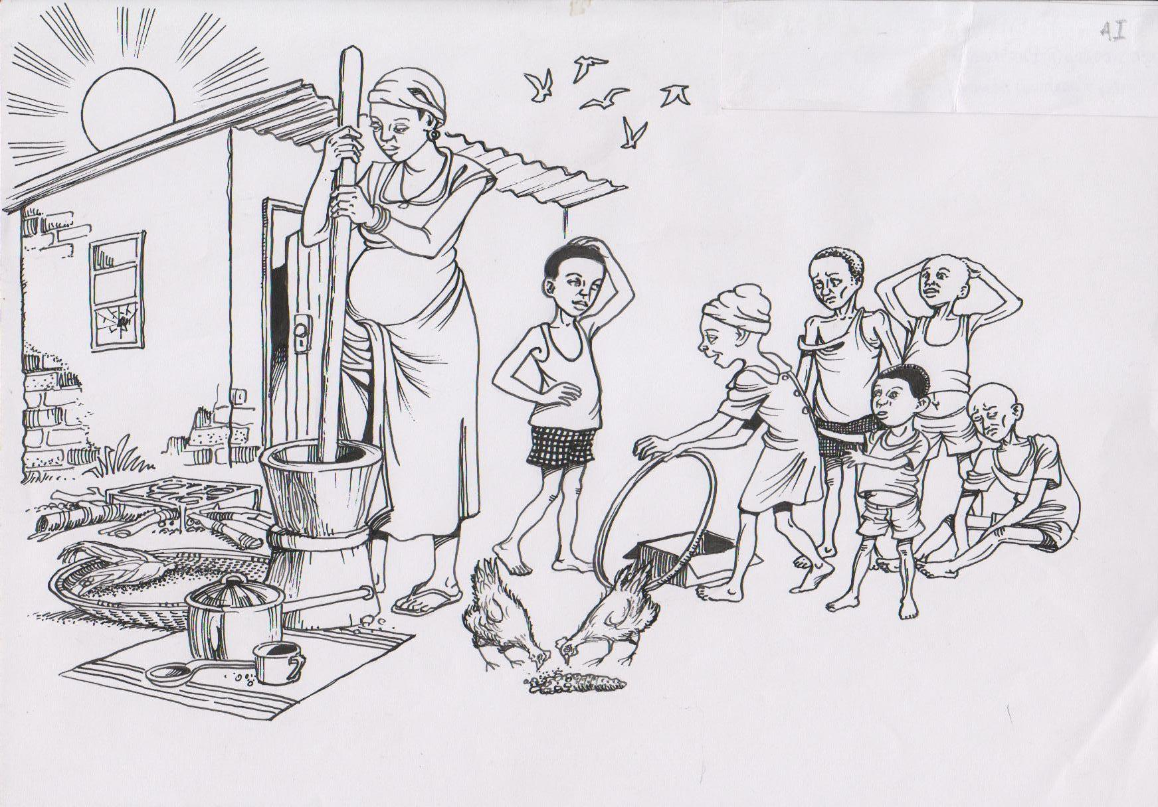
Notes:
I’ll go through one of the problem stories with you. This would be in the form of a flip book, with the narrative on the back. We can talk about the drawings themselves afterwards if you’d like.
Biba is pregnant. She starts her day by grinding her maize. Her cooking pot is ready so she can begin to prepare food for the day

Slide 13
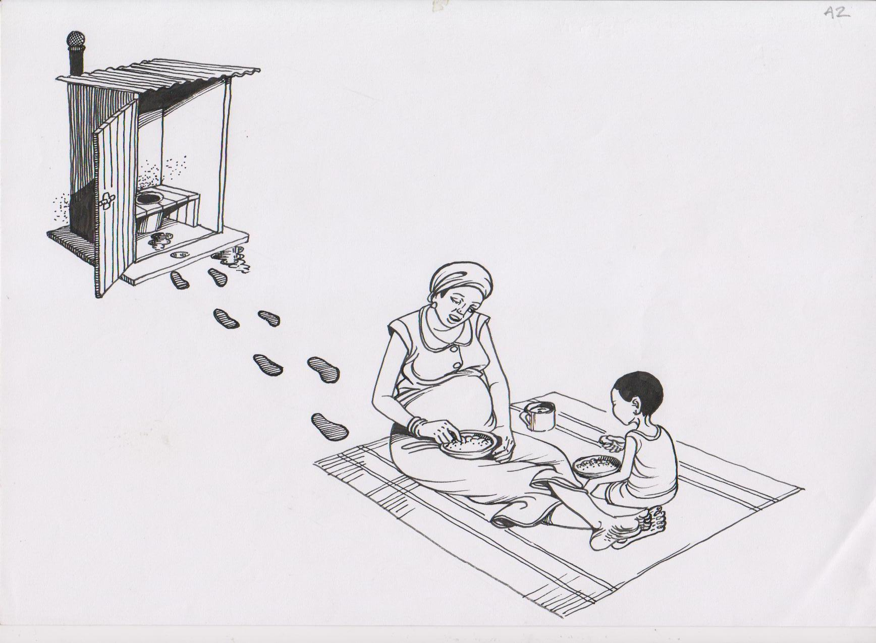
Notes:
At midday Biba is coming from the latrine, having not washed her hands, and sits on a mat to take her first meal of maize porridge mixed with water

Slide 14
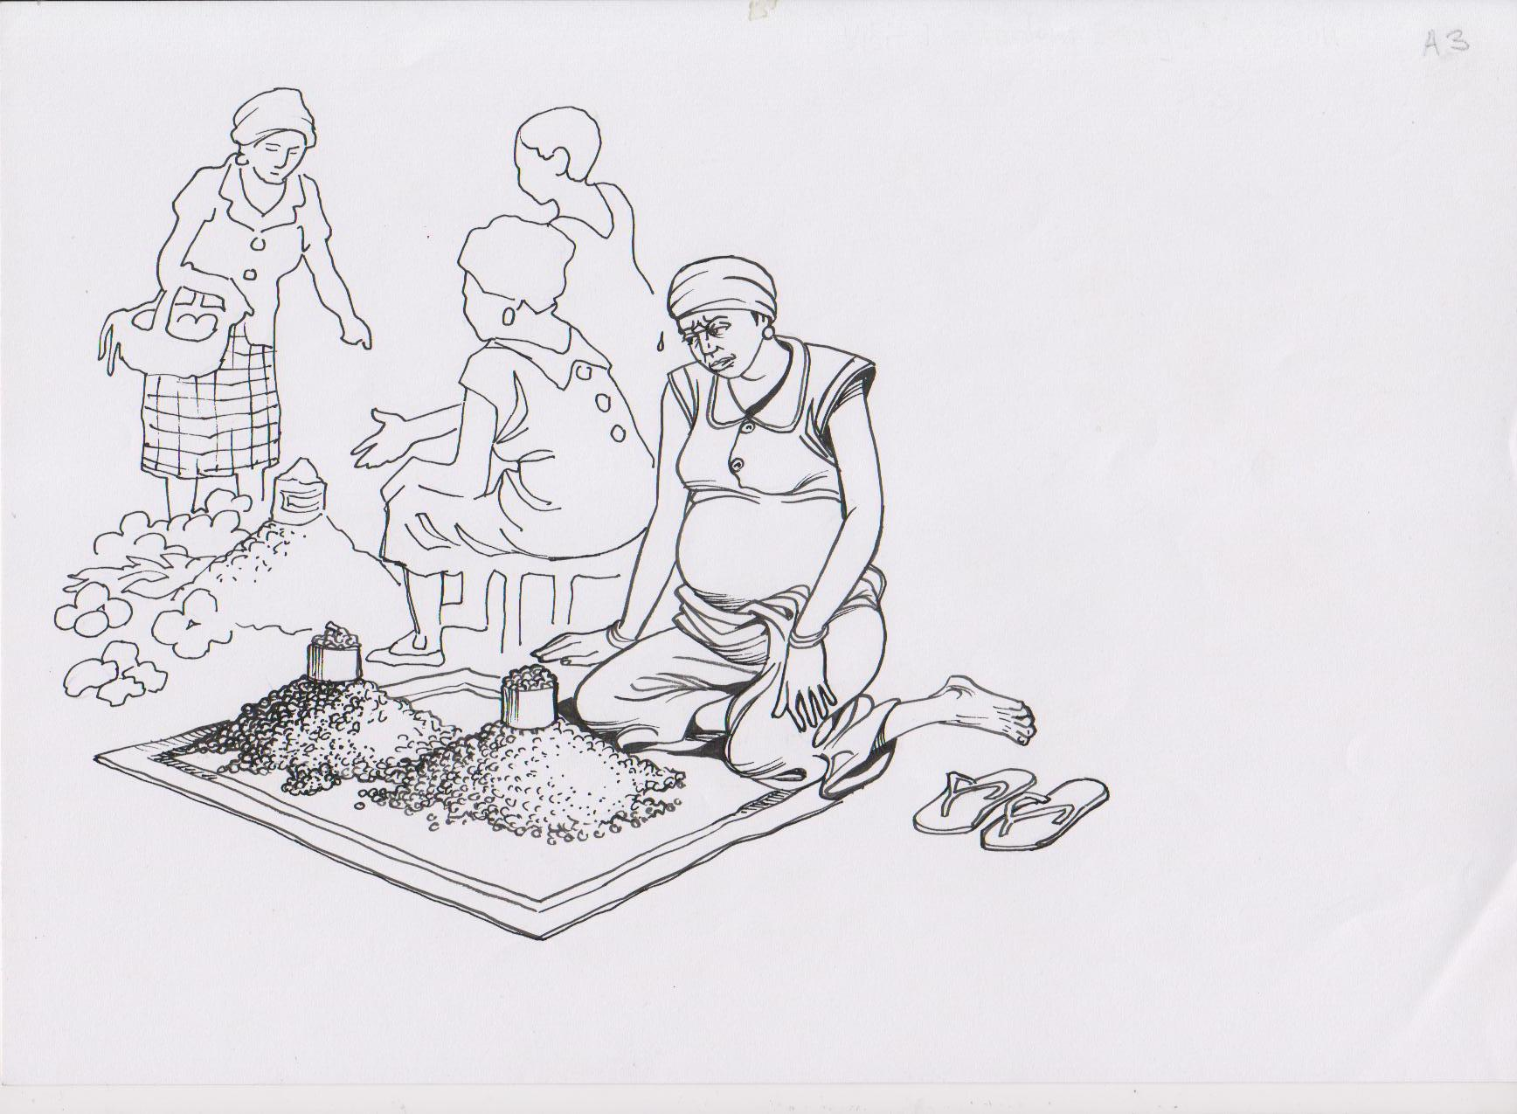
Notes:
In the afternoon Biba goes to the market to sell peanuts and beans she has grown in her fields. She does not put any peanuts or beans in the sauce for her meals of maize

Slide 15
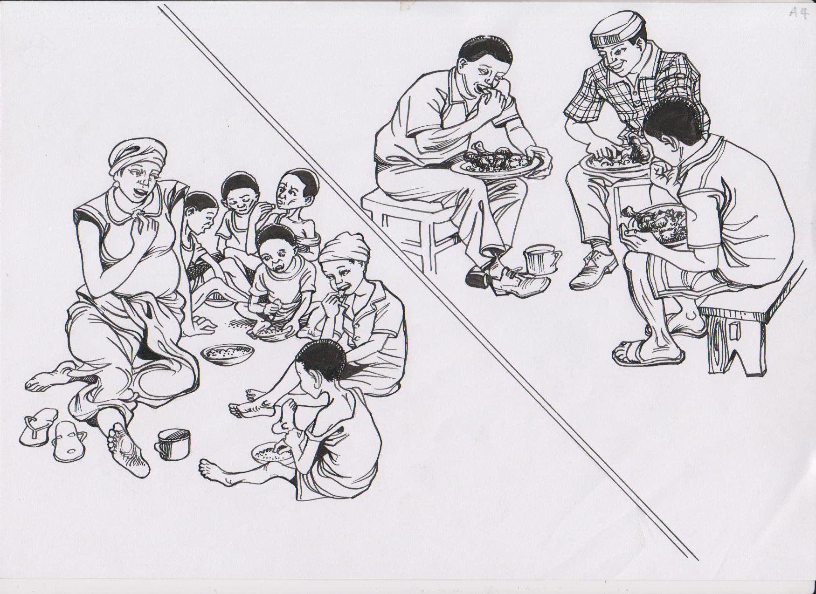
Notes:
In the evening, Biba and her children eat small portions of maize without sauce. He husband, Peter, generally eats in the village with his friends.

Slide 16
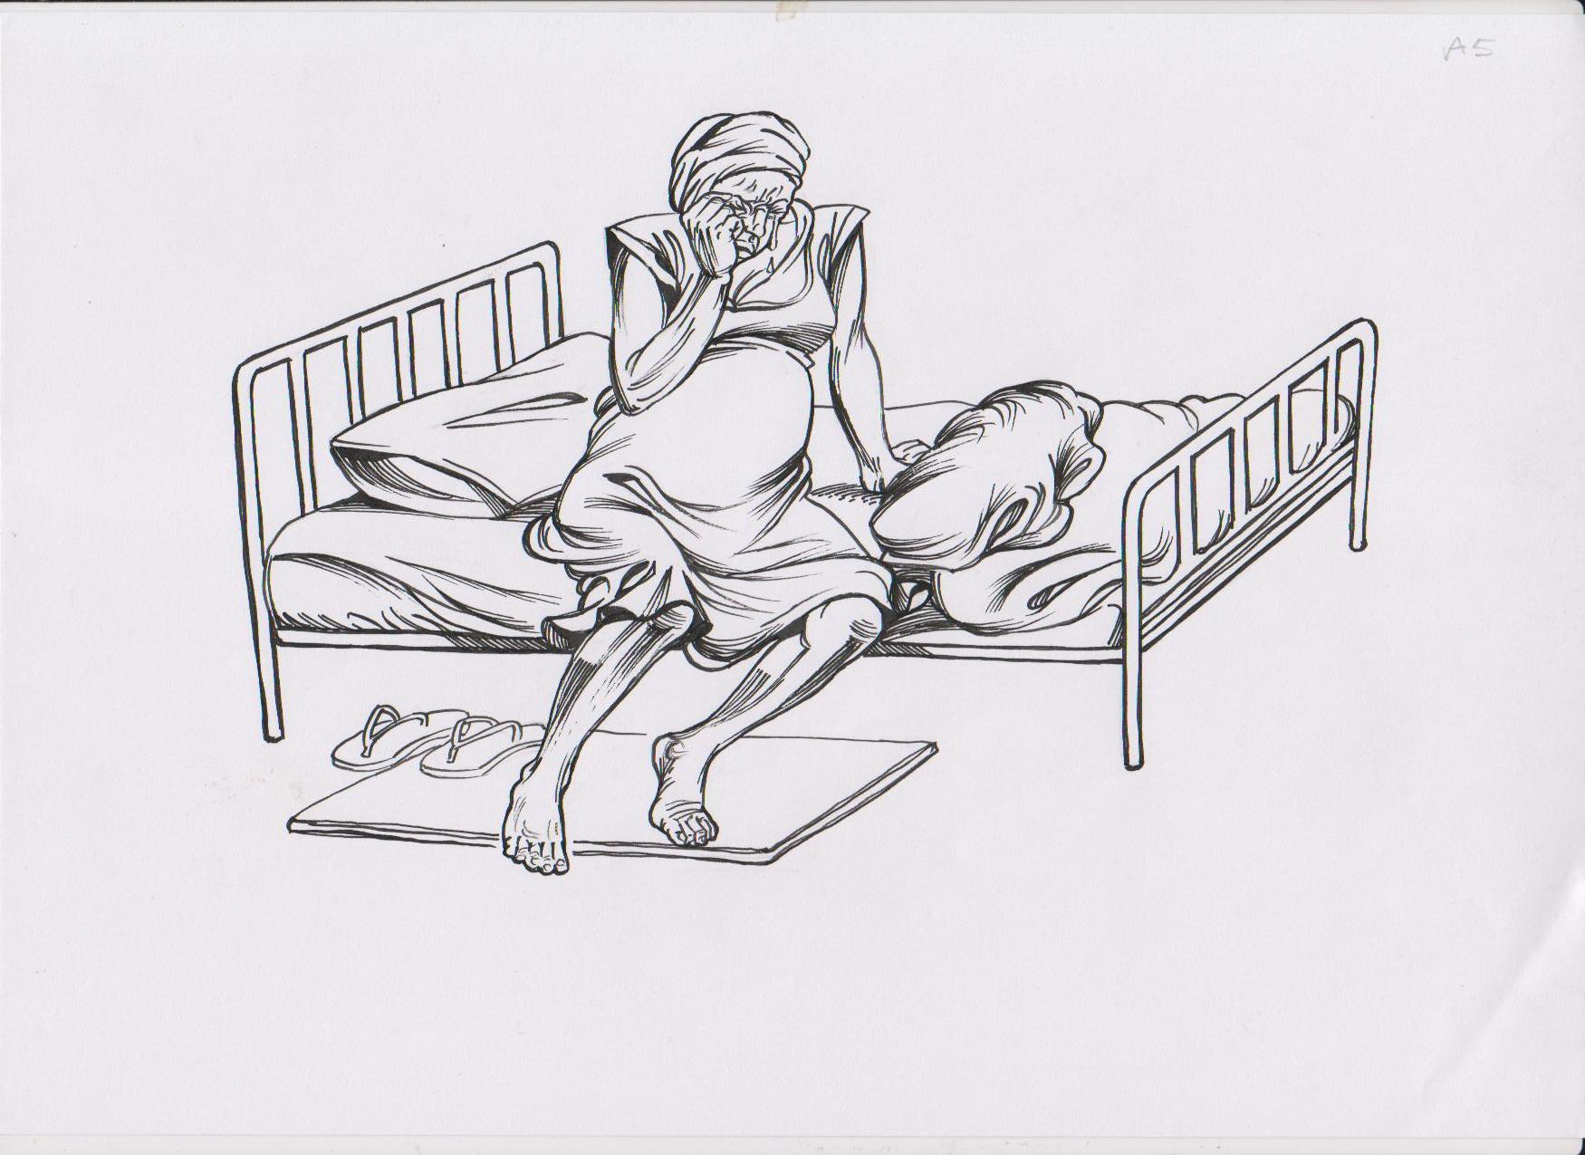
Notes:
Because Biba isn’t eating enough good food she goes into labor early. The baby is too small and weak to survive. Biba is weak and sad.

Slide 17
Example Guiding Questions
At the end of the story, Biba’s baby died. What happened in the story that might have caused that?
Can you tell me about pregnant women in this area, about the work that they do and how much they push their bodies when they are pregnant? Is it similar to Biba’s situation, or different? How?
Is it common for people to sell nutritious crops because they need the money, instead of eating them? Explain.

Slide 18
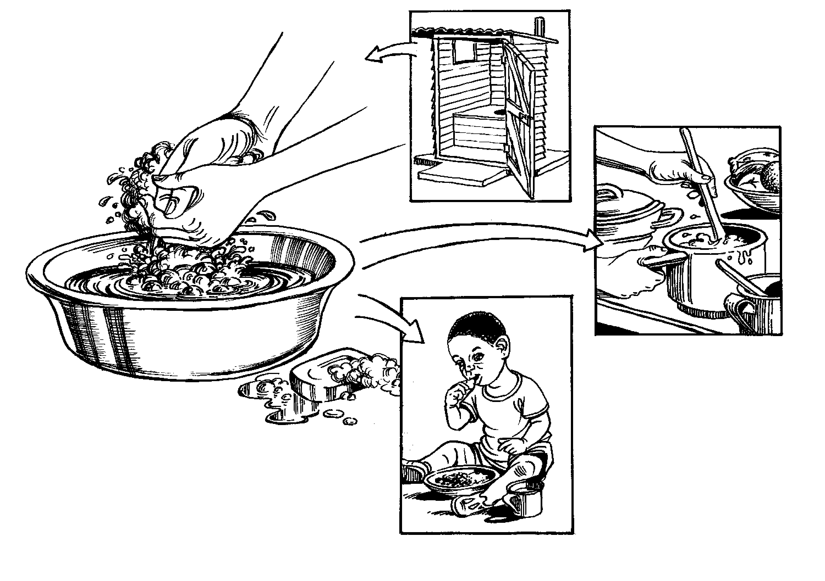

Notes:
The family receives a household handbook with illustrations for each of the recommended behaviors. The example in the slide is for handwashing. (btw, we want to change that illustration to a tippy-tap or something. It's okay if only one person is washing their hands, but not if more than one.) The negotiation process is as follows:
- Remind the family what the illustration means
- Ask the family if they already do this. If they answer yes, you circle the tick mark and no further negotiation is needed. You praise them
- If the family says no, you move through a series of questions that aims to understand the acceptability of the action and the potential barriers that the family might have. Dialogue ensues to help in overcoming the barriers, if possible
- If after the dialogue the family still says they can't or won't do it, you circle the X, but always hoping that these things can continue to be addressed over time
- If after the dialogue the family agrees to try the action then they can sign their name, or their initials, or a fingerprint in the space provided. You will then follow up in the next visit to see how they did.

Slide 19
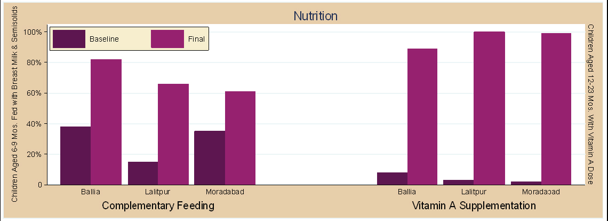
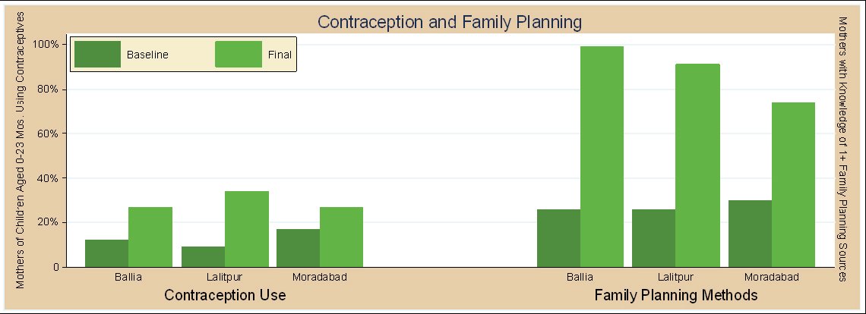
Notes:
Results of TTC implementation in India
Piloted and developed by WV-India, demonstrating over project course:
- 38-78% increase in family planning
- 23-42% increase in improved complementary feeding practices
- Vitamin A supplementation increases from 2% to 100%

Slide 20
ttC/CHW evolved from USAID-funded Pragati Child Survival Project implemented in India (1998 and 2007)
Drew on external resources:
WHO/UNICEF CHW Curricula (Caring for the Newborn at Home and Counsel the Family on Feeding),
American College of Nurse Midwives Home Based Life Saving Skills (counseling methodology),
USAID/Health Care Improvement Project CHW-AIM (functionality assessment), and UNICEF Facts for Life
Key contributors: Michele Gaudrault, Danielle Chekarou, Dan Irvine, and Fe Garcia
M&E package and database – above authors and Beulah Jayakumar, Annette Ghee, and Polly Walker
For more information: www.wvi.org/health
Thank You
Notes:
WV has evolved its signature "Timed and Targeted Counseling" CHW support package from initial USAID-funded child survival work implemented in India between 1998 and 2007.
The Pragati Child Survival Project (CSP) was a four-year cooperative agreement between USAID and World Vision (WV) under the Child Survival Grant Program’s Expanded Impact category, from 2004 to 2007. CSP reached 1.12 million children under the age of five years and 1.6 million women of reproductive age living in 5,000 villages in Ballia, Lalitpur and Moradabad districts in Uttar Pradesh State (UP). The project took child survival and family planning interventions to scale in the three districts with their proportional levels of effort at: immunization (40%), family planning (30%), maternal and infant nutrition (20%) and vitamin A supplementation (10%). Key national partners included the Integrated Child Development Scheme (ICDS) and the Ministry of Health (MOH), as well as local NGOs. The grassroots work force of the project was mainly Anganwadi Workers (AWWs) under ICDS, numbering approximately 4,400 in the three districts. CSP brought to scale the strategies, methods and tools developed and tested in the Ballia Integrated Rural Child Survival (BRICS) project, active from 1998 to 2002.
Following assessment of the India work in 2007 (Irvine and Kruger), WV adapted the India model, drawing on external resources such as the WHO/UNICEF CHW Curricula (Caring for the Newborn at Home and Counsel the Family on Feeding), American College of Nurse Midwives Home Based Life Saving Skills (counseling methodology), USAID/Health Care Improvement Project CHW-AIM (functionality assessment), and UNICEF Facts for Life.
Core curriculum design by Michele Gaudrault, Danielle Chekarou and Dan Irvine
Original Monitoring and Evaluation guideline by Beulah Jayakumar, Michele Gaudrault, Annette Ghee and Dan Irvine
Monitoring database by Annette Ghee and Polly Walker

